Slide 1
outline
Redo simulations with correct pileup file :
There was a mistake in the .kumac to generate the MinBias events (wrong Z vertex range)
Now the pileup files consist of :
# MinBias events | 10 | 50 (not in these plots) | 100 | 100 (first test)
# hits in inner layer | 329 | 1658 | 3510 | 4900
#hits in outer layer | 102 | 488 | 1028 | 1900

Slide 2
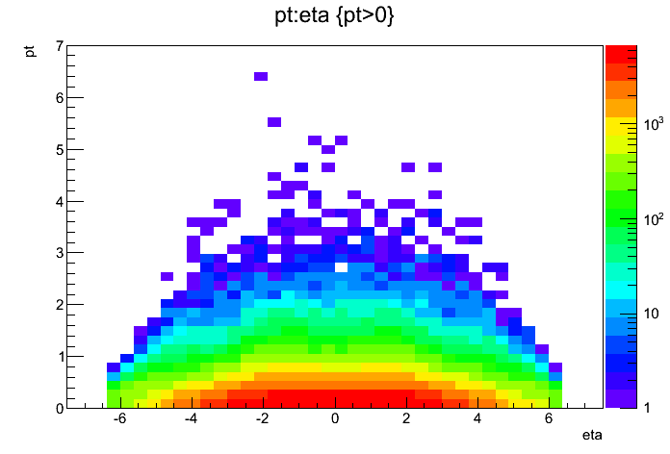
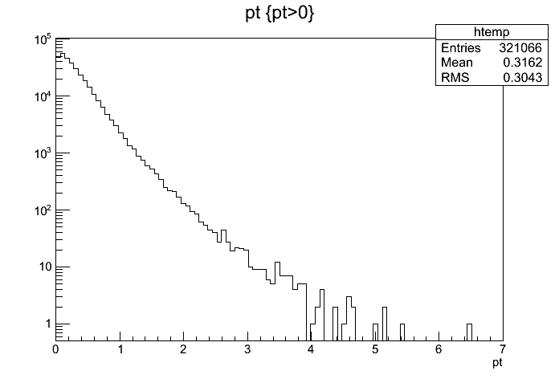
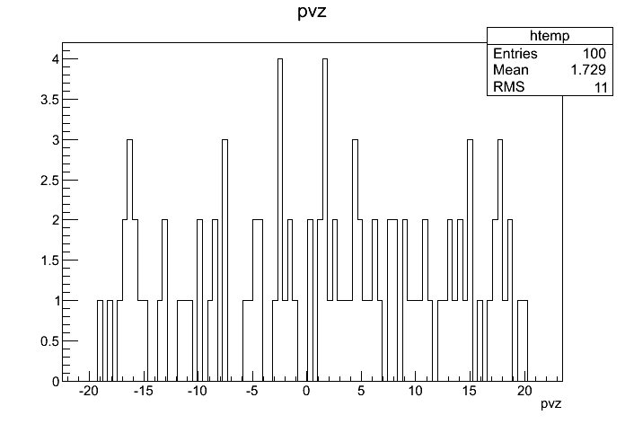
Checking the pileup
events are generated :
0 < b < 20 fm : impact parameter
0 < Pt < 100 GeV/c : transverse momentum
-20 < Z_{vertex} < 20 cm : vertex position
σ_{xy} = 0.01 ; σ_{Z} = 20 cm : vertex distribution (beam diamond)

Slide 3
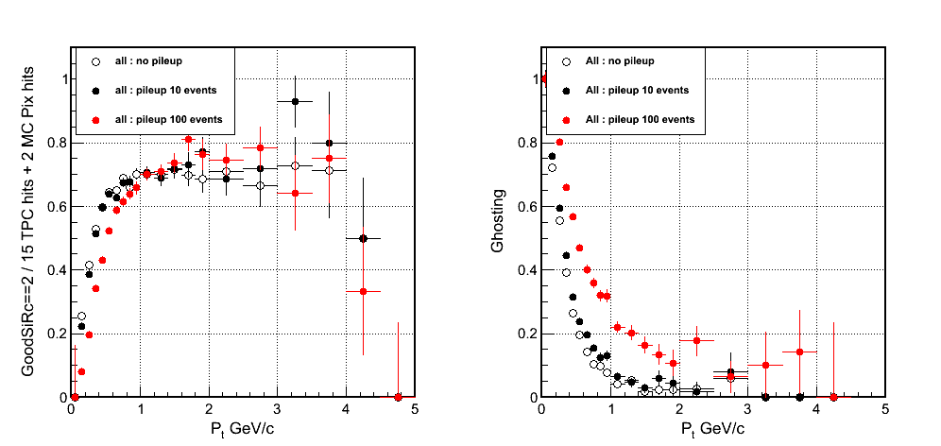
All particles

Slide 4
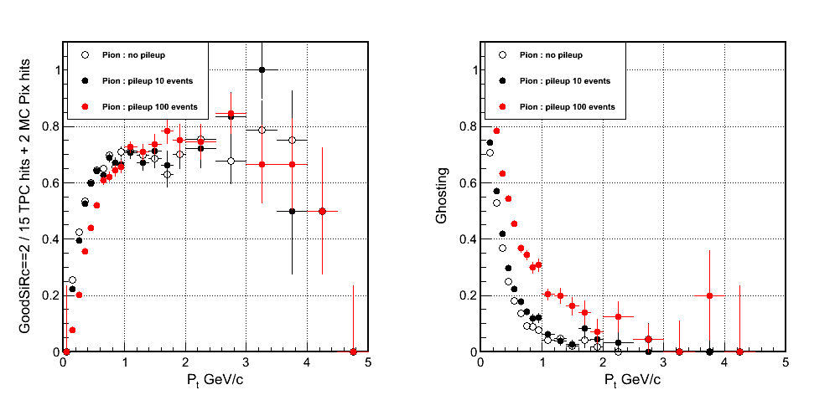
pions

Slide 5
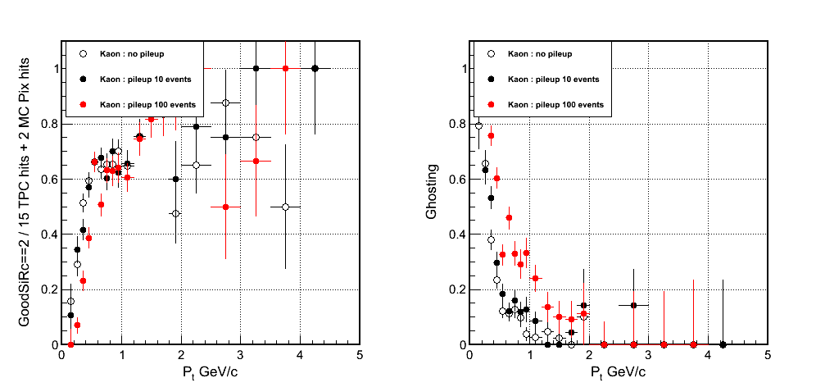
kaons

Slide 6
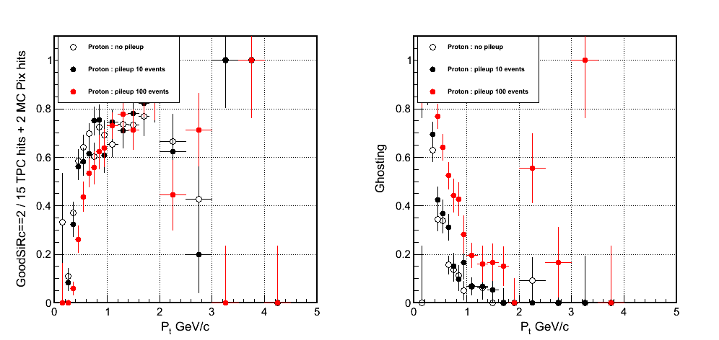
protons

Slide 7
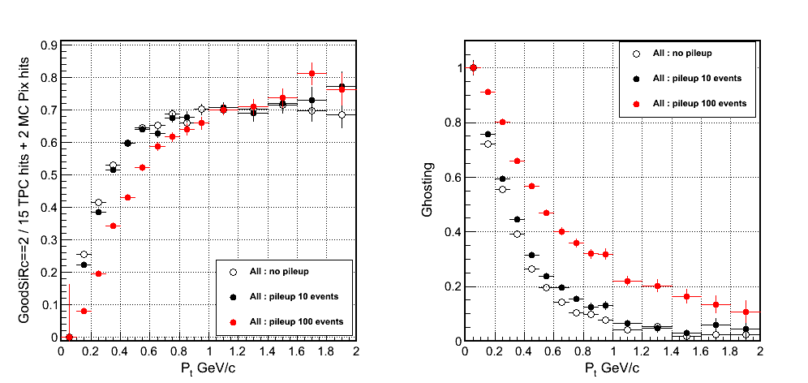
All particles (zoom)

Slide 8
comments
The correct kumac for MinBias events gives less hits in the pixel layers than my first test :
Before for 100 MinBias events it added 4900(1900) hits in the inner(outer) layer
Results with pileup = 100 MinBias give same conclusion :
Efficiency does not “suffer” from pileup but ghosting strongly depends on it
Pileup with 10 MinBias events also shows the same trend but less pronounced .

