Slide 1
Day 152
Alignment :
Day 152, run 14152025-27 (run over ~40K events)
Used only Sector-4 Ladder-4 and
Sector-7 Ladder-2 (see next 2 slides) with bad sensors masked out (but bad pixels still in).

Slide 2
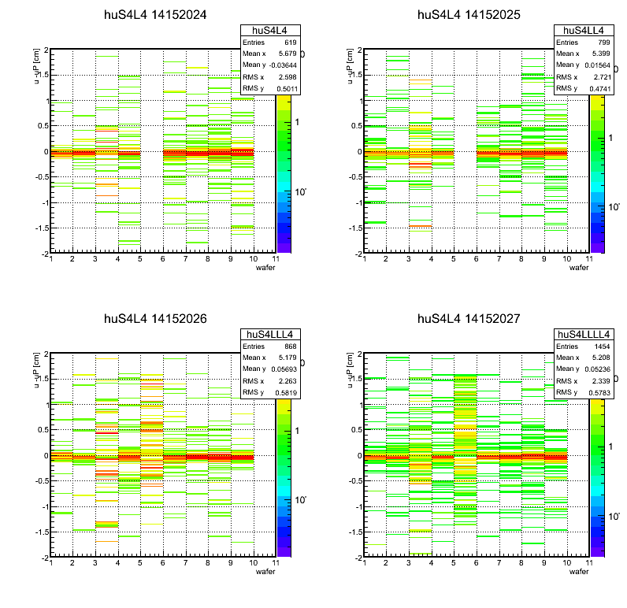
Sector 4 ladder 4 (sensors 3+5 masked out)

Slide 3
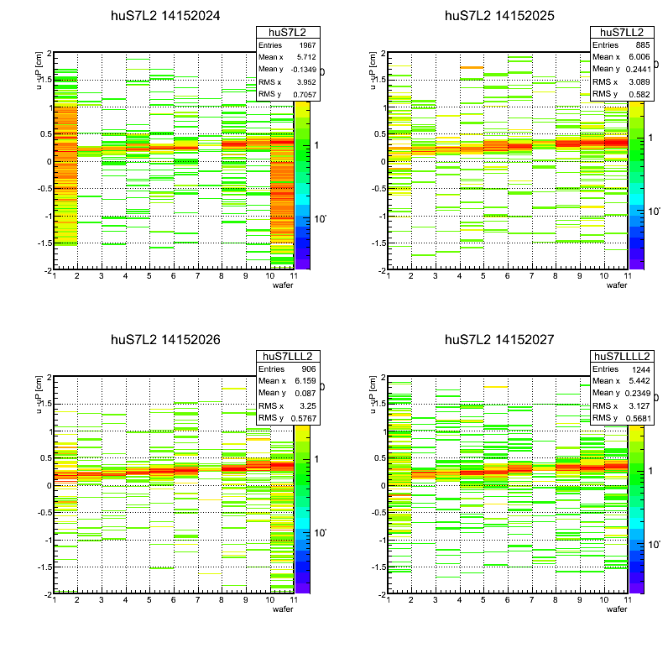
Sector 7 ladder 2 with sensors 1+10 masked out
du at ladder center ~ 2.5mm

Slide 4
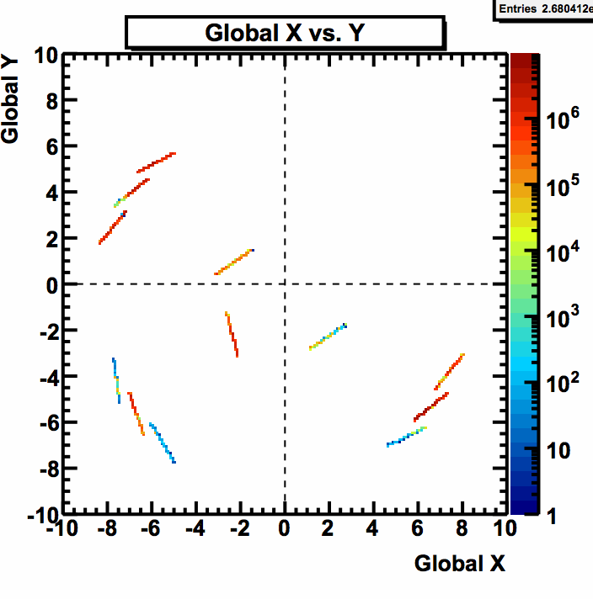
u
u-x angle ~200 degrees

Slide 5
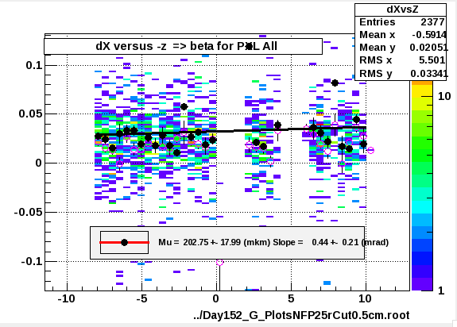
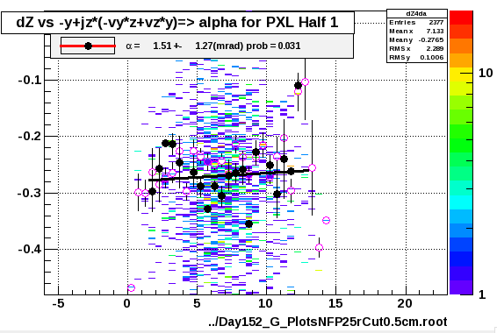
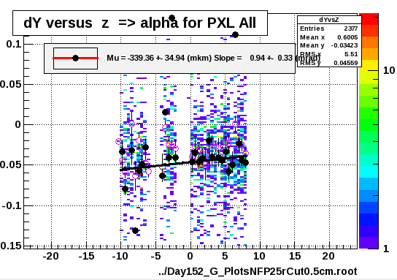
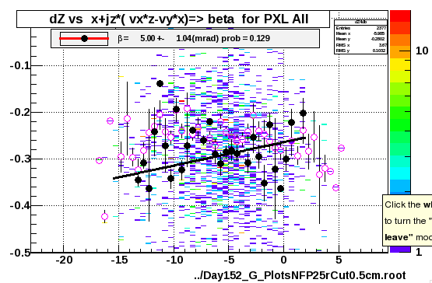
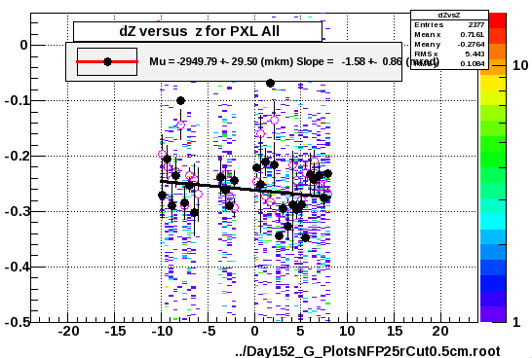
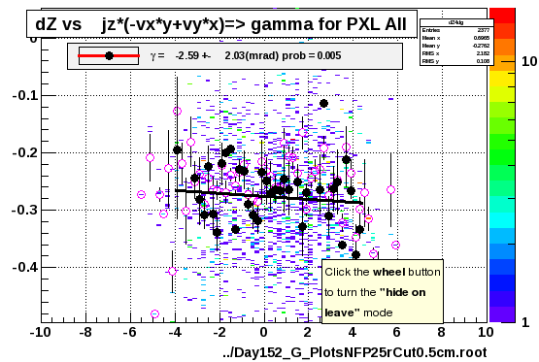
Sector 4

Slide 6
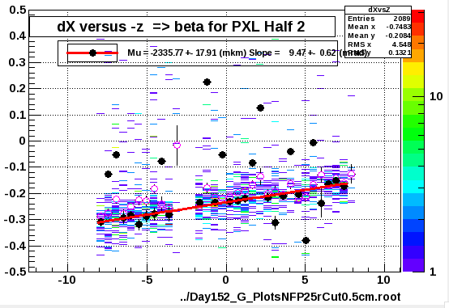
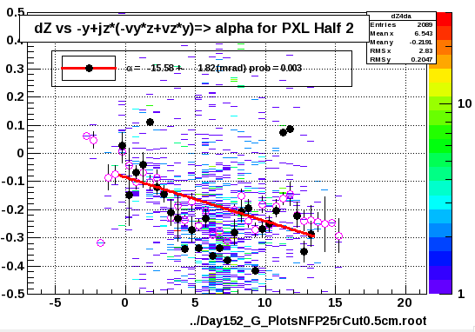
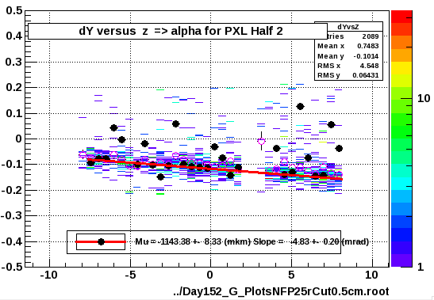
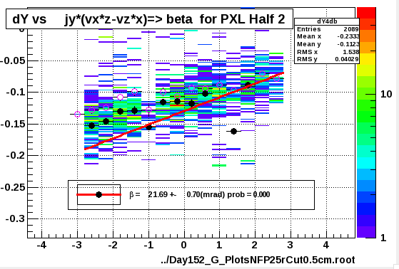
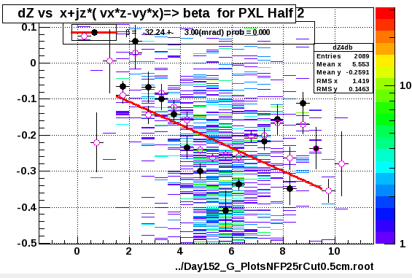
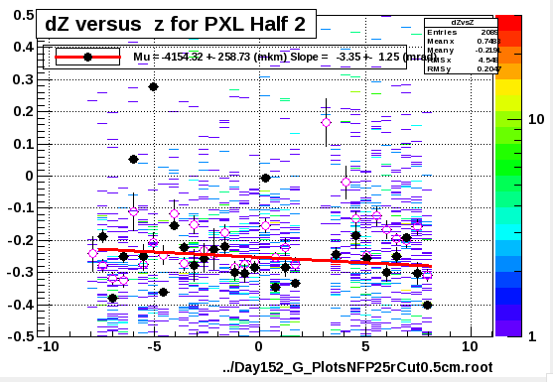
Sector 7, Ld-2
Ladder has an angle of about 203 degrees with x-axis
du= 2.5mm this should give an effective shift of
x=2.5*cos200 = -2.3 mm , y = 2.5*sin200= -1mm
This is exactly what is seen in the dX, dY reports
As Xin pointed out dw will have an effect too which we kind of see in the spread of values in the next slide
There are signs of rotations present. The du slope indicates alpha and/or beta rots

Slide 7
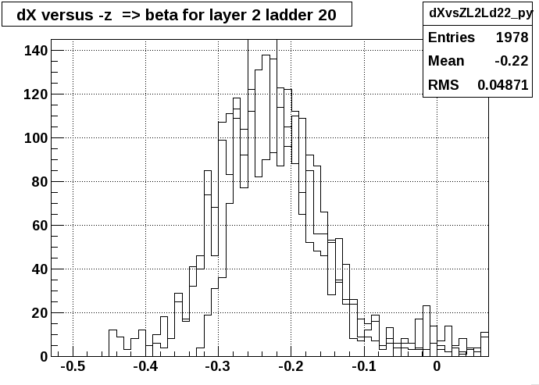
DATA : Day152
“Demonstrating” that Global DX, DY common to all ladders in sector
Sector-4 Global dX ~0. (~100+-50 microns)
Sector-7 Global dX -2.3 +-0.01 mm
Sector-4 Global dY -200 to -400 microns
Sector-7 Global dY -1.1 to -2.8 mm

Slide 8
Summary
Sector 4 looks healty in rots….minor shifts
Sector 7 looks unhealthy in rots
need to check correctness of Db entries
I estimated (by hand for now) 0.5 degree rots
Jonathan runs a correction loop right now (z-shift) to see if we can correct … correctly !
Details to follow on Friday
Histograms are low statistics and very noisy. Need to process more and better data!

