Slide 1
The Heavy Flavor Tracker (HFT)
The Silicon Vertex Upgrade of STAR @ RHIC
Spiros Margetis
Kent State University, USA
Excited QCD 2010, Slovakia

Slide 2
Outline
The Physics
The Challenges
The HFT

Slide 3
The Bottom Line
Hot and dense (partonic) matter with strong collectivity has been formed in Au+Au collisions at RHIC. Study of the properties of the new form of matter requires more penetrating probes like heavy quarks.
Mechanism for parton energy loss.
Thermalization.
New micro-vertex detector is needed for STAR experiment.
PHENIX has a similar approach, but with a different technology and reconstruction philosophy.
DOE milestone 2016: “Measure production rates, high pT spectra, and correlations in heavy-ion collisions at √s_{NN} = 200 GeV for identified hadrons with heavy flavor valence quarks to constrain the mechanism for parton energy loss in the quark-gluon plasma.”

Slide 4
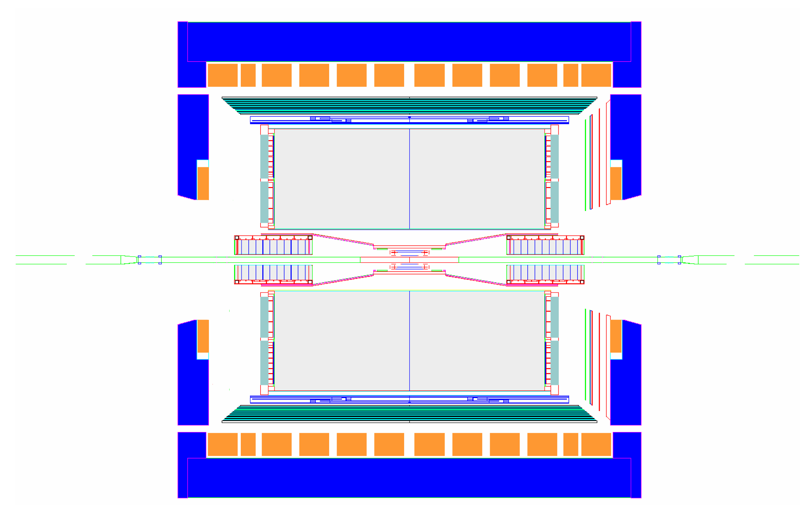
STAR Detector
MRPC ToF barrel
100% ready for run 10 (now!)
MTD
EMC barrel
EMC End Cap
FMS
BBC
FPD
TPC
FHC
PMD
DAQ1000
Completed
HLT
HFT
FGT
Ongoing
R&D

Slide 5
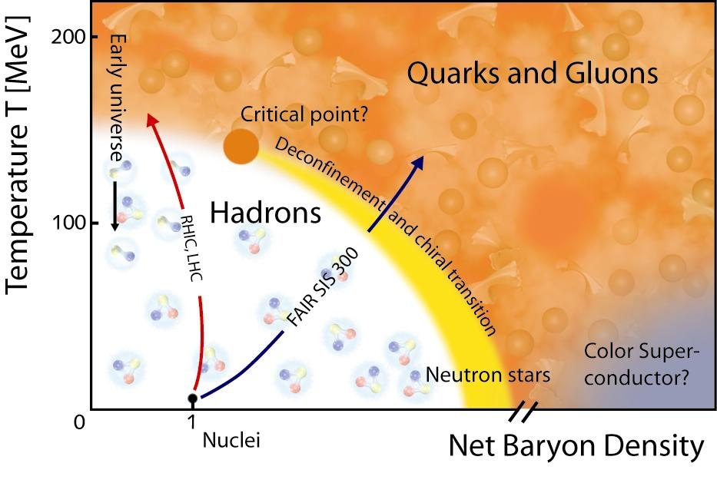
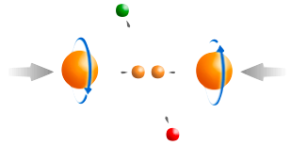
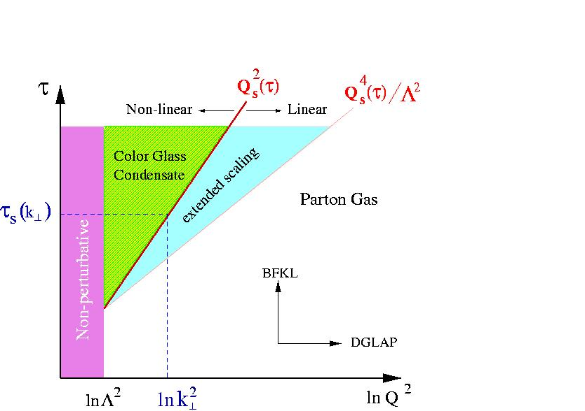
STAR Physics Focus
At 200 GeV top energy
- Study medium properties, EoS
- pQCD in hot and dense medium
2) RHIC beam energy scan
- Search for the QCD critical point
- Chiral symmetry restoration
Spin program
- Study proton intrinsic properties
Forward program
- Study low-x properties, search for CGC
- Study elastic (inelastic) processes (pp2pp)
- Investigate gluonic exchanges

Slide 6
The QCD Phase Diagram and High-Energy Nuclear Collisions
The nature of thermalization at the top energy:
Heavy quarks
Di-lepton
1
T_{ini}, T_{C}
LHC, RHIC
2
T_{E}
RHIC, FAIR
3
Phase boundary
RHIC, FAIR, NICA
Early Universe
quark-gluon plasma
1
2
3
T_{E}
Critical Point?
Temperature
hadron gas
CSC
nuclei
Baryon Chemical Potential

Slide 7
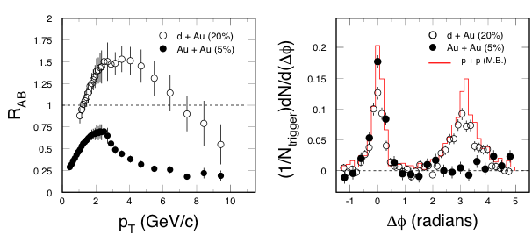
Partonic Energy Loss at RHIC
STAR: Nucl. Phys. A757, 102(2005).
Central Au+Au collisions: light quark hadrons and the away-side jet in back-to-back ‘jets’ are suppressed. Different for p+p and d+Au collisions.
Energy density at RHIC: ε > 5 GeV/fm³ ~ 30ε₀
Explore pQCD in hot/dense medium
R_{AA}(c,b) measurements are needed!

Slide 8
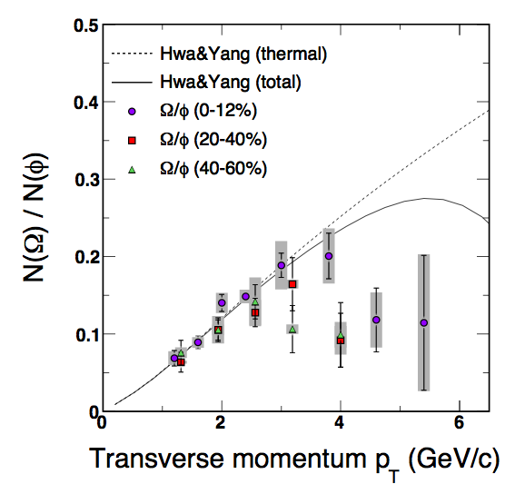
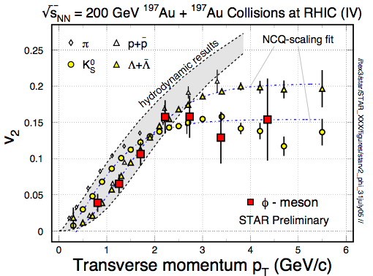
φ -meson Flow: Partonic Flow
STAR: Phys. Rev. Lett. 99, 112301(2007).
“φ-mesons (and other hadrons) are produced via coalescence of seemingly thermalized quarks in central Au+Au collisions. This observation implies hot and dense matter with partonic collectivity has been formed at RHIC”
In order to test early thermalization: v₂(p_{T}) of
c- and b-hadrons data are needed!

Slide 9
Partonic Collectivity at RHIC
STAR: preliminary
STAR: QM2009
Low p_{T} (≤ 2 GeV/c): hydrodynamic mass ordering
High p_{T} (> 2 GeV/c): number of quarks ordering
s-quark hadron: smaller interaction strength in hadronic medium
light- and s-quark hadrons: similar v₂ pattern
=> Collectivity developed at partonic stage!

Slide 10
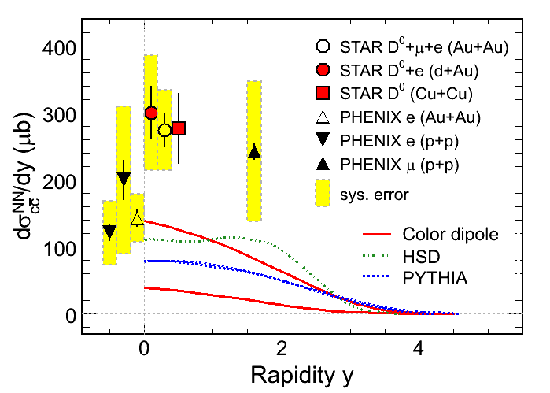
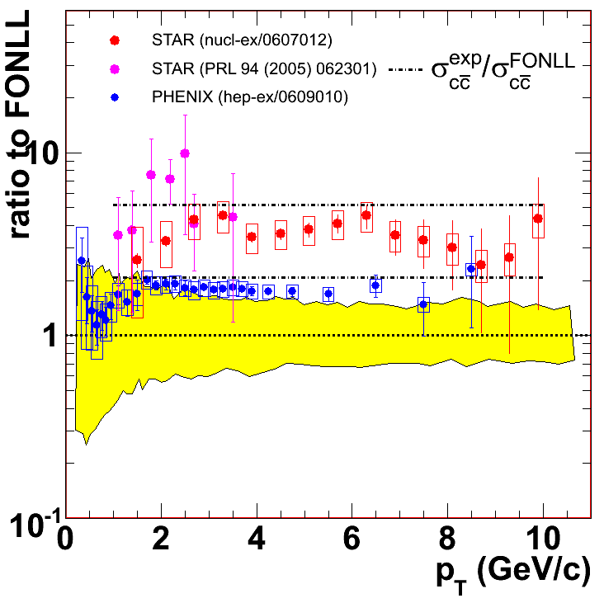
Charm Cross Sections at RHIC
Large systematic uncertainties in the measurements
New displaced, topologically reconstructed measurements for c- and b-hadrons are needed ⇦ Upgrade

Slide 11
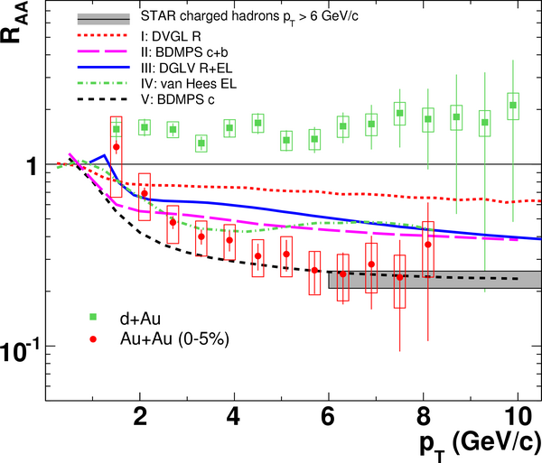
Heavy Quark Energy Loss
STAR: Phys. Rew. Lett, 98, 192301(2007).
1) Non-photonic
electrons decayed
from - charm and
beauty hadrons
2) At p_{T} ≥ 6 GeV/c,
R_{AA}(n.p.e.) ~ R_{AA}(h±)!
Contradicts naïve
pQCD predictions
Surprising results -
- challenge our understanding of the energy loss mechanism
- force us to RE-think about the elastic-collisions energy loss
- Requires direct measurements of c- and b-hadrons.

Slide 12
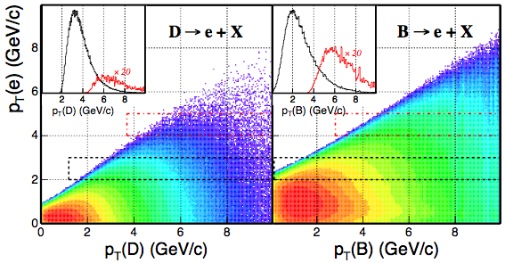
Decay e p_{T} vs. B- and C-hadron p_{T}
Key: Directly reconstructed heavy quark hadrons!
Pythia calculation Xin Dong, USTC October 2005

Slide 13
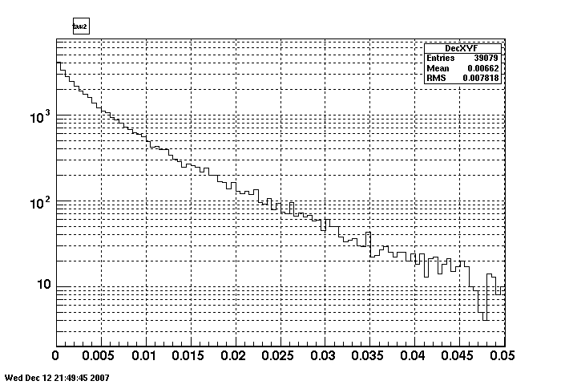
Challenge: e.g. D⁰ decay length
counts
D⁰->K+pi
Used <pt>~1GeV
1 GeV/ η=0 D0 has βγ∼0.5
Un-boost in Collider !
Mean R-φ value ~ 70 μm
~1 cτ
Decay Length in X-Y plane
cm

Slide 14
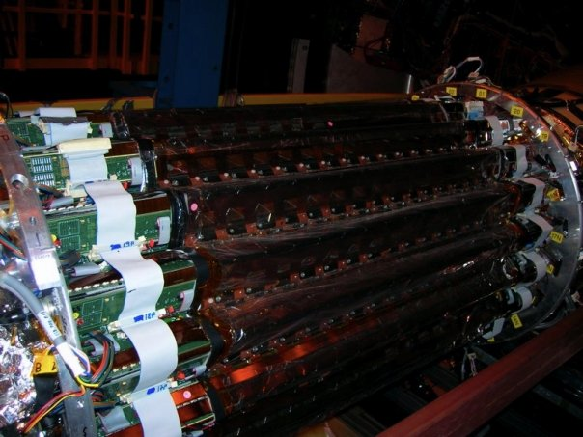
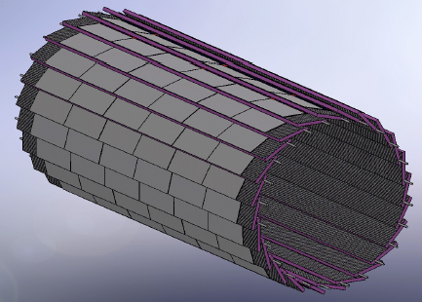
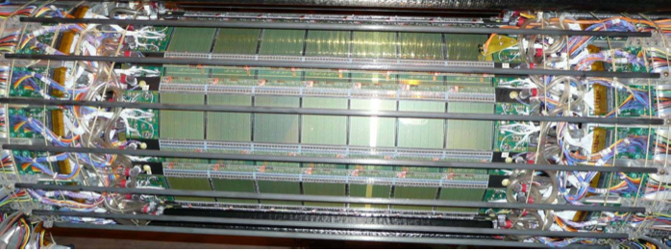
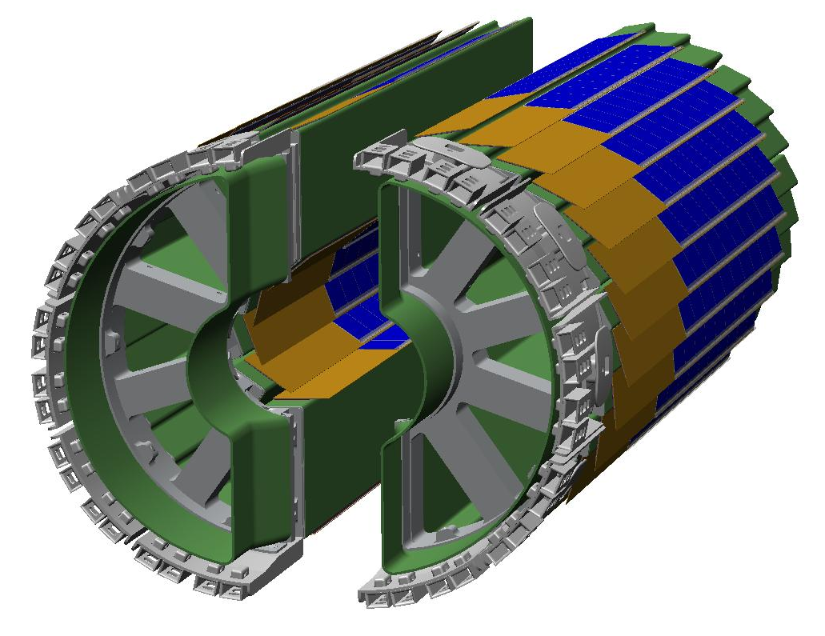
OLD (SVT)
NEW (HFT)
SSD
SSD+
23cm
22cm
IST
15cm
14cm
11cm
PIXELS
SVT
8cm
~6.5cm
SVT:~1.5%X0/layer
2.5cm
.
.
PXL:0.3-0.5%X0/layer
Detector resolutions differ by a factor of two but pointing by a factor of ten.

Slide 15
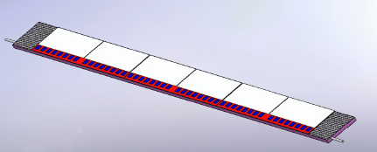
HFT
Low mass
Near the event vertex
Active pixels
SSD+ R=22cm
Technology
Pixel 1-2 R=2.5, 8cm
IST R=14cm
New beam pipe
SSD+
IST
PIXEL

Slide 16
Projection error is a strong function of first-layer distance and thickness
SVT+SSD
10

Slide 17
SVT+SSD D0-vertex resolution (simulation)
Reco vs. MC [cm]
Reco - MC [cm]
MC [cm]
MC [cm]
Left : correlation between reconstructed path length and MC
Right : Decay length resolution
There is no systematic shift (red crosses = mean) in reconstructed quantities.
The standard deviation (blue crosses) of the distribution (reco-MC) is flat at
~ 250 μm , which is of the order of the resolution of (SSD+SVT).

Slide 18
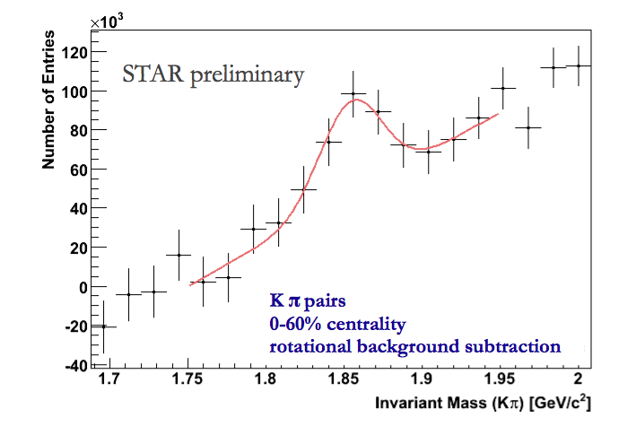
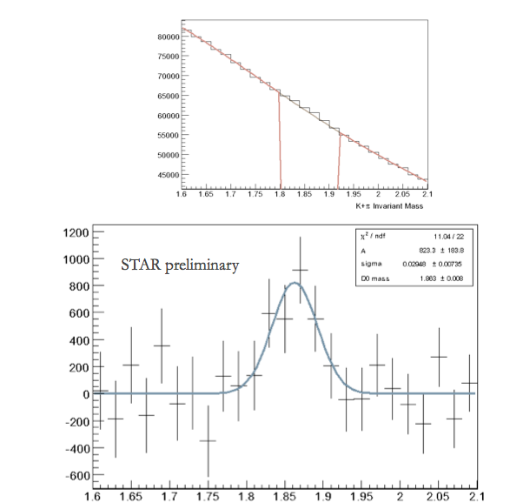
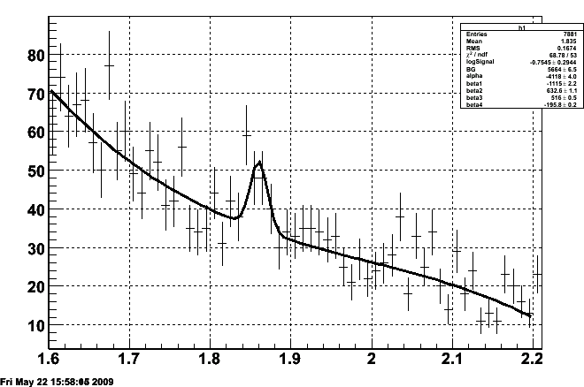
Glimpses at 200 GeV DATA
TPC only Cu+Cu
(Relatively) low significance peaks have been observed already in the DATA but of limited physics reach
+SVT+SSD Au+Au
STAR preliminary

Slide 19
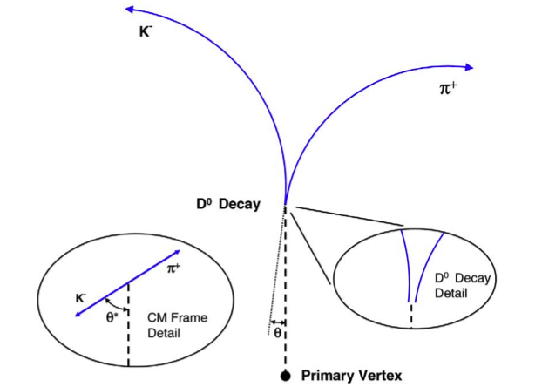
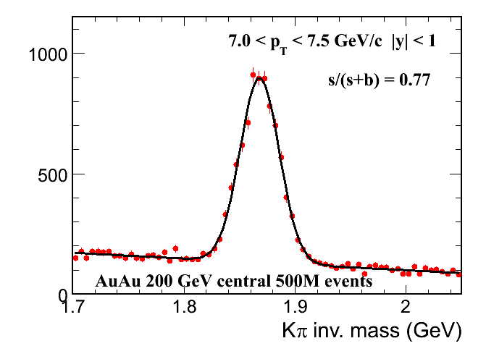
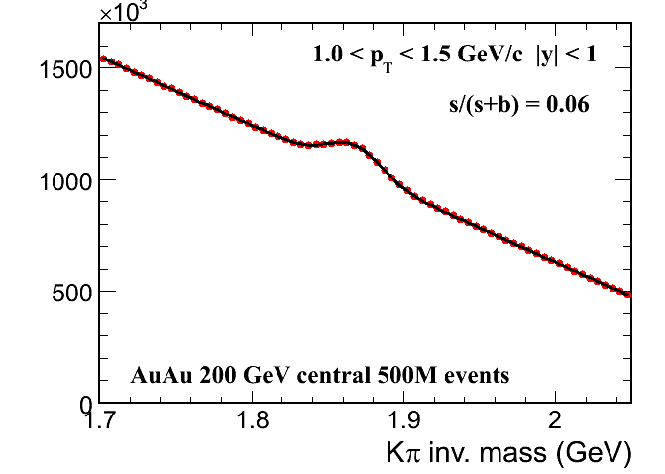
HFT Performance example on the D⁰ ➝ Kπ reconstruction
Simulation of Au+Au@200GeV Hijing events with STAR tracking software including pixel pileup (RHIC-II luminosity) extrapolated to 500 M events (~one RHIC run).
Identification done via topological cuts and PID using Time Of Flight

Slide 20
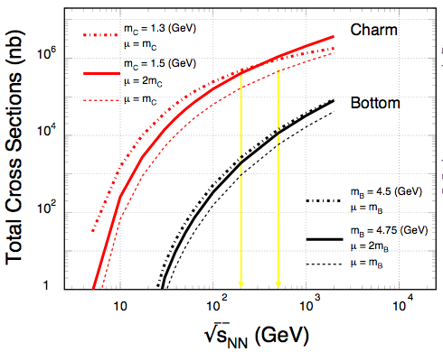
Heavy Quark Production
NLO pQCD predictions of charm and bottom for the total p+p hadro-production cross sections.
Renormalization scale and factorization scale were chosen to be equal.
RHIC: 200, 500 GeV
LHC: 900, 14000 GeV
Ideal energy range for studying pQCD predictions for heavy quark production.
Necessary reference for both, heavy ion and spin programs at RHIC.
RHIC LHC
Estimated error bars of measurement comparable to line thickness!

Slide 21
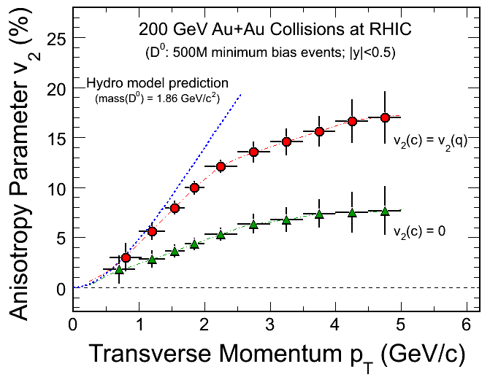
HFT - Charm Hadron v₂
Charm-quark flow
→ Thermalization
of light-quarks!
Charm-quark does
not flow
→ Drag coefficients
- 200 GeV Au+Au minimum bias collisions (500M events).
- Charm collectivity  drag/diffusion constants  medium properties!
Notes:
Hydro model: Pasi Huovinen, private communication, January 2008.
Just to remind you: these calculations were done using my "standard" set of parameters: initial time 0.6 fm/c, first order phase transition at T_c=165 MeV, chemical equilibrium all the way until until kinetic freeze-out, freeze-out at T_f=130 MeV reproduces pion spectra and (anti)proton p_T-slope, initial profiles as a combination of participant and binary collision scaling.

Slide 22
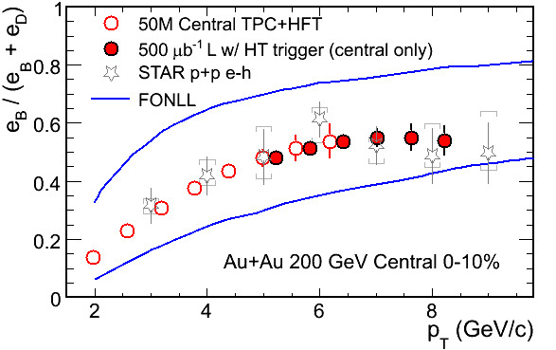
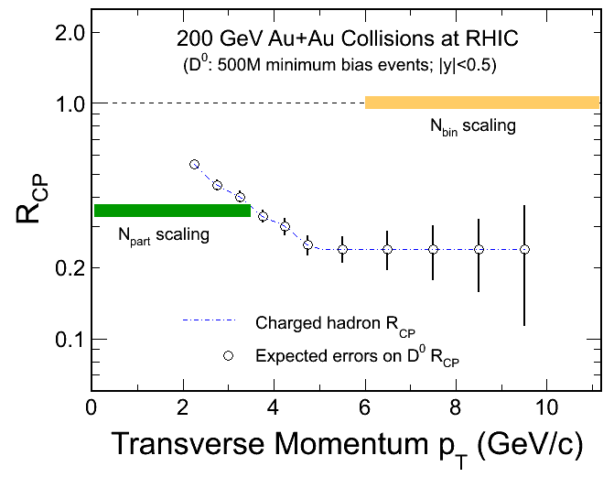
HFT - Charm Hadron R_{CP}
Simulation – D⁰s, NOT decay electrons
R_{CP}=a*N^{10%}/N^{(60-80)%}
Significant Bottom contributions in HQ decay electrons.
200 GeV Au+Au minimum bias collisions (|y|<0.5 500M events).
Charm R_{AA}  energy loss mechanism!
Notes:
10%

Slide 23
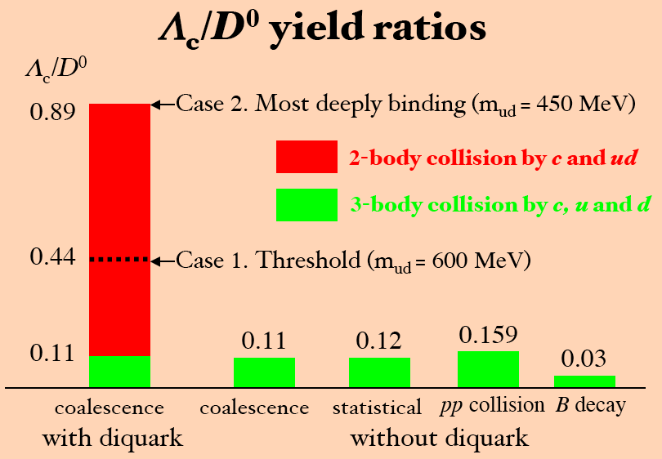
Charm Baryon/Meson Ratios
Λ_{C} → pK⁻π⁺
D⁰ → K⁻π⁻⁺
2-body collisions by c and ud
3-body collisions by c, u and d
QGP
medium
Y. Oh, C.M. Ko, S.H. Lee, S. Yasui, Phys. Rev. C79, 044905(2009).
S.H. Lee, K.Ohnishi, S. Yasui, I-K.Yoo, C.M. Ko, Phys. Rev. Lett. 100, 222301(2008).

Slide 24
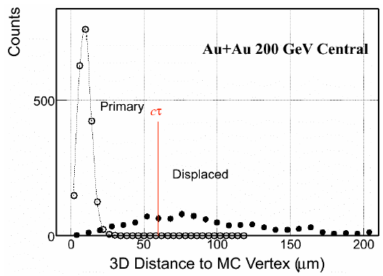
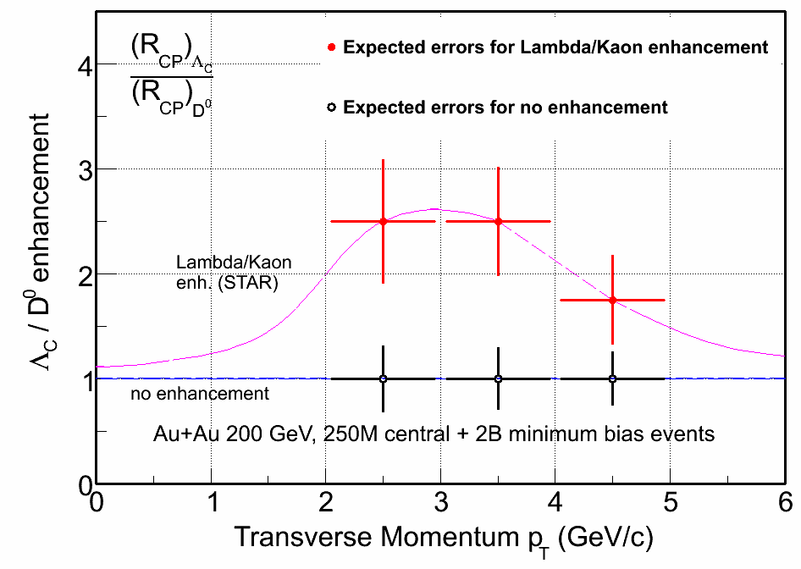
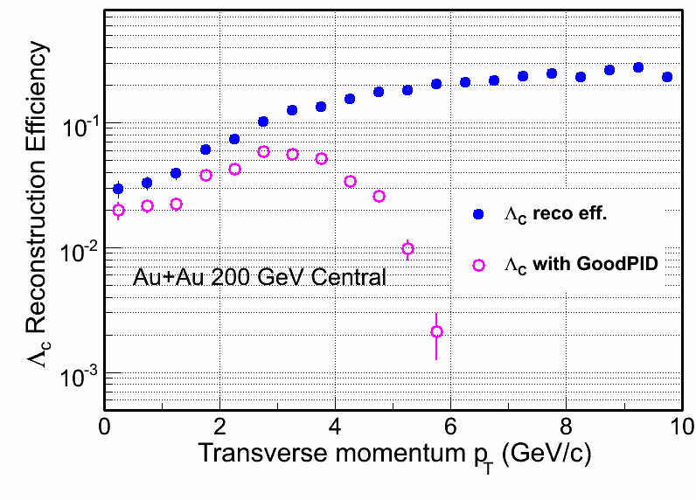
Λ_{C} Measurements
Λ_{C} ( ➔ p + K + π):
Lowest mass charm baryon
Total yield and Λ_{C}/D⁰ ratios can be measured.

Slide 25
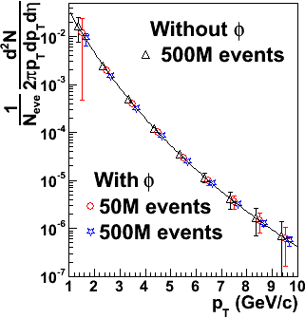
D_{s} Reconstruction
200 GeV Central Au+Au Collisions at RHIC
D_{s}→ K⁺K⁻π (BR 5.5%)
D_{s}→φπ→ K⁺K⁻π (BR 2.2%)
mass = 1968.49 ± 0.34 MeV
decay length ~ 150 μm
Work in progress …
200 GeV central Au+Au
Ideal PID
Power-law spectrum with:
n = 11, <p_{T}> = 1 GeV/c
0.5B events will work!

Slide 26
Strategies for Bottom Measurement
(1) All Charm states
( D^{0,±}, D_{s}, Λ_{C} )
(1.a) Displaced vertex
electrons (TOF+HFT)
⇦
⇦
(2) Charm decay electrons
(Charm)
⇦
(1.a) - (2)
⇦
Some Bottom states
(Statistics limited at RHIC)
Bottom decay electrons
Measure Charm and Bottom hadron:
Cross sections, Spectra and v₂

Slide 27
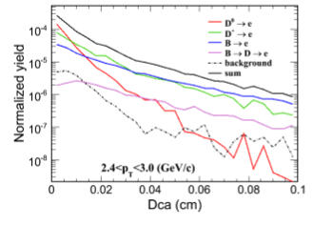
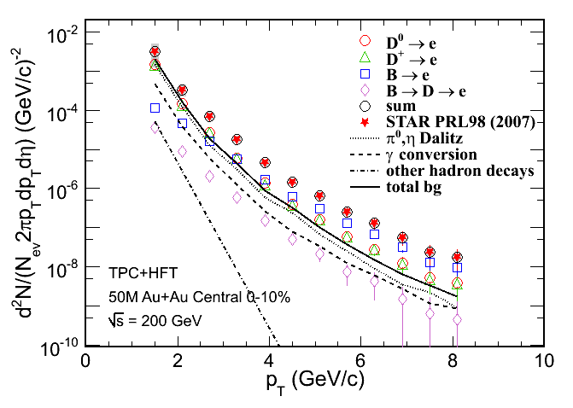
B-meson capabilities (in progress)
B->e+X approach
Rate limited, not resolution

Slide 28
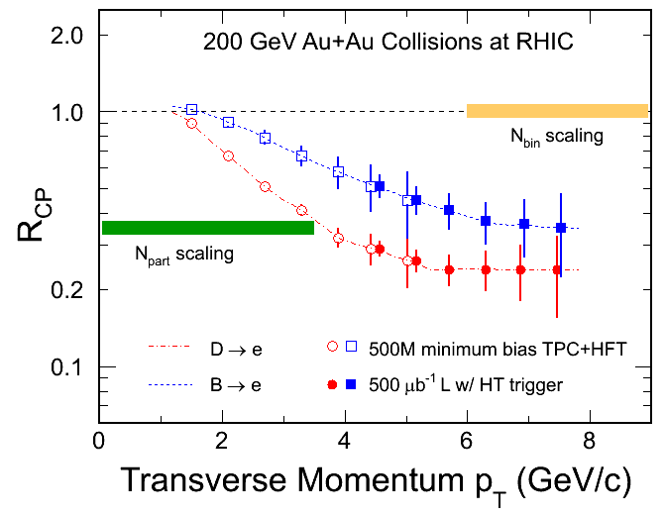
c- and b-decay Electrons
H. van Hees et al. Eur. Phys. J. C61, 799(2009). (arXiv: 0808.3710)
R_{CP}=a*N^{10%}/N^{(60-80)%}
DCA cuts  c- and b-decay electron distributions and R_{CP}
200 GeV Au+Au minimum biased collisions (|y|<0.5 500M events)
Notes:
10%

Slide 29
Summary
Detailed spectra of heavy flavor (c, b) is an invaluable piece of information
First generation of detectors needs smart replacements
The Heavy Flavor Tracker in STAR is the most advanced answer to this need

Slide 30
Spares

Slide 31
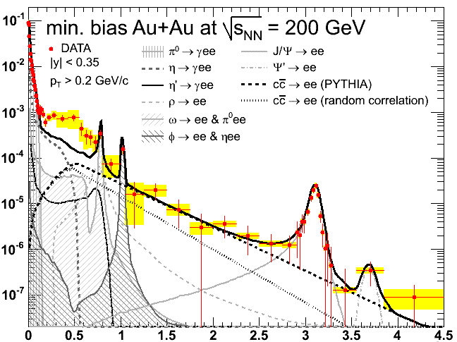
The di-Lepton Program at STAR TOF + TPC + HFT
ρ ϕ J/ψ
Direct
radiation from
the Hot/Dense
Medium
Chiral
symmetry
Restoration
⇧ A robust di-lepton physics program extending STAR scientific reach
(1) σ
(2) v₂
(3) R_{AA}
DY, charm Bk
PHENIX: 0706.3034
Mass (GeV/c²)
p_{T} (GeV/c)

Slide 32
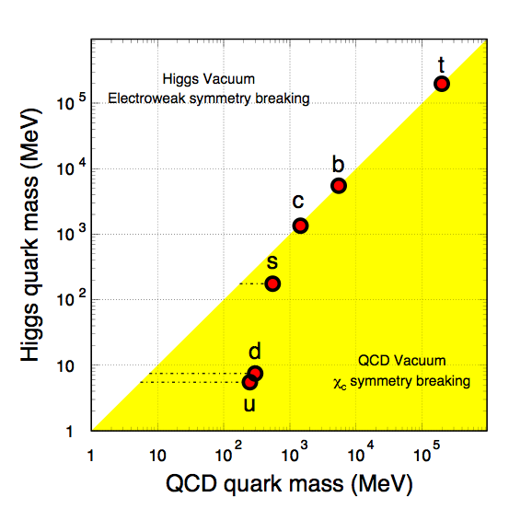
Quark Masses
- Higgs mass: electro-weak symmetry breaking (current quark mass).
- QCD mass: Chiral symmetry breaking (constituent quark mass).
Strong interactions do not affect heavy-quark mass.
New scale compare to the excitation of the system.
Study properties of the hot and dense medium at the foremost early stage of heavy-ion collisions.
Explore pQCD at RHIC.
Total quark mass (MeV)
X. Zhu, et al, Phys. Lett. B647, 366(2007).

Slide 33
Requirement for the HFT
 | Measurements | Requirements
Heavy Ion | heavy-quark hadron v₂ - the heavy-quark collectivity | - Low material budget for high reconstruction efficiency p_{T} coverage ≥ 0.5 GeV/c mid-rapidity High counting rate
 | heavy-quark hadron R_{AA} - the heavy-quark energy loss | High p_{T} coverage ~ 10 GeV/c
p+p | energy and spin dependence of the heavy-quark production | - p_{T} coverage ≥ 0.5 GeV/c
 | gluon distribution with heavy quarks | - wide rapidity and p_{T} coverage

