Slide 1
First SSD Measurements
April 11, 2012

Slide 2
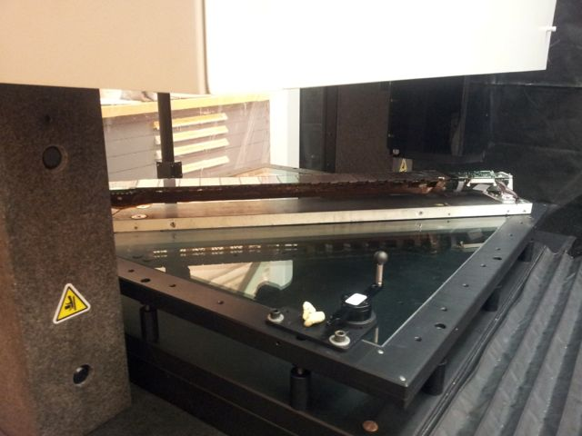
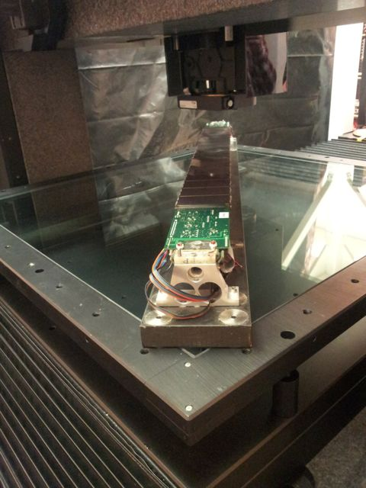
Pictures of Apparatus

Slide 3
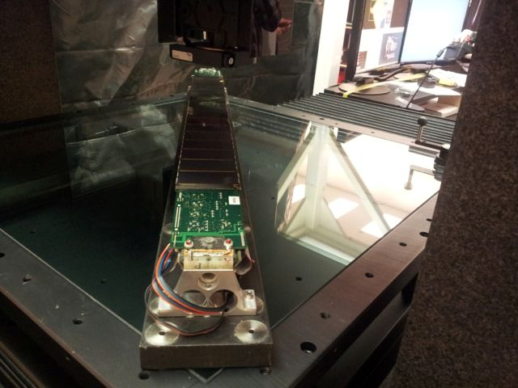

Slide 4
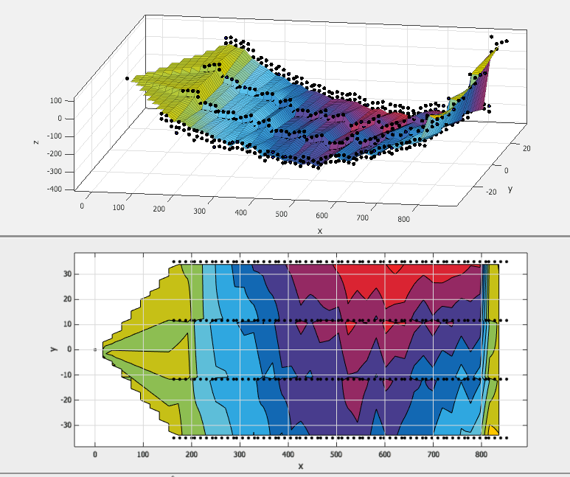
Flat – Looking at side closest to beam pipe

Slide 5
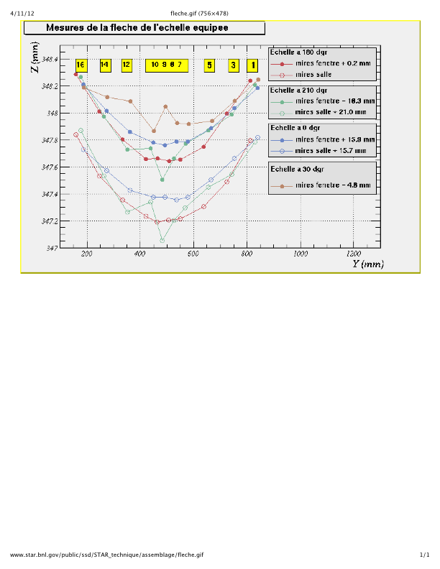
Old Rotation Tests

Slide 6
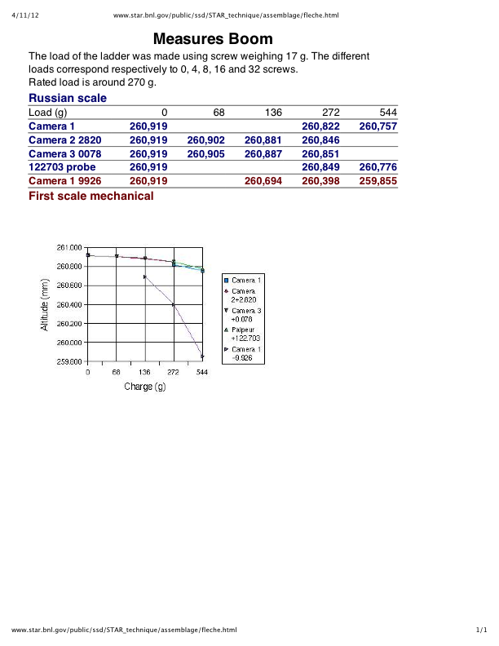
Old Deflection Measurement

Slide 7
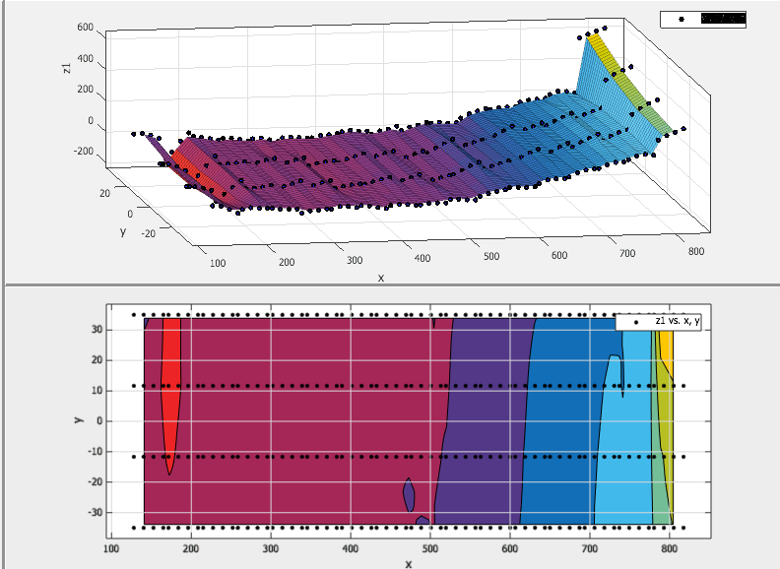
Don’t Understand 45 Degree slid

