Slide 1
Day 152
Comparison of dU = u – uP for files from :
Day 152, run 14152024 (run over 7998 events)
Day 152, run 14152026 (run over 9995 events)
Day 152, run 14152026 (run over 9989 events)
Day 152, run 14152027 (run over 13986 events)
Per ladder for all 3 sectors

Slide 2
Sector 2

Slide 3
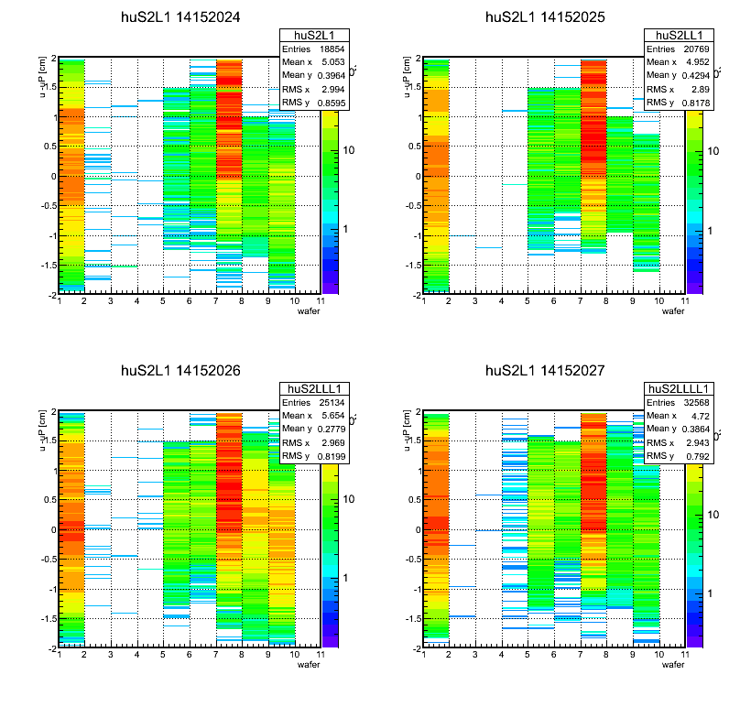
Sector 2 ladder 1

Slide 4
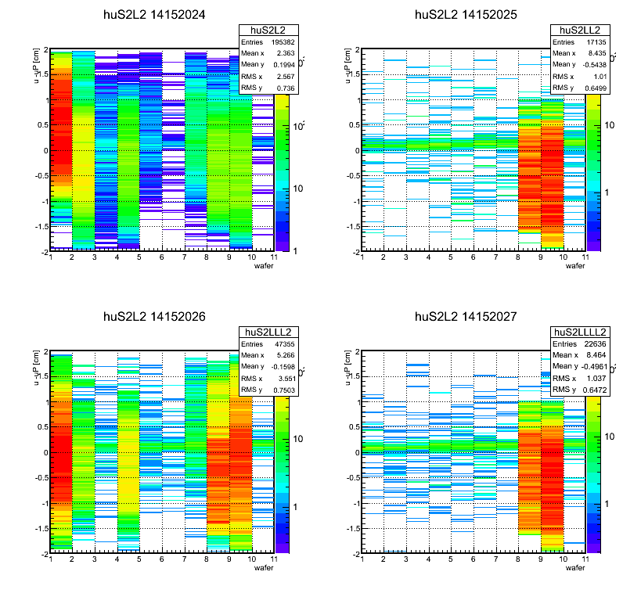
Sector 2 ladder 2

Slide 5
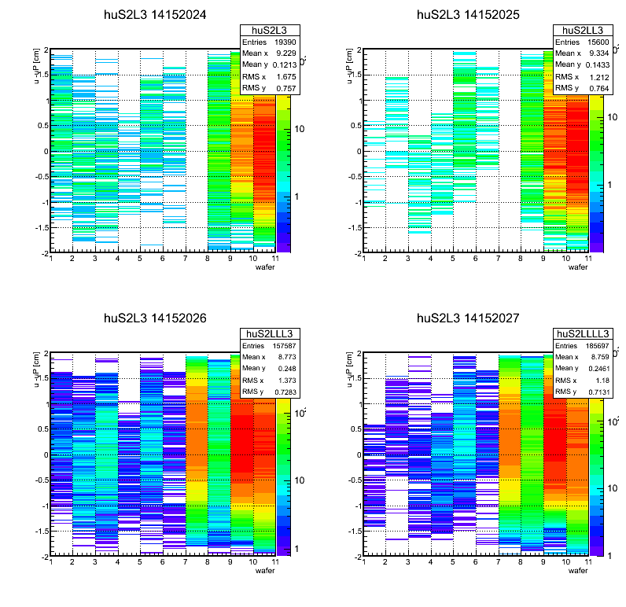
Sector 2 ladder 3

Slide 6
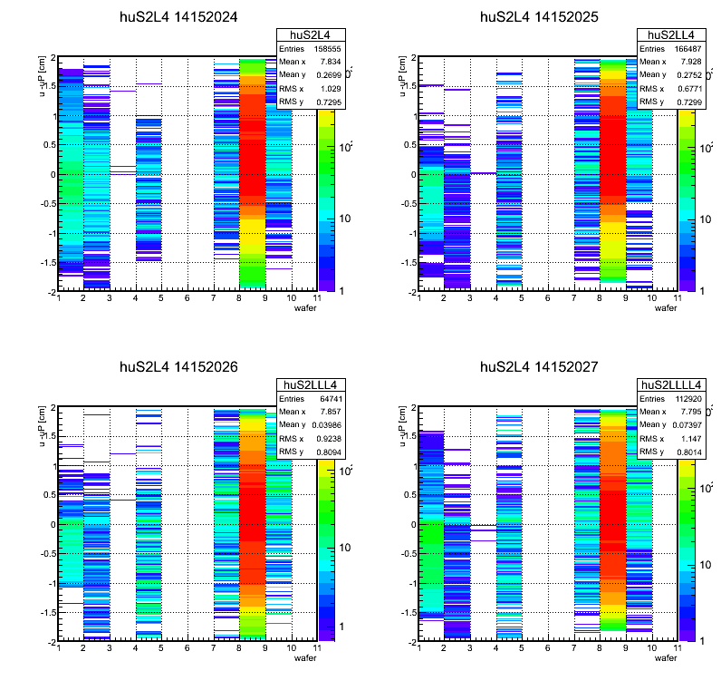
Sector 2 ladder 4

Slide 7
Sector 4

Slide 8
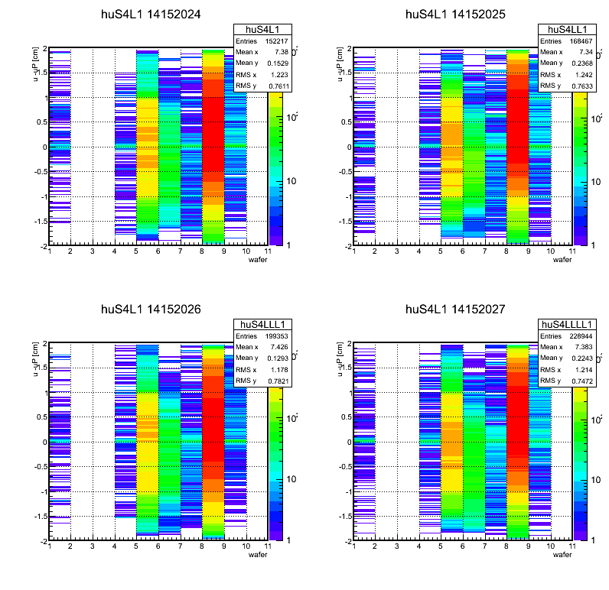

Slide 9
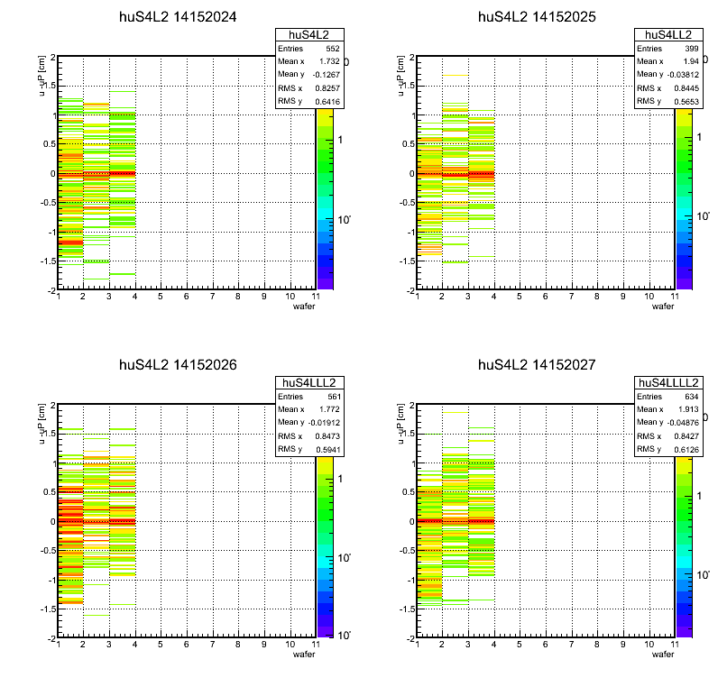

Slide 10
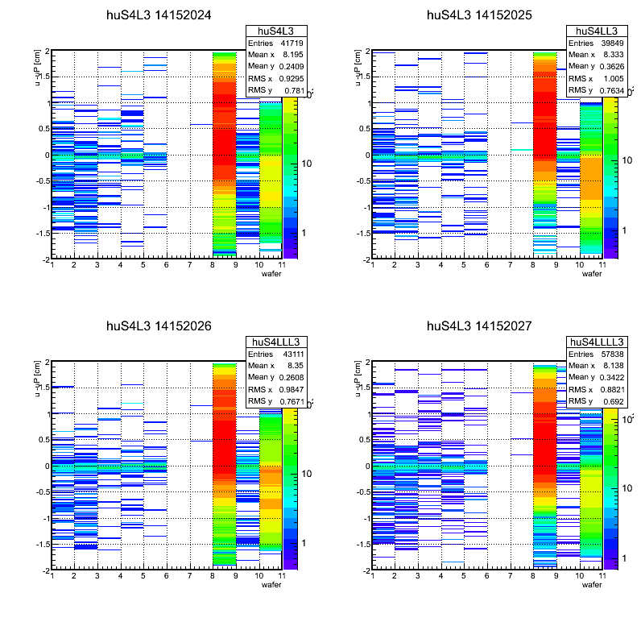

Slide 11
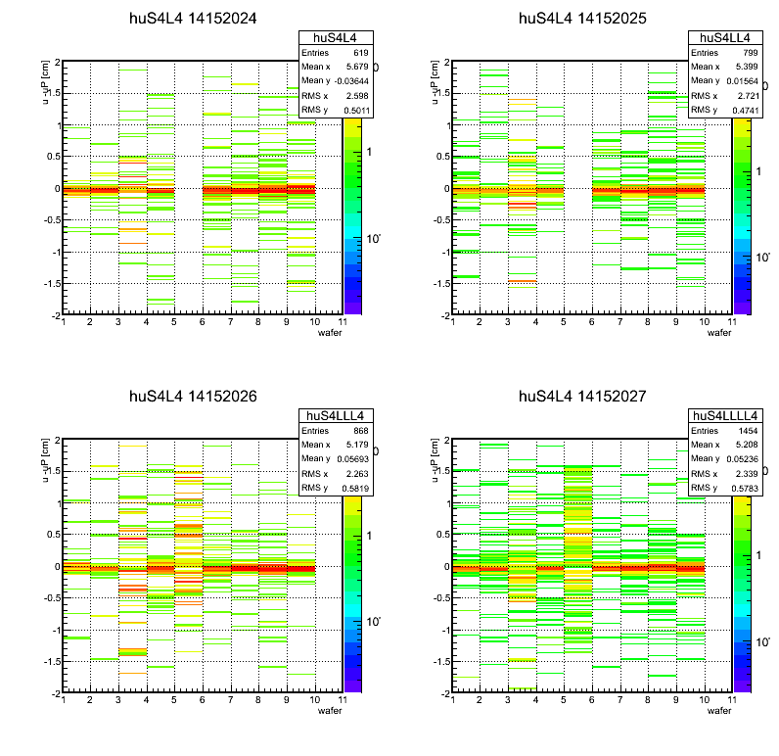

Slide 12
Sector 7

Slide 13
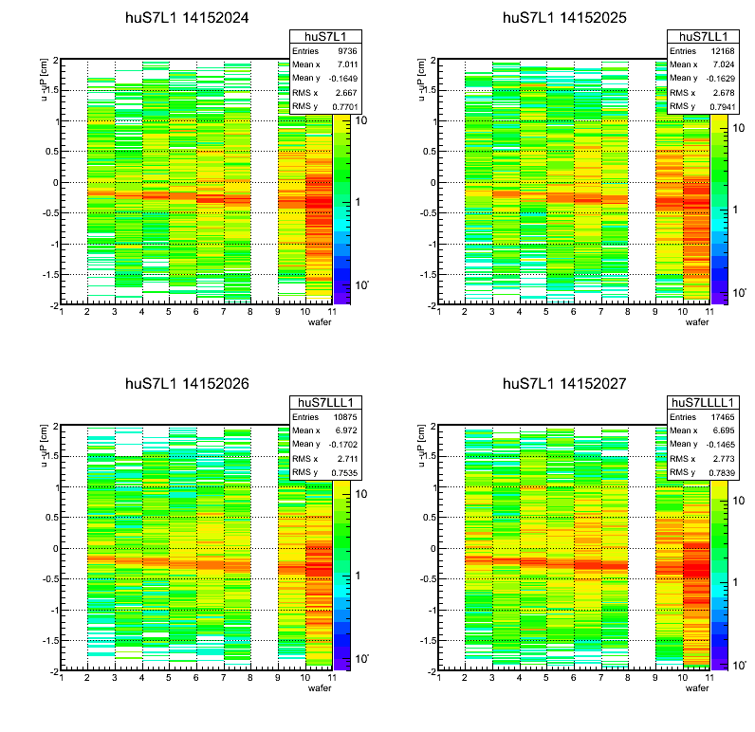

Slide 14
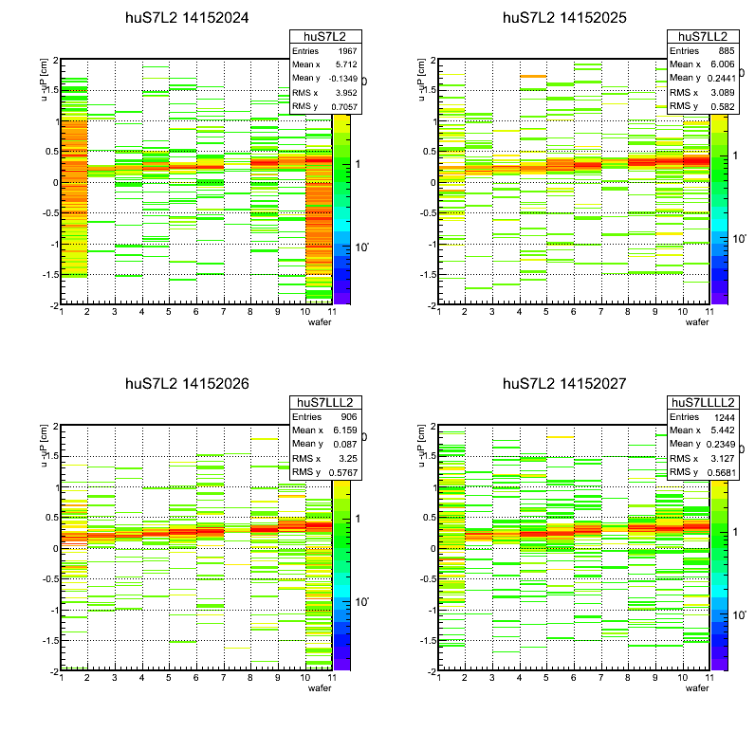

Slide 15
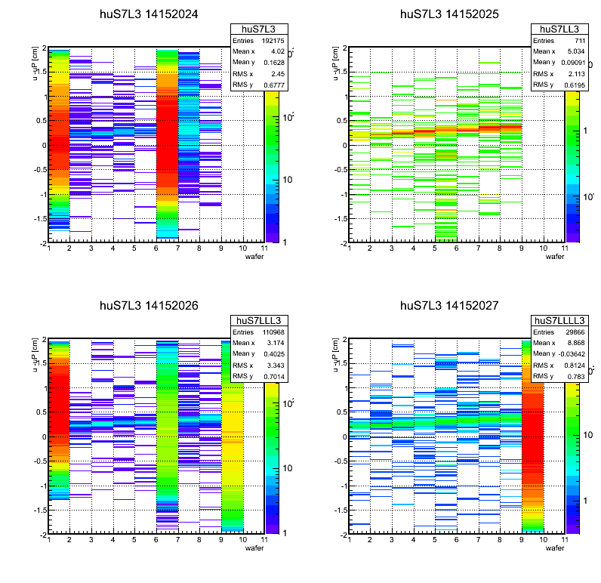

Slide 16
