Slide 1
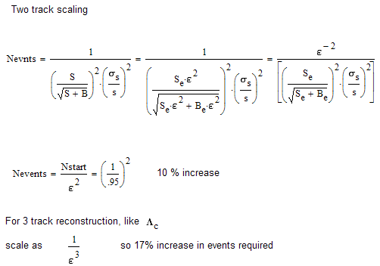
What is the consequence of running with radiation damage
Expected drop in efficiency for 3x10¹² Neq/cm²: 5% efficiency reduction
square for correlations

Slide 2
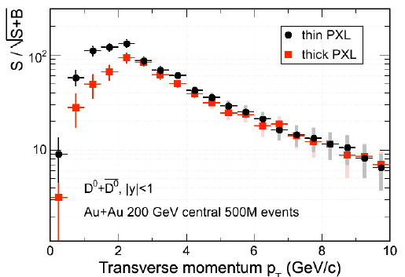
Effect of detector thickness change
thick/thin .62/.32
factor of ~2 in significance or factor of 3-4 in events required
factor increase for copper vs aluminum
(.52/.37) 1.5-2.5

Slide 3
Effect of no IST
Loose redundancy
Loose fast readout
With TOF and IST can do tracking to reduce pileup especially in 500 pp
Previous committee emphasized importance of these two points
Number of additional events required for D of average pt (1.0 GeV/c)
60%
100% more events required for Λ_{c} (3 body decays)

Slide 4
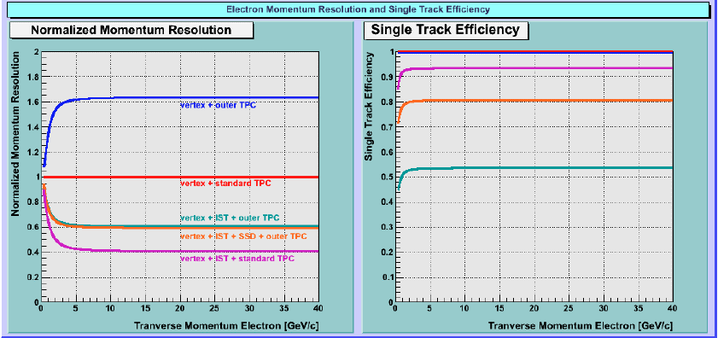
Impact of IST/SSD - pp program
STAR
pp - W program
Normalized to Vertex + standard TPC
Evaluated impact of IST/SSD improvement over Vertex and outer TPC only due to potential TPC performance degradation of TPC inner sectors at 500GeV high-luminosity pp collisions
Normalized momentum resolution dramatically improves with IST layer Vertex+outer TPC ⇒ Vertex+IST+outer TPC
The role of the SSD layer in addition to an IST layer is to increase the single-track efficiency at the level of ~30% (absolute)
Exchanging the IST to the SSD layer is not expected to change this conclusion significantly!
Therefore: The combination of both, the IST and SSD layers are essential for efficient high-pT tracking
Bernd Surrow
STAR HFT Pre-CD1 Review, BNL, November 2009

Slide 5
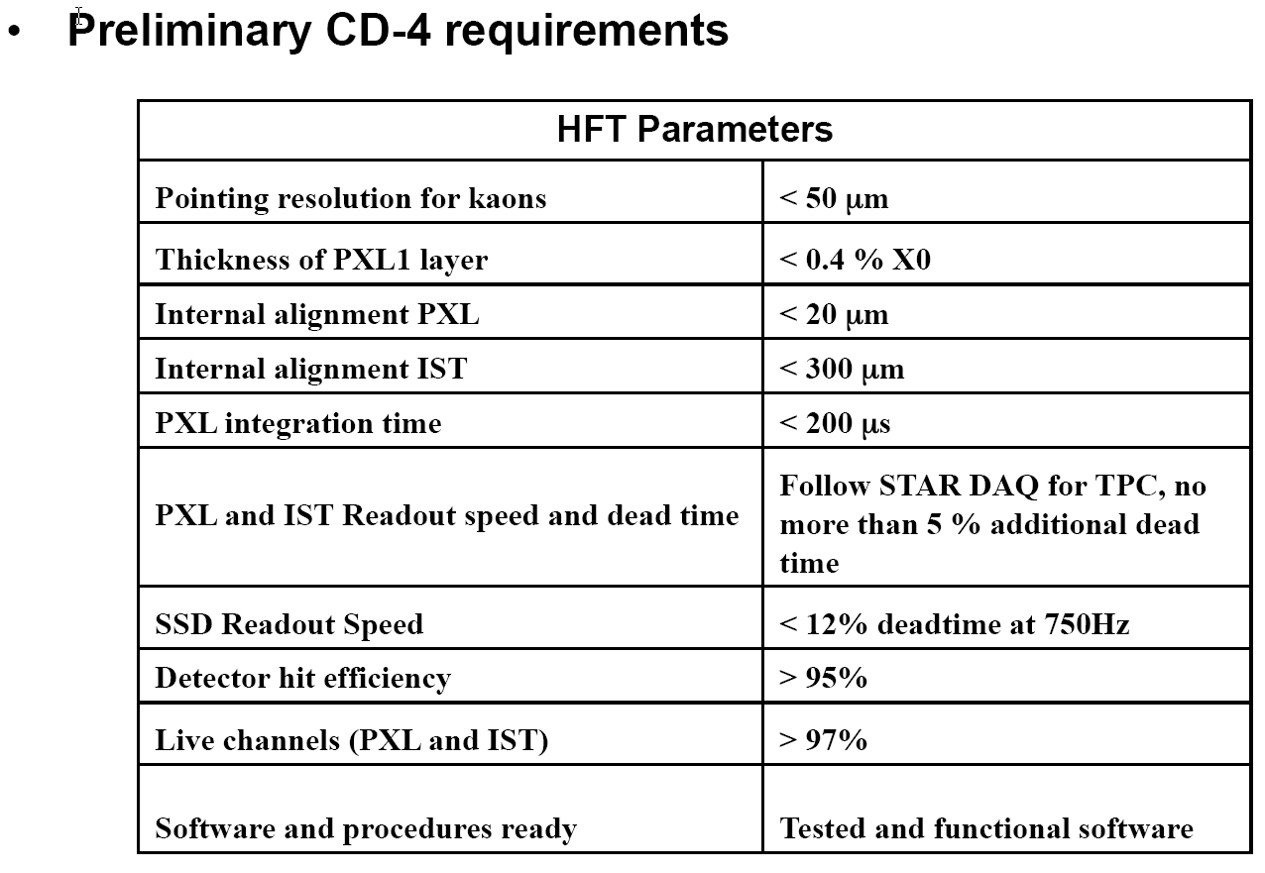

Slide 6
Full simulation

Slide 7
Fast simulation

