Slide 1
SSD upgrade
M. LeVine, R. Scheetz BNL
Ch. Renard, S. Bouvier Subatech
H. Matis, J. Thomas LBNL

Slide 2
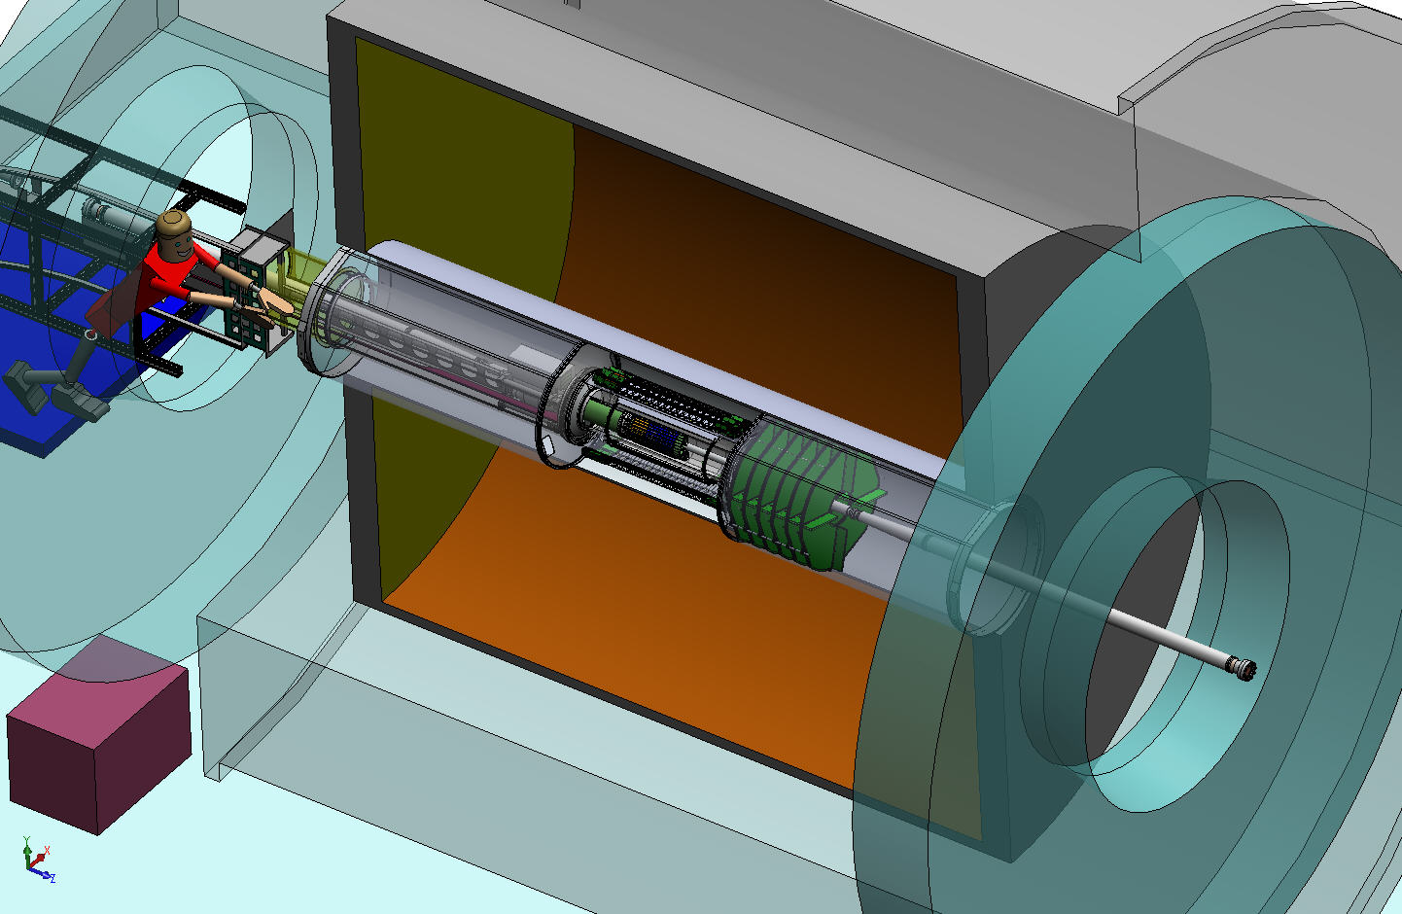
HFT components
HFT
SSD
IST
PXL
IFC
Inner Field Cage
Magnet
Return Iron
FGT
TPC
Volume
Solenoid
EAST
WEST

Slide 3
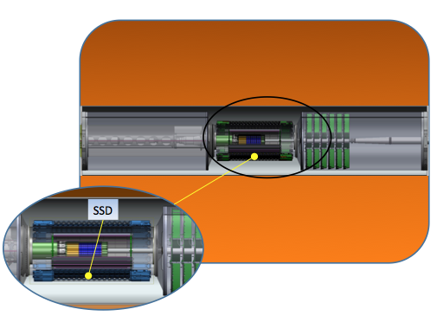
SSD
Notes:
Existing detector! Essential for HFT to provide improved pointing accuracy from TPC tracks
Cylindrical coverage: radius ~22.4 cm
Eta coverage: +/- 1.2
Resolution R-phi ~ 20µm Z ~ 750 µm

Slide 4
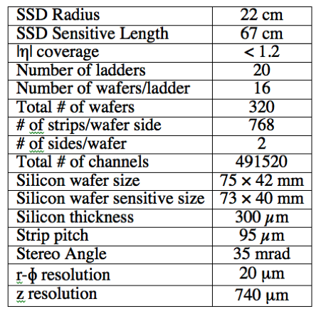
SSD characteristics
Notes:
Existing detector – in use in STAR from 2003 to 2007
Radius near midpoint between beam axis and TPC inner radius
Improves pointing accuracy to PXL detector (note esp in Z direction)

Slide 5
SSD ladder
Notes:
16 modules per ladder
Modules have 768 strips each side, at stereo angle of ~2 deg
Each face (P- and N-) read out separately at both ends of ladder

Slide 6
SSD expected lifetime in RHIC
Radiation expected during 12 weeks of 500 GeV p-p running: 3.4 krad
Extrapolated from measurements in STAR IR
Lifetime limit of SSD silicon+associated (on ladder) electronics: >200 krad
Based on measurements of SSD module in 20 MeV proton beam
Radiation limit: >30 years of p-p running
Notes:
1) H. Matis private communication
2) M. Germain et al. / Nuclear Instruments and Methods in Physics Research A 482 (2002) 634–643

Slide 7
SSD upgrade scope
Improve readout performance
Change mechanical mounting to improve hermiticity and interface with IDS
Improve reliability of air cooling
Notes:
Inner detector support

Slide 8
SSD readout upgrade
SSD electronics -- designed to read out at 200 Hz
New STAR DAQ now reads up to 1 kHz with low dead time
SSD must conform to the new performance standard

Slide 9
Readout upgrade concept
Reading out front end:
Replace single ADC with 16 ADCs
digitize 16 modules in parallel
Increase sampling rate to 5.00 MHz
All ladders processed concurrently
Transferring data to PC
Increase link throughput to DAQ PC to 120 Mbyte/s per 5 ladders
1850 µs -> 450 µs
Multiple (derandomizing) buffers effectively hides this time
Dead time: 11%@750Hz, <2%@100Hz
[cf. existing: >80%@750Hz,30% @ 100Hz]
2.5 ms -> 154 µs
Notes:
Readout at ladder
Formerly: 2.5ms
Now: 154 us
Link transfer time:
Link formerly served 10 ladders, was encumbered by ~40% overhead to fit TPC recvr board format
Formerly: 1850 us
Now: 450 us
Now dead time characterized by two different times – dead time @ 750Hz now 12% and <2% @ 100Hz

Slide 10
Readout components
Ladder cards
RDO (1 of 8)
Slave
FPGA
VME FPGA
Fiber links
VME interface
Slave
FPGA
DAQ PC
Slave
FPGA
Master FPGA
DAQ interface
DDL
Slave FPGA
Slave FPGA
TRG interface
Outer support cone
South platform VME crate
DAQ room
Notes:
Ladder cards: one on each end of ladder, each reads out one face of ladder
Fiber links connect ladders to RDO
5 ladder cards – 5 ladder faces
One chip (slave FPGA) is dedicated to processing and buffering data from a single ladder
Master FPGA handles interaction with TRG and DAQ
Link to DAQ PC (DDL) is bidirectional 1.5 Gbps fiber [designed for ALICE @LHC] in use in STAR for TPC and other detectors

Slide 11
Data formats
non zero-suppressed
3 10-bit ADC values to a 32-bit word
Fixed order: position in buffer/word -> geographical position of strip
zero suppressed
Only strips with ADC value above threshold are present
ADC value (10 bits) + strip location (14 bits)
One strip per 32-bit word
Alleviates large memory access burden on DAQ PC
Doing this in real time in FPGA is simple

Slide 12
Ladder data path
5 MHz
80 MHz
module
adc 12bit
16 bit serial output
16 bit width 32 words deep
X16
16
packer
20
FIFO
serializer
to fiber
50 MHz
40 MHz
2
JTAG TDOs
5 MHz
80 MHz
module
Write enable: true on 10 clocks only
adc 12bit
16 bit serial output
1 set of adc samples: 10 X 16 bits =>
repacked into: 2 X 4 X 20 bits
Notes:
This is a “cartoon” version of the ladder card, focusing on the event dataflow.
ADC produces a 16-bit serial train. We will use 10 bits.
A single set of samples produces 16X10 bits, packed into 2 sets of 4X20 bit words at serializer
Packer: 16 bits in, 20 bits (+ 1 bit start) out.
For every 5 16-bit word in, produce 4 20-bit words to serializer

Slide 13
RDO slave - unpacker
unpacking 4 20-bit words to 5 16-bit words
word 1
FIFO1
JTAG TDOs
40 MHz
word 2
5 MHz
2
FIFO2
deserialize
1:10 deserialize
10
demux
word 3
mux
50 MHz
FIFO
50 MHz
20
x16
10
x16
first wd
FIFO3
word 4
16 bit
FIFO4
word 5
20 bit
Notes:
Word 1 output when FIFO1 not empty
Word 2 when FIFO2 not empty
Word 3 when FIFO3 not empty
Word 4 when FIFO4 not empty
Followed by Word 5
Repeats ….

Slide 14
Slave FPGA – ADC processing
(no zero suppression)
Packing
register
Pedestal
memory
-
1
2
3
Buffer 0..3
256X32 bits
+
Subtract/
multiplex
10
ADC 1
1
write ped address
write ped data
from unpacker
remainder
Readout to master FPGA
Pedestal
memory
-
1
2
3
Buffer 0..3
256X32 bits
Subtract/
multiplex
10
ADC 16
+
16
read address
mode
read address
14
address
÷ 3
8
10
2
10
counter
0-767
Mode: ADC,
pedestal, or
difference
Select: ADC, pedestal only, or max(difference,0)
Pedestal write
Notes:
Organization shown here follows RDO unpacker (2nd functional block)
No zero suppression - 16 buffers shown
Case for zero suppression not illustrated here

Slide 15
Dead time calculation - no zero suppression
Notes:
Dead time as a function of random trigger rate for one or several de-randomizing buffers at the RDO.
No zero suppression is performed.
Characteristic time for single buffer due to occupancy on DDL fiber
DT @ 1kHz: ~33%
With 4 buffers, DT ~11.2%
For comparison -- existing readout gives 30% DT @ 100Hz
>80% DT @ 1kHz

Slide 16
Dead time calculations – zero suppression
3 % occupancy
Notes:
Dead time as a function of random trigger rates, for one or several de-randomizing buffers in the RDO. Empty strips are suppressed in the RDO; 3 per cent occupancy is assumed. Under these conditions, it is clear that multiple buffers offer no advantage.
Principal advantage is to relieve DAQ computer of extraneous traffic on PCI bus.

Slide 17
Status: slave FPGA
Components chosen
Altera Cyclone III EP3C55
FPGA code largely finished
Functional simulations complete
Post P&R done for subsystems
Full place and route in progress

Slide 18
Status: ladder board
Analog
Level shifter (mux replacement)
Serial ADC (16 inputs instead of 1)
Digital
Serial ADC
Event control
Data packer
SerDes
GBIC
4 temperature monitors
Slow control (JTAG)
Debug (USB interface)
Status - layout of PCB complete

Slide 19
Ladder board PCB
Flex circuit layer

Slide 20
Status: documentation
Notes:
Documentation of many details now in 63-page document:
Connector pin-outs
Data formats, headers
Command definitions

Slide 21
Testing road map
Ladder board standalone test
JTAG header to program FPGA for testing
Use USB interface to verify/correct FPGA behavior up to serdes
RDO standalone test
VME interface to program, probe master, slaves
Use user-defined JTAG to verify, debug
Integrate ladder, RDO with fiber
Entire system can be tested w/o DAQ PC
Use VME to communicate with master FPGA

Slide 22
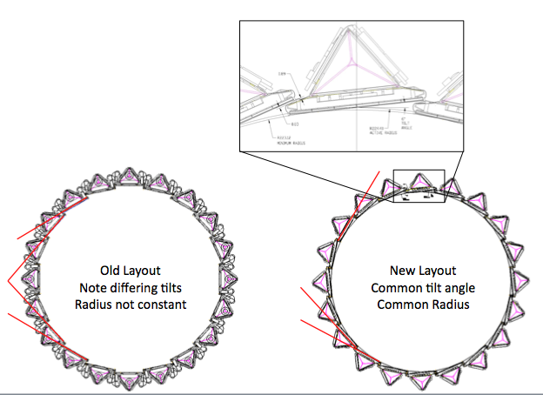
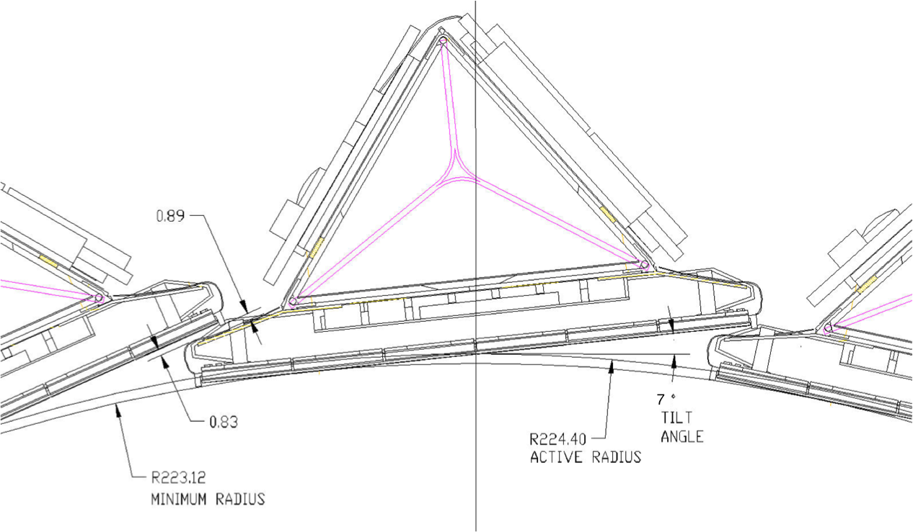
SSD mounting
Notes:
Radius reduced from 23cm to 22.4cm, resulting in better coverage:
Improved hermiticity:
It will be the 7degree tilt with something between 0.088 and 0.132 %overlap(i.e. hermetic). Old SSD had an 'average' -0.16% (negative, i.e. holes),calculation for different staves of old SSD Layout in lower left corner.Calculation for straight radial tracks, no curvature. 0.132 is 1 full strip overlap past the dead triangle.
The triangle corners where there is only one active trip are overlapped. What is not overlapped is the 1 mm gap around each module in the z direction. The wafers are 75 mm x 42 mm. The active area is 73 mm x 40 mm. So the net active area is 40/42 = 95%

Slide 23
New SSD ladder arrangement
Cooling plenum
Notes:
Cooling plenum is provided by mylar film

Slide 24
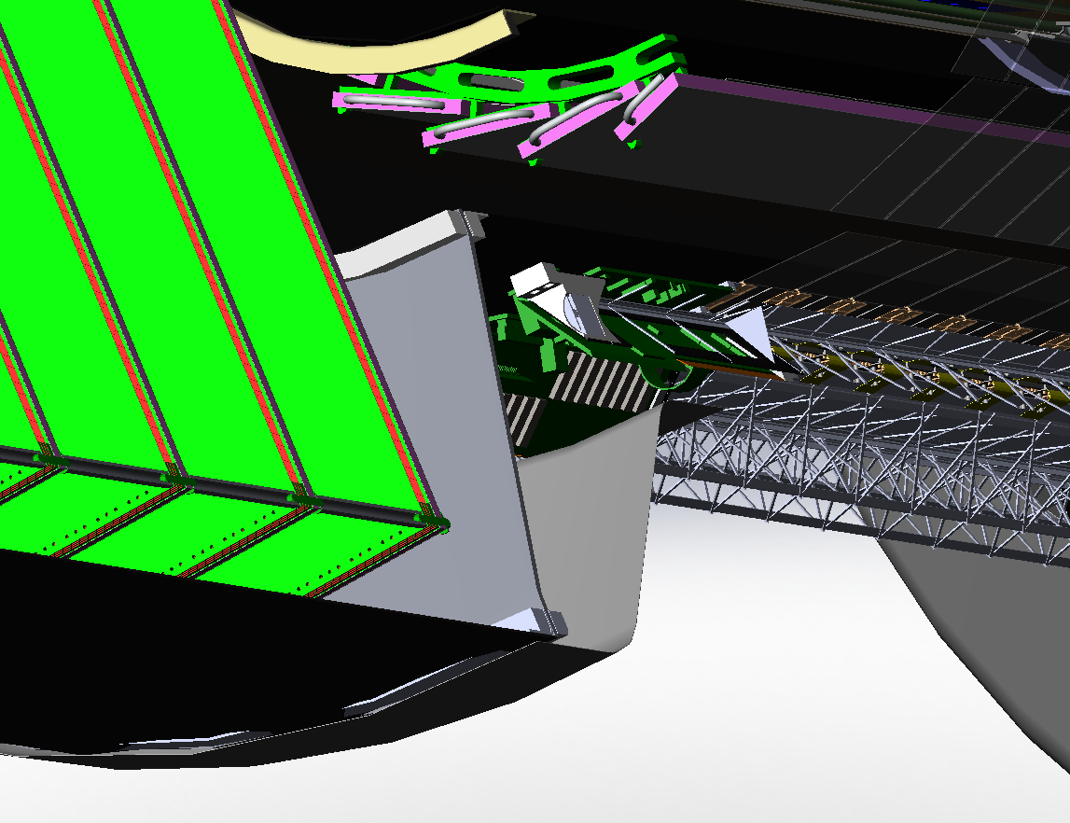
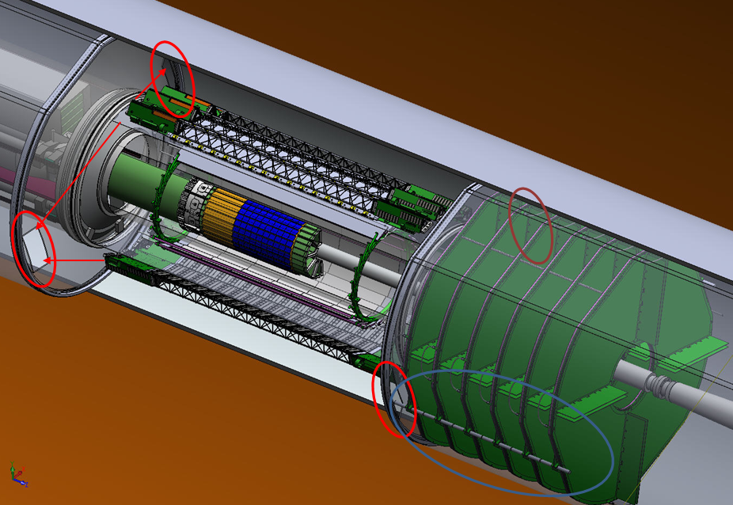
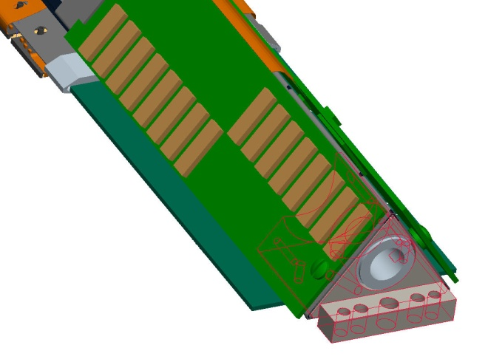
SSD services
LV/HV (no HV out West)
No Cooling out West
Air Taken from IFC Volume
Optical
Data/Control
Module
Connectors
(internal)
Chordal Gaps
Between FGT
And WSC Shell
Low Voltage Power in
On Both Sides
HV East Side Only
Air Coolant (suction)
East End Only
Notes:
Services (cables) pass through FGT chordal gaps
Vacuum plumbing attaches at East end

Slide 25
System overview
DAQ Room
North Platform
Cooling
DAQ Computers
The SSD is mounted on the OSC
SSD
WSC
ESC
South Platform
(RDO & Power)
RDO
LV/HV
PS

Slide 26
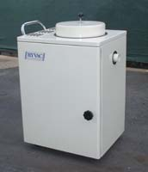
SSD cooling
Replace Vortex blower (76 kW)
Use maintainable vacuum
Reroute tubing
Instrument with temperature and flow measurements

Slide 27
SSD ladder power requirements
 | FEE (ladder modules) | Ladder cards | Total
Old SSD | 9.6 W | 10.0 W | 19.6 W
Upgraded SSD | 11.5 W | 13.6 W | 25.1 W
Notes:
Source: Christophe Renard detailed bottom up calculation
http://www.star.bnl.gov/public/ssd/STAR_operations.html#LadderStatus
says for old SSD, one ladder side, including C2D2 card and floatind part of ADC card:0.5A@-2V, 2.0A@+2V and 0.4A@5V that make 2.5A x 2V + 0.4A x 5V = 7W +-20%Remark1: voltage sense is done one the C2D2 card . So it is higher than the real voltage on the hybrids that must be as close as possible to +2V and -2V.Remark2: The non floating part of the ADC card was powered by the RDO card. It was around 200mA@+5V = 1W.
http://www.star.bnl.gov/public/ssd/STAR_technique/ssd_cooling_system_doc_2.pdf
says for old SSD, one ladder side:- without C2D2/ADC cards: 9.8W/2 predicted and 10W/2 measured.- only C2D2/ADC cards: 6W/2 predicted and 6W/2 measured- Costar = 44mW = 11mA x 4VIn v07, Table 70 says for one ladder side, without C2D2/ADC cards:- old SSD: 1356.352mA@-2V and 2674.73mA@+2V that make 4031.082mA x 2V = 8062.164mW- SSD upgrade: 1609.952mA@-2V and 2912.48mA@+2V that make 4522.432mA x 2V = 9044.864mW

Slide 28
SSD deliverables
Instrument 21 of the existing SSD ladders with new readout electronics compatible with the readout requirements for the TPC
42 ladder cards (2 per ladder) + 8 spares
8 RDO cards + 4 spares
SSD installed on the Outer Support Cylinder
Provide services including cabling and cooling compatible with the IDS and FGT

Slide 29
SSD WBS
1.4.1Electronics
1.4.1.1 Prototype
1.4.1.2 Production
1.4.2 Mechanics
1.4.3 Detector Assembly
1.4.4 Infrastructure
1.4.4.1 Cables
1.4.4.2 Cooling
1.4.5 Installation/Assembly
Notes:
1.4.1 Electronics: ladder cards, RDO boards
1.4.2 Mechanics: mounting hardware, cable supports and patch panels
1.4.3 Detector assembly: attach ladder boards to existing ladders, ship to assembly area for testing
1.4.5 Installation/Assembly: The completed ladders are mounted on the cone system. Alignment. Install cables on new cones.

Slide 30
SSD milestones
date | milestone
Q3 FY10 | Review of board layout for ladder board and RDO Start board (prototype) fabrication for both
Q2 FY11 | Finish testing ladder board @BNL (digital event processing only). Finish testing RDO @BNL. Integrated testing @ Subatech for both boards
Q3 FY11 | Develop slow controls and DAQ software
Q4 FY11 | Produce full complement of boards
Q4 FY12 | Move Full System to STAR for test
Q3 FY13 | Install completed SSD in STAR

Slide 31
SSD cost profile
Fiscal year | Base cost (K$) | Contingency (K$) | Total (K$)
FY10 | 120 | 30 | 150
FY11 | 110 | 20 | 130
FY12 | 220 | 120 | 340
FY13 | 210 | 120 | 330
FY14 | 0 | 0 | 0
Total | 660 | 290 | 950
Notes:
FY12-13 contingency: covers eventual replacement of entire power supply to provide maintainability over service life

Slide 32
SSD manpower profile (readout)
FY 2010
Renard (EE, Subatech) 30%, Scheetz (EE, BNL) 20%, Hammond (ET, BNL) 15%, LeVine (physicist, BNL) 100%
FY 2011
Renard (EE, Subatech) 20%, Scheetz (EE, BNL) 15%, Hammond (ET, BNL) 15%, Postdoc TBD (slow controls) 50%, LeVine (physicist, BNL) 100%
FY 2012
Postdoc TBD (slow controls) 50%, Hammond (ET, BNL) 10%, LeVine (physicist, BNL) 100%
FY 2013
Postdoc TBD (slow controls) 20%, LeVine (physicist, BNL) 60%

Slide 33
SSD manpower (cooling, mechanics)
FY 2010
Matis (Physicist, LBNL) 50% management
FY 2011
Matis (Physicist, LBNL) 50% management, Thomas (physicist, LBNL) 25% cooling
FY 2011
Matis (Physicist, LBNL) 50% management, Thomas (physicist, LBNL) 25% cooling, ME(TBD) 16% cooling integration
FY 2012
BNL MT (TBD) – cooling 15%, Matis (Physicist, LBNL) 50% management
FY 2013
BNL MT (TBD) – cooling 33%, Matis (Physicist, LBNL) 50% management

Slide 34
Risk assessment
WBS # | Description of Risk | Mitigation
1.4.1.1 | PCB layout oversights, low schedule risk | Schedule and budget include 2nd iteration of prototype boards
1.4.1.2 | Components (chips, DDL) become unavailable, moderate to high cost/schedule risk | Procure components as early as possible
1.4.1.1 | Readout of modules at 4.55 MHz produces unreliable results, low technical risk | Analog input to ADC observed – no problem exists up to 5 MHz
1.4.4.2 | Engineering time to generate manifold geometry and cooling tube routing plan may be underestimated, cost risk | Contingency, schedule float
1.4.4.3 | Completed tubing manifold cannot be installed because of interference from other components of HFT | Schedule float

Slide 35
New developments
Measured analog response at ADCs
Single event upsets and remediation
Improved zero-suppression
Integration issues being addressed
Cables, fibers, routing, grounding
Safety issues (grounding, floating PS, fuses, HV)

Slide 36
Analog response vs clock frequency
4.3 MHz
5.0 MHz
6.0 MHz
Horiz:100 ns/cm
Notes:
Observations using SSD ladder:
Analog signal from pulser on nearest module observed at ADC input
ADC aperture adjustable in 12 ns increments
100 ns/cm

Slide 37
Single event upsets
Ionizing radiation causes single bit errors in configuration memory (internal to FPGA)
Change FPGA behavior
Scale from observed error frequency in TOF
Estimate 1 error per 10 minutes in SSD
Must pro-actively detect these errors by running CRC checks while acquiring data

Slide 38
Improvement to zero suppression
Zero suppression based on preserving above-threshold strips
Want to retain neighbors as well
Problem: strips are not read out in order
Have to store them in intermediate buffer, in geographic order, before suppression
RAM has been added (larger FPGA)
Implementation will come later

Slide 39
Integration issues
Power cables will be Cu-coated Al
Cables to West (through FGT) are the most difficult due to limited area
Routing details being addressed
Grounding plan being integrated with other HFT subdetectors

Slide 40
Safety issues
Need to ensure that details will be approved by RHIC safety committee
Floating PS with safety resistors
Fuse protection for sense wires
HV considerations
HV is <100V, I < 0.1ma

Slide 41
SSD - summary
Design progressing well
Costs have been accurately estimated
Risks are minimal
No technical risks
Mitigation strategies in place

Slide 42
Spare slides
Spare slides

Slide 43
---- Backup material

Slide 44
Existing readout configuration
1 ADC reads 16 modules sequentially
ADC sampling speed: 3 MHz
Connection to RDO is via copper cable
Restricts RDO location to magnet face
1 RDO serves 10 ladders
Data link to DAQ computer oversubscribed
Performance of existing system:
Dead time @100 Hz: 30%
Dead time @ 750 Hz: >80%
Notes:
Existing readout: A single ADC digitizes 16 X 768 strips, sequentially @3MHz sampling rate.
10 ADC cards connected to a single [copper] parallel bus (30MHz)
Link from RDO to DAQ services 10 ladder sides @ 120 Mbyte/s
Designed to readout at 100 Hz. Meets this requirement

Slide 45
SSD mounting detail

Slide 46
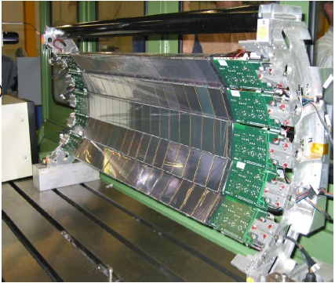
SSD: interior view
Notes:
One quarter of the SSD cylinder (5 ladders)
16 silicon modules on each ladder visible in this view
Readout electronics at both ends

Slide 47
Slow controls
Path from RDO to ladder defined
JTAG transported on fiber pair
Multiple paths from VME CPU to RDO possible:
FP JTAG connector
Compatible with existing software, hardware
Provides migration path
VME interface
Best performance
Requires software development

Slide 48
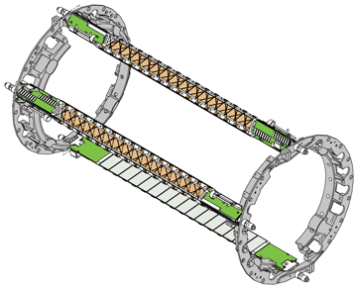
SSD with 3 mounted ladders
Notes:
3 ladders shown out of 20 total

Slide 49
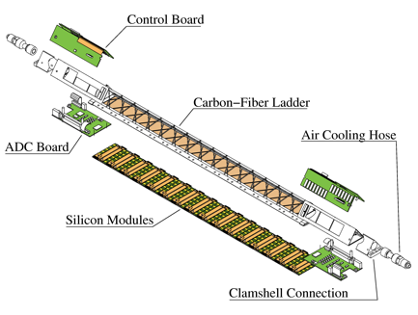
Ladder: exploded view
Notes:
Ladder consists of 16 modules. Each module has 2 faces, read out independently
Module: Si wafer 42 mm by 75 mm doubled sided with 768 strips on each side of the detector.
20 physical ladders, but from readout point of view, there are 40 faces (also called ladders)
P- and N- faces read out separately, from opposite ends of the same ladder

Slide 50
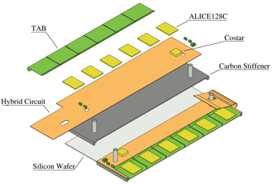
Module: exploded view
Notes:
Each face has 768 strips, connected to 6 ALICE128 analog multiplexers, connected in a daisy chain, read out at the end of the ladder

Slide 51
Complications to zero suppression
Want to keep nearest neighbors to above-threshold strips
Strips are not read out in order
Need to unscramble them on FPGA
FPGA on slave RDO upgraded to handle this
Will not be part of the baseline system

Slide 52
Cost details for SSD readout
RDO card (qty: 10)
Components $3080
Fabrication $ 910
Assembly $ 910
Total (each card) $4900
Ladder card (qty: 50)
Components $1920
Fabrication $1250
Assembly $ 300
Total (each card) $3470
DDL links (qty: 12)
SIU $ 670
½ DRORC $ 840
Total (per link) $1510
DAQ PC (qty: 2)
Each $2900
Total production cost:
$246.2K
Includes spares
Costs are burdened
Does not include prototypes

Slide 53
Data formats: zero suppressed
Only strips with ADC value above threshold are present
ADC value (10 bits) + strip location (14 bits)
One strip per 32-bit word
Alleviates large memory access burden on DAQ PC
Doing this in real time in FPGA is simple

Slide 54
Data flow: Ladder card
Each yellow box (x5) represents one ladder
Connection card + ADC card
Dual input ADC (x8) with bit-serial outputs
16 outputs feed 1 gigabit serializer
Green boxes: readout card
Connection to readout card
gigabit fiber pair per ladder

Slide 55
Dataflow: Readout card
Per ladder (5X):
Optical link
Deserializer
Slave FPGA
1 master FPGA
Manages data from the ladder FPGAs
Manages the DDL connection to the DAQ PC
Manages connection to TRG

Slide 56
Existing readout configuration
Notes:
Existing readout: A single ADC digitizes 16 X 768 strips, sequentially @3MHz sampling rate.
10 ADC cards connected to a single [copper] parallel bus (30MHz)
Link from RDO to DAQ services 10 ladder sides @ 120 Mbyte/s
Designed to readout at 100 Hz. Meets this requirement

Slide 57
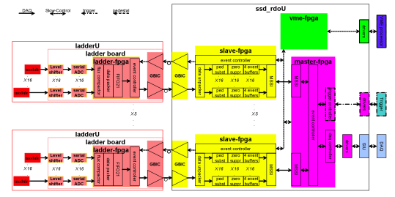
Data flow organization
Notes:
Note that RDO is organized around 5 (ladder-specific) slave FPGAs and a master FPGA (Christophe)
Each yellow box (x5) represents one ladder
Connection card + ADC card
Dual input ADC (x8) with bit-serial outputs
16 outputs feed 1 gigabit serializer
Green boxes: readout card
Connection to readout card
gigabit fiber pair per ladder
Per ladder (5X):
Optical link
Deserializer
Slave FPGA
1 master FPGA
Manages data from the ladder FPGAs
Manages the DDL connection to the DAQ PC
Manages connection to TRG

Slide 58
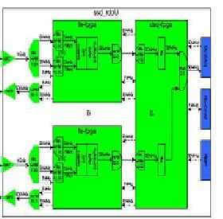
Readout components
RDO
Ladder card (1 of 5)
DAQ PC
Ladder card
(1 of 5)
DDL
Duplex fiber pair
South platform VME crate
Outer support cone
DAQ room
Notes:
Ladder-modular organization
5 ladders send data to a readout card
4 readout cards @ each end of SSD
Each readout card feeds a DDL link to a DAQ PC
A PC-based DRORC card hosts 2 DDL fibers

Slide 59
Funding profile
FY 2010 $150K prototyping
FY 2011 $25K shipping, tools, …
FY 2012 $250K production
FY 2013 $15K tools

Slide 60
SSD mechanical development
Replace Vortex blower (76 kW)
Use maintainable vacuum
Reroute tubing – avoid kinks
Instrument with temperature and flow measurements

Slide 61
Status: ladder board (analog)
16 x
Power switch (+2V & agnd)
No change
Hybrid (Alice128)
No change
Flex (<=1m long)
No change
connector (30p)
No change
Level shift (4V->2.5V)
Mux replacmt.
Serial ADC (12b,5MS/s)
16 instead of 1
Power measure (-2V)
No change
Notes:
The only change in the analog part is the ADC.
The 16 analog lines were multiplexed to 1 ADC.
Now, each analog line has a dedicated ADC.
The new ADC works at lower voltage, implying level shifting for the analog lines.

Slide 62
Status: ladder board (digital)
Power switch (+2V & agnd)
No change
x16 x1
temperature (x4)
Bias & latchup ()
No change
Power measure (-2V)
No change
slow control (JTAG)
Level shift (4V->2.5V)
SerDes (24b,40MHz)
gbic (1Gb/s)
Flex (<=1m long)
No change
Event ctrl (hold,test,clk,token)
debug (8b,usb)
Serial ADC (12b,5MS/s)
Data packer (5*16->4*20)
Notes:
The digital part of the ladder board is mostly new, due to the changes
from 1 to 16 ADC (now, we convert data from the 16 sensors at the same time),
from parallel ADC to serial ADC
from daisy chain copper bus to high speed serial optical line

Slide 63
SSD cost profile
Notes:
FY12 contingency bump to account for eventual replacement of power supply system to allow for maintenance during service life

Slide 64
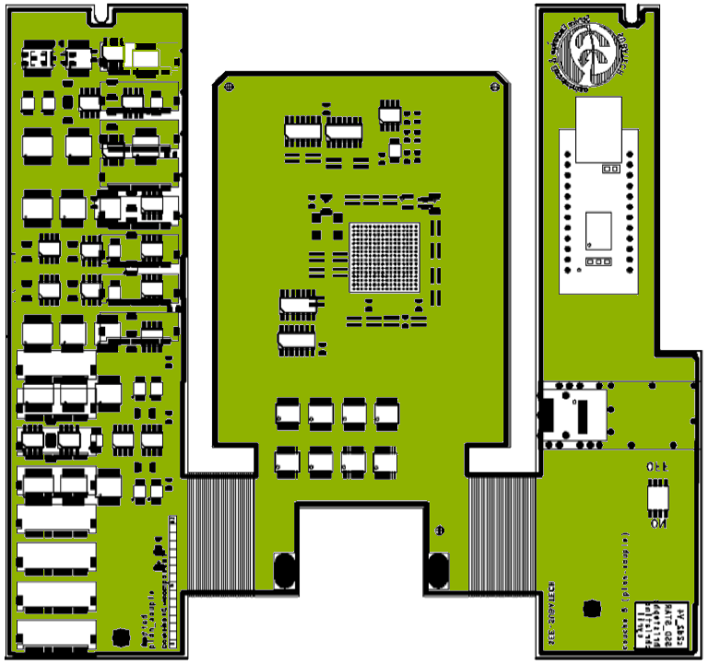
Ladder board PCB
Flex circuit layer
Notes:
Outline is done.
Main components are in.
Detailed place to be done before route.
Note: no connectors for inter-board connections

Slide 65
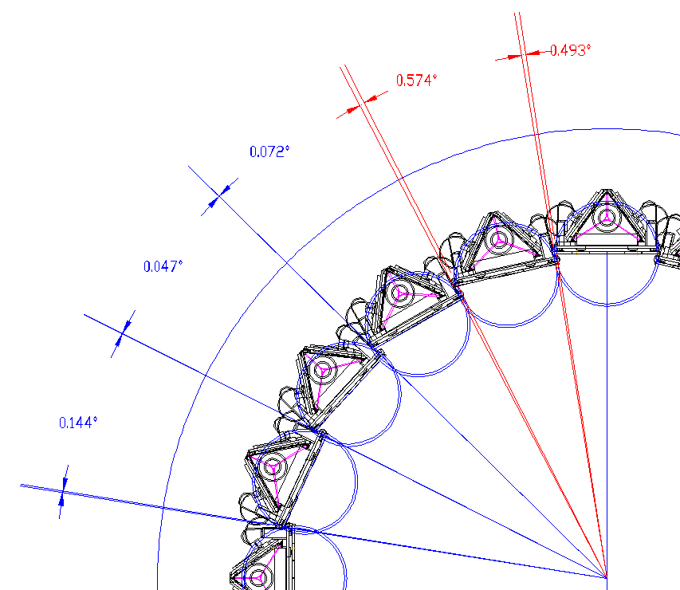
SSD original layout

Slide 66
Risk assessment
Digital design fully simulated
Oversights in layout
Schedule and budget allow for extra iteration in prototypes
Schedule impact
None (slack in schedule)
Cost impact
No impact foreseen on production costs

Slide 67
Upgrade overview
Ladder-modular organization
5 ladders send data to a readout card
4 readout cards @ each end of SSD
Each readout card feeds a DDL link to a DAQ PC
A PC-based DRORC card hosts 2 DDL fibers

