Slide 1
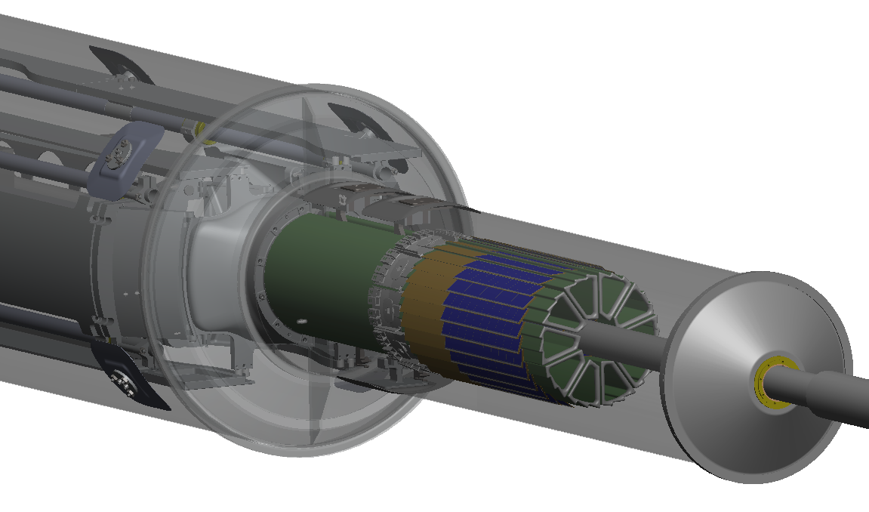
The STAR-PXL sensor and electronics
Progress report for FTF
LBNL
Leo Greiner, Eric Anderssen,
Thorsten Stezelberger, Joe Silber, Xiangming Sun, Michal Szelezniak, Chinh Vu,
Howard Wieman
UTA
Jerry Hoffman, Jo Schambach
IPHC Strasburg
Marc Winter CMOS group

Slide 2
Talk Outline
Technical progress
Expected progress for the next 6 months
Resource overview and needs
Slow control considerations, interlocks
Lab space needs at BNL

Slide 3
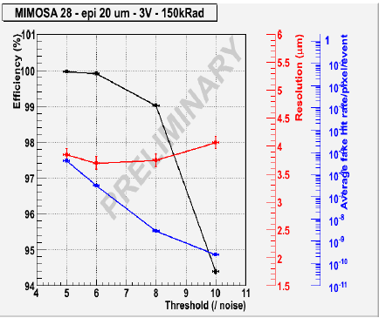
Technical Progress (Sensor)
Fabrication of Ultimate sensor pre-production prototype
Delivered March 24, 2011
Tested by IPHC
Meets PXL requirements and will be used for the prototype detector.
However: there are some caveats in the function of this pre-production sensor prototype.

Slide 4
Technical Progress (Sensor)
Functional anomalies of pre-production prototype
High power on current draw on VDDA – up to 500mA for un-configured sensors.
Analog marker does not function at 160 MHz
High dispersion in analog outputs.
VCLP regulator has low yield (possible ESD cause)
START has a 1 clock indeterminacy
SIZE
These issues will be addressed (as changes are prudent) in a redesign and resubmission to be done received by Q1 2012
http://rnc.lbl.gov/hft/hardware/docs/iphc_2011_05_05/news_ultimate_testing.pptx
http://rnc.lbl.gov/hft/hardware/docs/iphc_2011_05_05/UltimateTestResult.ppt

Slide 5
Technical Progress (RDO)
Pre-production RDO system has been designed
Board form factors have been established.
Design of RDO motherboard, daughter card, TCD receiver board, Xilinx flashXL PCB complete.
PCBs for above boards have been produced and loaded.
Power on tests are good.
See next 2 slides

Slide 6
Production System Design
We will use the 9U VME physical standard for RDO motherboards. (Not the electrical standard)
1 standard VME crate with P1 backplane for STAR TCD distribution.
Data from sectors arrives via cables plugging into the back of the RDO boards in the P2/P3 locations.
System consists of:
10 double wide 9U VME RDO boards
1 single wide 6U VME TCD board
SIU
SIU
SIU
SIU
SIU
SIU
SIU
SIU
SIU
SIU
STAR TCD
Daughter Card
Daughter Card
Daughter Card
Daughter Card
Daughter Card
Daughter Card
Daughter Card
Daughter Card
Daughter Card
Daughter Card
356 M pixel readout in a single 9U VME crate
USB
USB
USB
USB
USB
USB
USB
USB
USB
USB
JTAG
JTAG
JTAG
JTAG
JTAG
JTAG
JTAG
JTAG
JTAG
JTAG
Standard 21 slot 9U VME crate

Slide 7
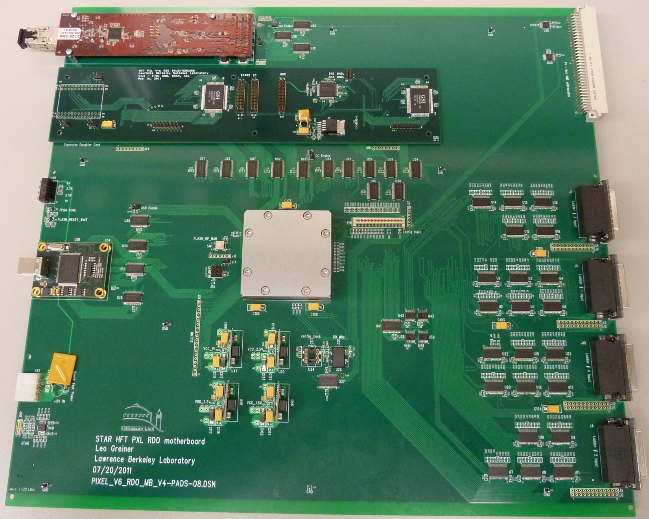
Production Prototype RDO board
SIU
VME P1
Daughter
Card
USB
Ladder
Data
Connectors
JTAG
Xilinx Virtex-6 FPGA

Slide 8
Technical Progress (Latch-up)
Completed tests of LU and SEU for Ultimate sensor, Mimosa-26 and all components to be used in the ladder and MTB in testing at the 88” cyclotron at LBNL.
Completed a test of Mimosa-26 sensors run in STAR for the last running period. ~ 1 week of protons and full run of Au.
Estimate of LU events for STAR running of full detector is .3 / hr. (scaling with radiation field)
LU and SEU onset LET in sensors is consistent with previous measurements.
LU and SEU onset LET for ladder and MTB components is higher than for sensors.
http://rnc.lbl.gov/hft/hardware/docs/iphc_2011_09_05/Summary%20of%20latch-up%20measurements.ppt
http://rnc.lbl.gov/hft/hardware/docs/iphc_2011_09_05/M26_in_STAR.ppt

Slide 9
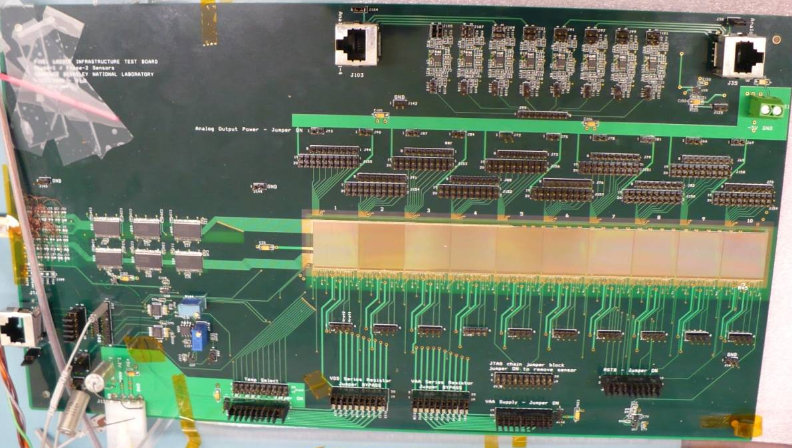
Technical Progress (Ladder)
ITB Testing
10 Phase-1sensors in ladder configuration
The performance of Phase-1 sensors is independent of the ITB configuration, especially the number of high-frequency decoupling capacitors on the board. Both, analog and digital readout modes confirm this observation. The performance is not degraded even after removing all small capacitors associated with VDD, VDA and VCLP voltages.
Test results obtained from threshold scans suggest that the bus-type power distribution provides, on average, a slightly better noise performance but with an increased FPN.
Analog test results for the bus-type power distribution indicate that there is no noticeable degradation of the sensor performance.
http://indico.cern.ch/getFile.py/access?contribId=16&sessionId=7&resId=0&materialId=slides&confId=144152

Slide 10
Expected Progress for next 6 months
Test and validate new pre-production RDO system.
Beam test Phase-1 and Ultimate sensor telescopes at CERN beam test.
Design and fabricate Ultimate based ladder cable.
Complete probe testing system for Ultimate sensors.
Procure and dice/thin 12 wafers of Ultimate sensors.
Begin testing of Ultimate based ladder cable.
Produce kapton/Cu cable design.
Re-design of pre-production MTB boards.
Begin production of RDO production boards.
Complete cable length tests with new VHDCI based data transmission cables.
PXL safety review.

Slide 11
Resource overview and needs
In addition to myself, Xiangming Sun, Michal Szelezniak and Jo Schambach we anticipate needing the following engineering assistance;
Engineers have been located and mostly committed at the proper level of effort based on the task needs. (Note – TS and CV will use less hours than what is in the schedule)
Other than the sensor procurement (already placed), we do not expect to make any large (>$50k) procurements in the next 6 month period.

Slide 12
Slow Control Considerations / interlocks
Status of RDO system is monitored on event by event status based on headers transferred to control PCs.
Information transfer on PC via shared file was agreed with Yuri.
This is a longstanding agreement, subject to change under implementation by Jo. If changes are made, they will likely be to make the interface and perhaps underlying structures like the TOF.
Agreement with Tonko and Jeff is that we provide a script that configures the detector and puts it into run mode. This script will be called by STAR configuration control. It will return a status word.
Interlocks will be based on air flow sensors for the cooling air system for PXL. This should be a conventional STAR system to cut power to the sensors.
The interface of typical slow control functions – VME crate power, programmable power supply power, etc. and alarm table definitions are yet to be fully defined.

Slide 13
Lab Space needs at BNL
PXL Lab space needs at BNL are quite moderate. I estimate:
1 desk
1 locker
1 workbench
Sufficient floor space to accommodate above.
(this assumes that spares are located in the clean room)

Slide 14
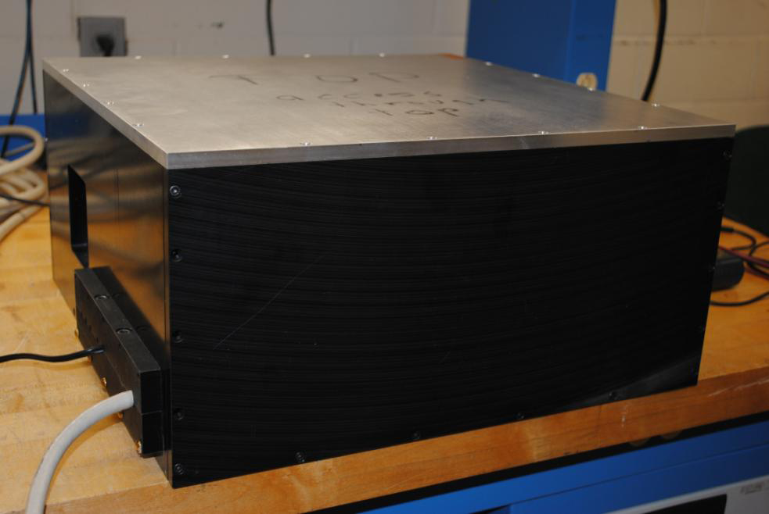
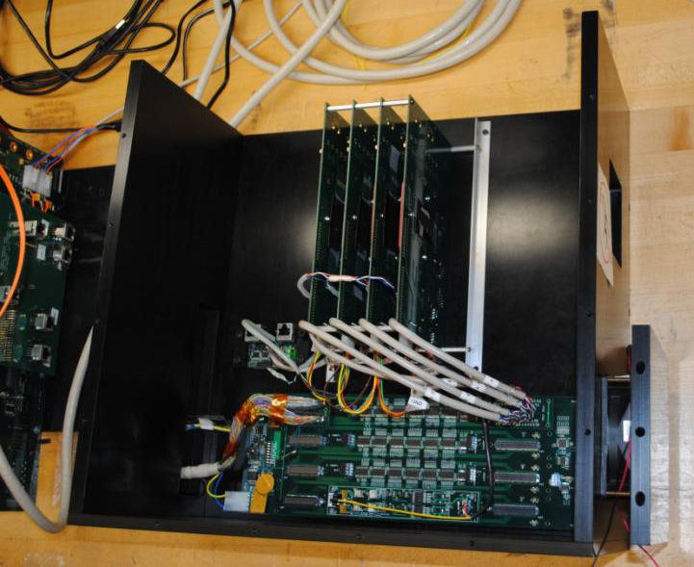
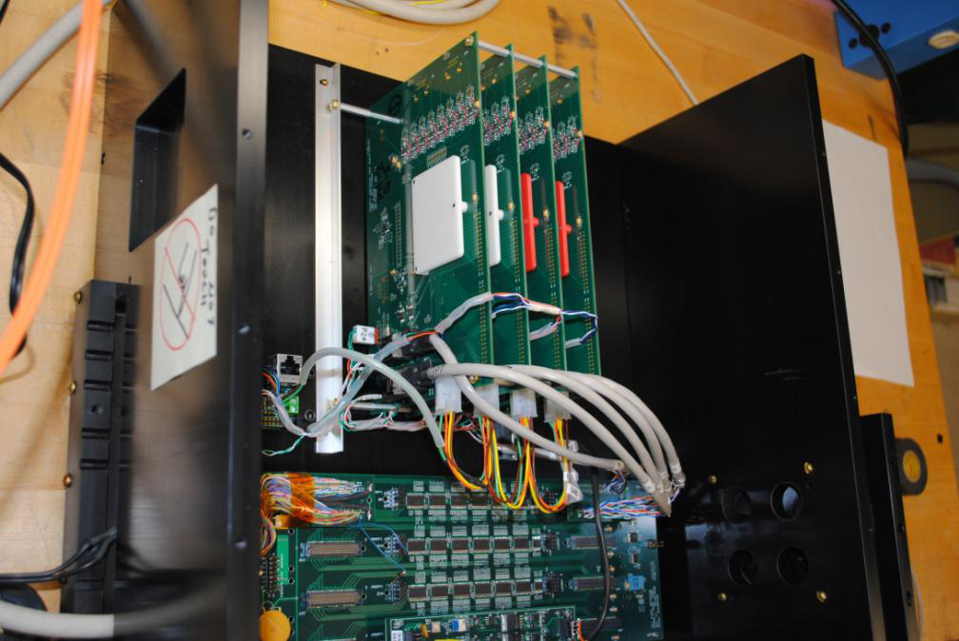
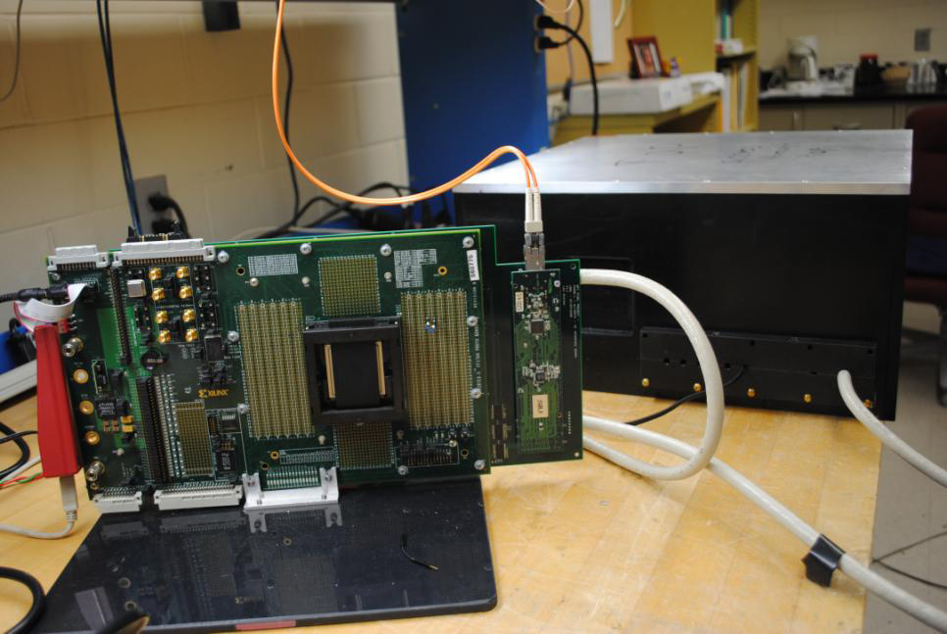
PXL Telescope test pictures

