Slide 1
GEANT MODELING AND COMPARISON WITH SOLIDWORKS MODEL
Jonathan Bouchet

Slide 2
outline
Overview of the AgML implementation of the PIXEL detector (PXL), Middle Support Cylinder (MSC) and beam pipe.
Beam Pipe :
Comparison with BrushwellMann drawing.
Radiation length, dimensions.
PXL and MSC :
Comparison of SolidWorks model (SW) and GEANT modeling :
The details of implementation (naming, dimensions of volumes).
Check of radiation length.
Disclaimer : this talk only covers the details of the geometry implementation ; STAR-software (reconstruction, etc..) issues are addressed in the next talk.

Slide 3
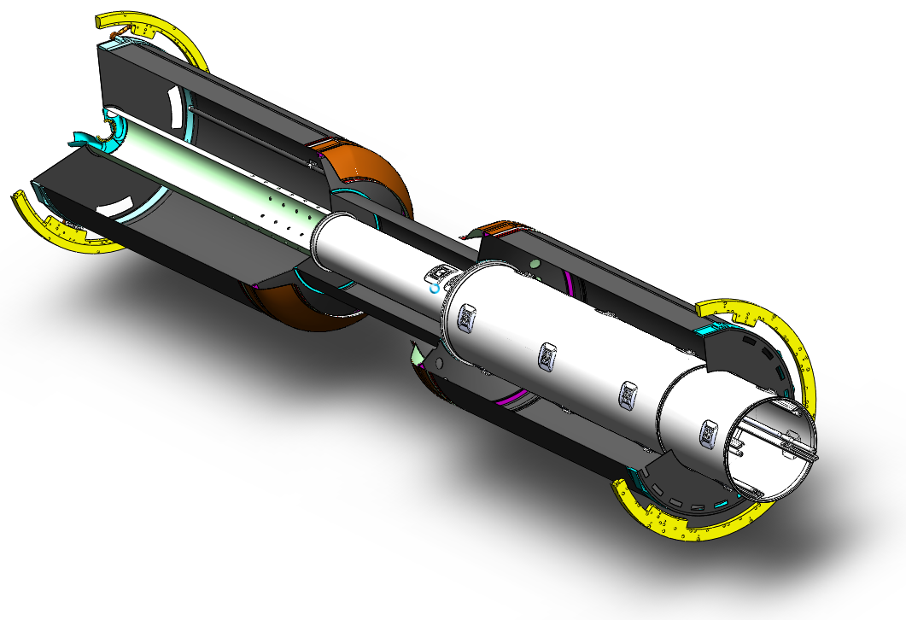
SW model of the PXL+MSC
Pixel Support
Tube (PST)
Pixel Insertion
Tube (PIT)
Middle Support Cylinder = PST + PIT

Slide 4
AgML : Abstract geometry Model Language (*)
STAR geometry is implemented in the Advanced Geant Interface (using GEANT3) :
Mortran pre-processor.
Several source codes are used for 1) simulation 2) conversion to TGeo (reconstruction) 3) conversion to Sti (tracking).
Sti cannot handle complex shapes.
No path forward to GEANT4, …
Change to AgML will allow :
Use of better simulation packages (GEANT4).
Unified geometry model : no differences in simulation, reconstruction and tracking.
Remove dependence on Jurassic technologies such as Mortran and ZEBRA.
(*) J. Webb : -Collaboration Meeting, tracking review
-STAR upgrade workshop

Slide 5
Representation of radiation length
Estimation of material budget for geometry dev13 [AgML].
Use of the existing command line in STARSIM to plot the material for a given window η,φ, Rmin, Rmax.
Use of StarBASE (*) code plot radiation length vs.η,φ :
Parameters :η,φ ranges, binning , as well as the number of triggers per bins can be set up : more handy than the STARSIM command.
It plots the radiation length for a given GEANT volume, not by choosing the [Rmin,Rmax] range from the STARSIM command.
Both methods use 10GeV geantinos.
(*) : http://drupal.star.bnl.gov/STAR/blog/jwebb/2010/feb/11/
howto-generate-geometry-material-differential-plots-using-starbase

Slide 6
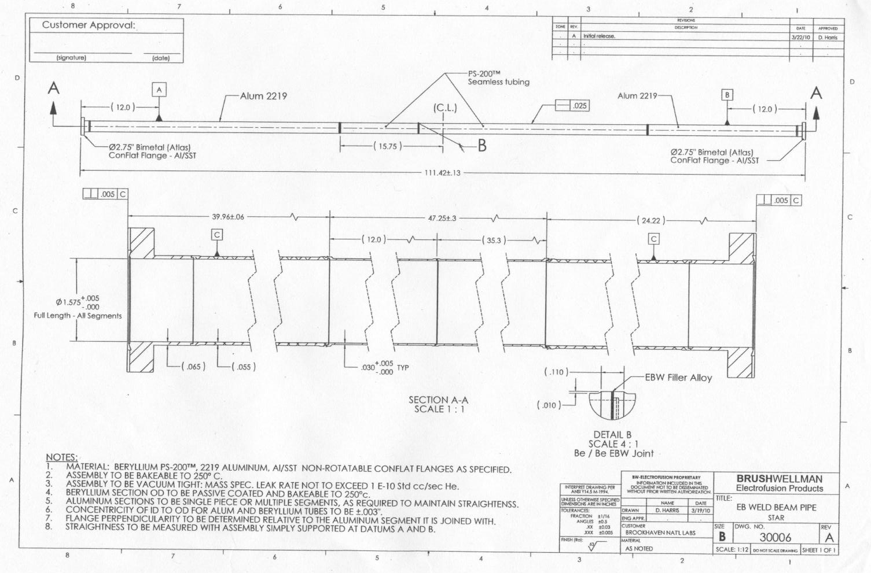
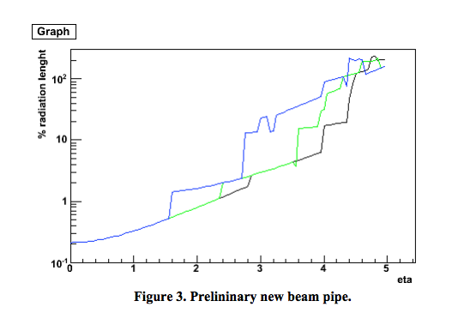
1.New Beam Pipe
Vertices :
30cm (blue)
0.cm (green)
-30.cm (black)
The input was the Brushwellman drawing.
Coded as 3 sections of aluminum (edges) and beryllium (central part).
For |η|<1, the estimated radiation length is ~ 0.2-0.3 % X₀
Figure3 : “Effective Thickness of the HFT Beam Pipe,. Beavis, August 26, 2009”
*Beam pipe has been coded by Amilkar Quintero

Slide 7
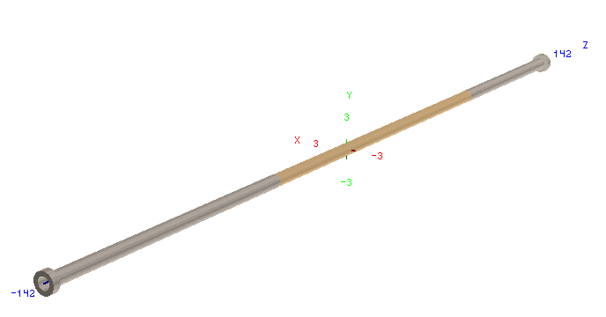
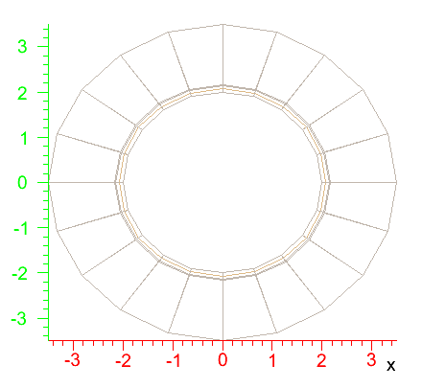
Dimensions of the beam pipe
Note : the length of the flanges is arbitrary
because it was not specified in the drawing.
 |  |  |  | flange
Zrange (inches) | -54.71 ; -15.75 | -15.75 ; 31.5 | 31.5 ; 55.71 | -55.71; -54.71
Rmin;Rmax (inches) | 0.7875; 0.8525 | 0.7875; 0.8175 | 0.7875; 0.8525 | 0.7875; 1.375
Material | Aluminum | Beryllium | Aluminum | Aluminum

Slide 8
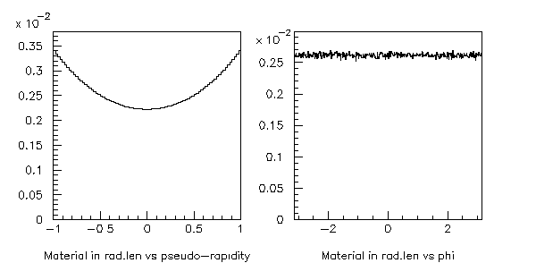
Radiation length of the beam pipe
For |η|<6
For |η|<1

Slide 9
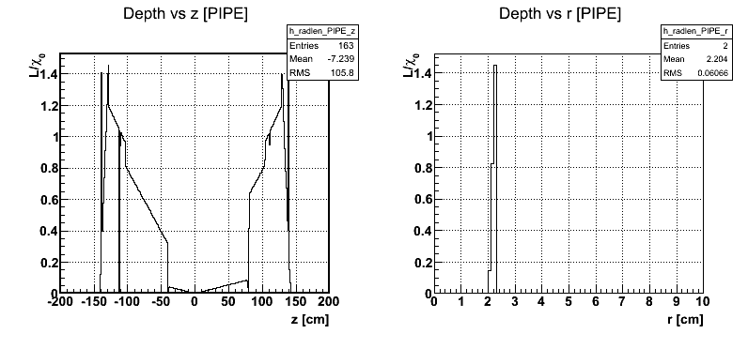
Radiation length of the beam pipe
The dimensions (length, radii) are agree with the Brushwellman drawing.
As seen in previous slide, there is more material budget for large Z :
in the central region where the pixel stands, the radiation is very low.

Slide 10
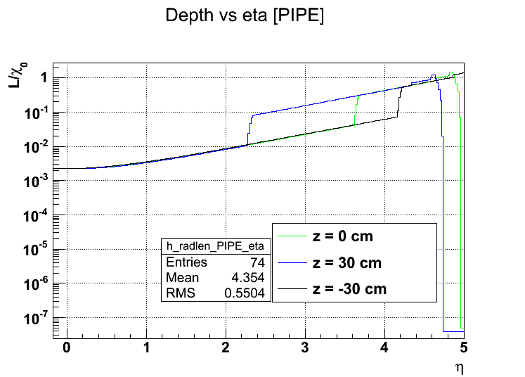
Comparison of the radiation length
~3-4.10⁻² X₀
~3.5%X₀
The ordering of the radiation length profile vs. vertices positions is OK but the eta values of the change in profile are not completely agree
Compatibility of both simulations ?

Slide 11
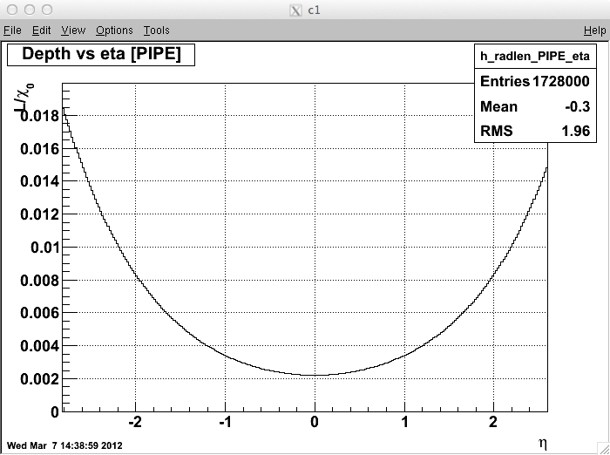
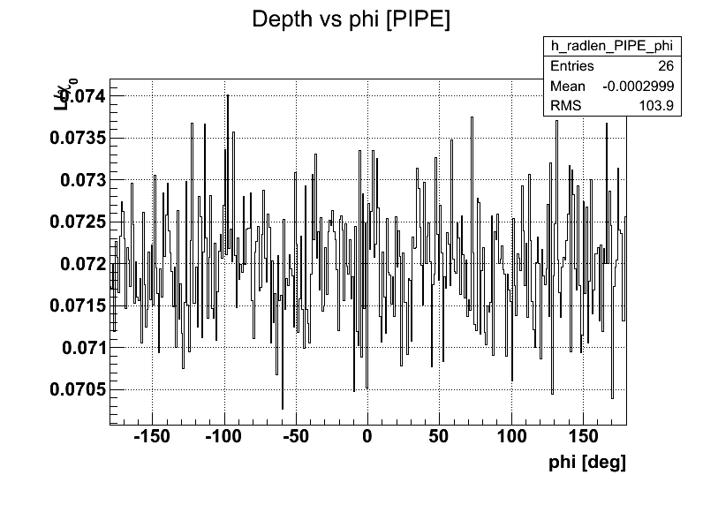
Comparison between methods used to plot the radiation length
STARSIM
StarBASE
The radiation length vs. η(top) and φ (bottom ) shows the SAME profile for both methods.

Slide 12
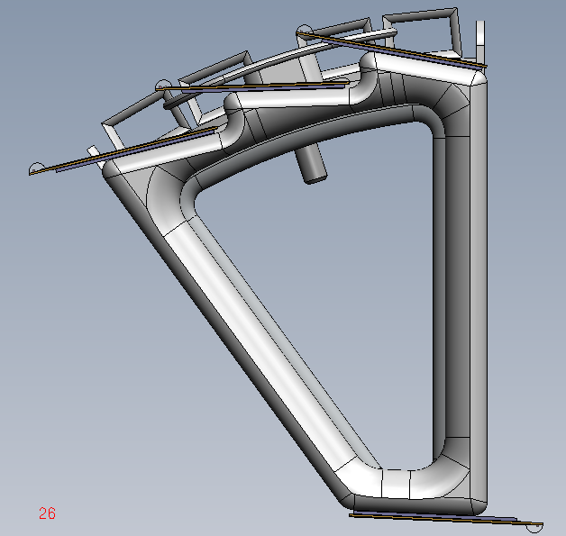
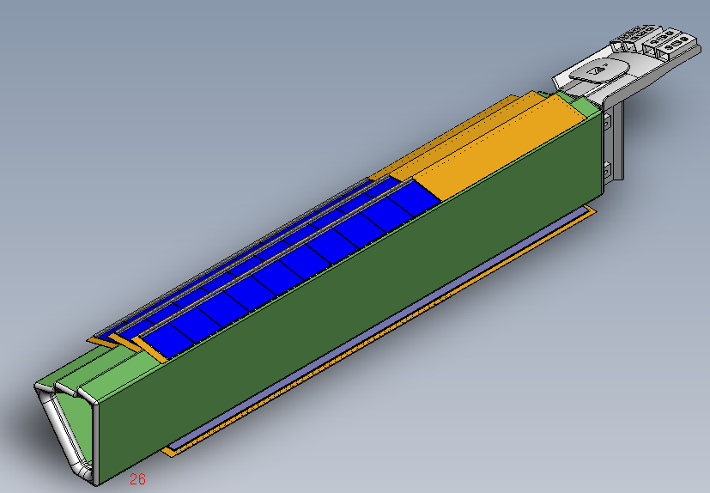
2.PXL (SW)
The input for the PIXEL (ladder + sector) dimensions/shapes is the SW representation.
Flemming has done a translation of SW model to TGeo geometry.
It provides directly the shape, dimensions of the elements and then simplifies their implementation in AgML.
The idea was to code 1 sector and then duplicate it x10

Slide 13
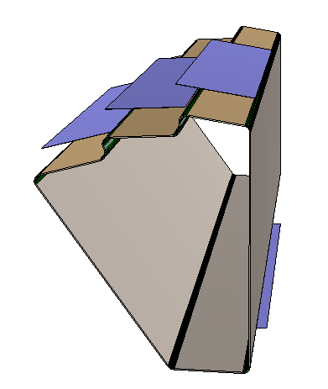
1st iteration : Sector Support + active silicon
This is the first version (in CVS since december) of the PXL in AgML.
Volume naming convention.
PLAC = active silicon ladder : it was the name used in UPGR15.
PXCA-PXCB-PXCC-PXCD,PXCE
PXCF,PXGH,PXCH are the corners, starting from the bottom right (⬆) :
PiXel Corner A …
PXTR-PXTM-PXTL are the
planes supporting the active silicon
on the top :
PiXel Top Right , PiXel Top Middle,
PiXel Top Left.
PXTJ are the 2 planes joining the planes on the top :
PiXel Top Join
PXLB, PXRB, PXIB are the planes on front of the beam pipe and between 2 sectors (Pixel Low Beam, Pixel Rear Beam , Pixel Inner Beam).
(⬆)

Slide 14
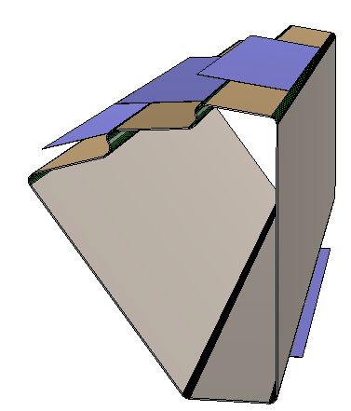
PXTM
PXTR
PLAC
PXTJ
PXRB
PXTL
PXLB
PXIB

Slide 15
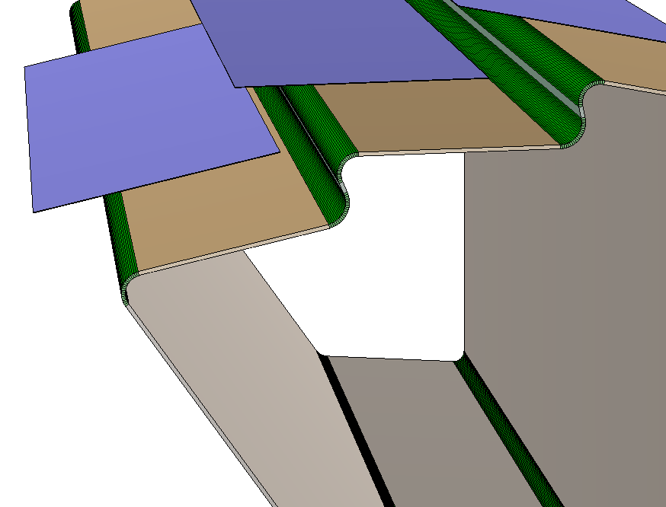
plane
arc

Slide 16
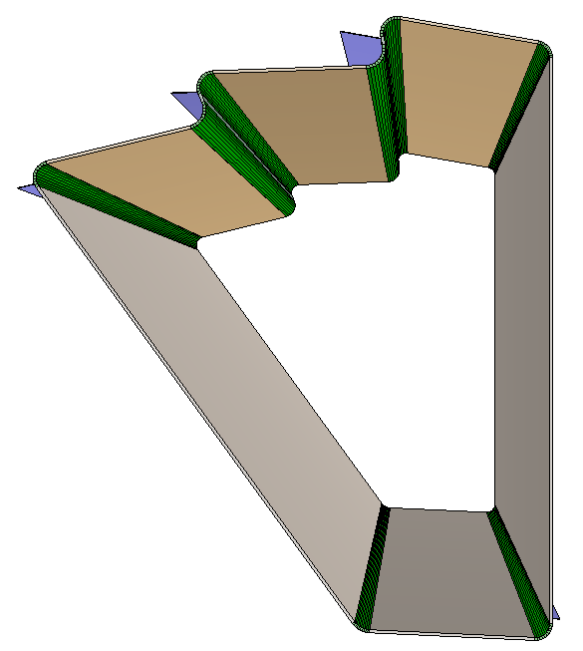
PXCD
PXCC
PXCE
PXCB
PXCF
PXCG
PXCA
PXCH

Slide 17
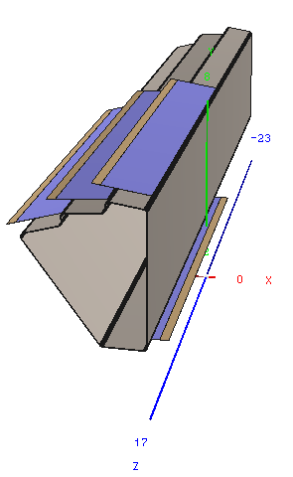
2nd iteration : fine details of a Ladder
thickness
PLAC
: active silicon
r/phi dimension
SIFL SIFR : passive silicon
Notes:
This volume needs a precise description since it includes all the materials that make possible the low radlen achievable → need to be reproduce for physics description

Slide 18
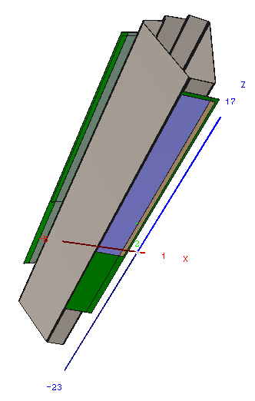
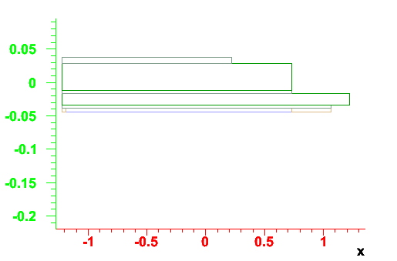
All layers together
GLUC : glue (adhesive)
CFBK : Carbon Fiber BacKing
thickness
r/phi dimension
GLUA, GLUB : glue (adhesive)
ALCA : Aluminum Cable

Slide 19
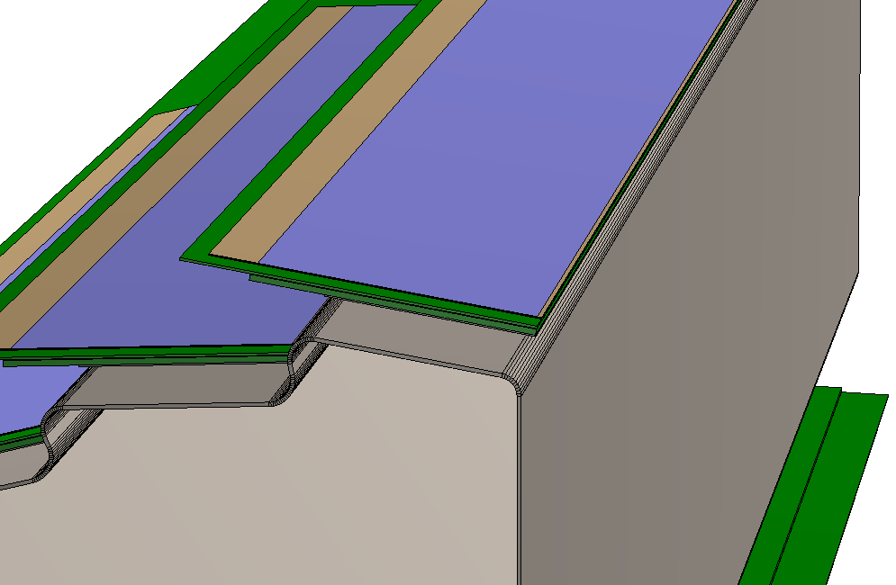
Layer of active silicon
Layer of
passive silicon

Slide 20
Summary of material budget
GEANT NAME | piece | shape | Composition / mixture | Radiation length [cm] | Density[g/cm³]
PLAC | Silicon active | box | Si | 9.36 | 2.33
SIFR | Silicon passive | box | Si | 9.36 | 2.33
SIFL | Silicon passive | box | Si | 9.36 | 2.33
GLUA | adhesive | box | O(0.164) C(0.763) H(0.073) | 34.7 | 1.2(*)
GLUB | adhesive | box | O(0.164) C(0.763) H(0.073) | 34.7 | 1.2(*)
GLUC | adhesive | box | O(0.164) C(0.763) H(0.073) | 34.7 | 1.2(*)
ALCA | Aluminum cable | box | Al | 23.7(*) | 2.7(*)
CBFK | Carbon Fiber backing | box | C | 68(*) | 1.3(*)
(*):forced
Calculated by GEANT

Slide 21
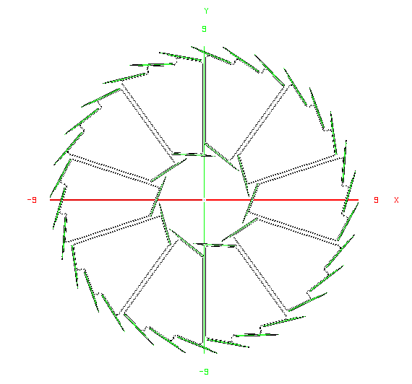
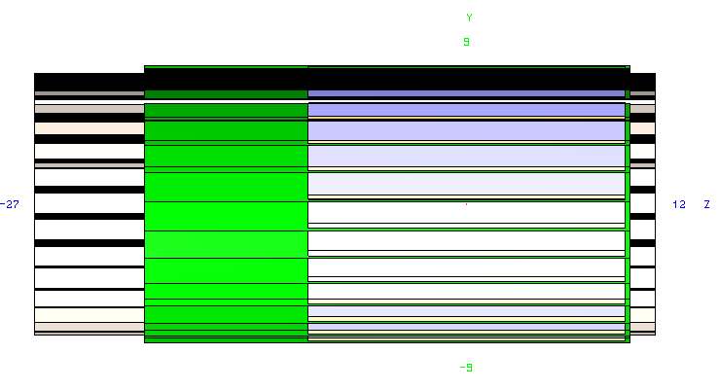
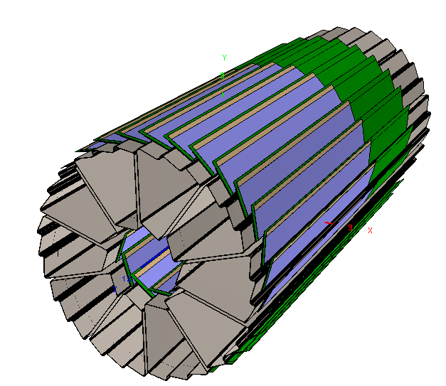
Overview of the PIXEL

Slide 22
PIXEL DETECTOR radiation length
For |η|<3
For |η|<1

Slide 23
PIXEL DETECTOR radiation length , for |eta|<.5
Peaks in the azimuthal profiles comes from tracks crossing the entire pixel support.
Other small peaks are the overlaps between ladder.

Slide 24
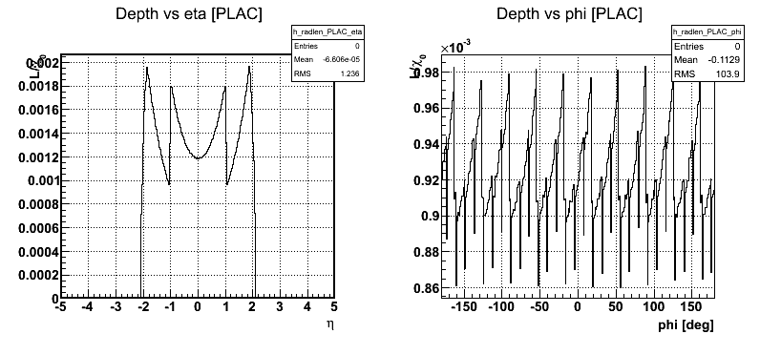
SILICON SENSITIVE radiation length
For 1 layer of active silicon, the expected radiation length is 0.0677% (see slide 40).
then for 2 ladders (inner and outer), the radiation length should be : 0.1354%

Slide 25
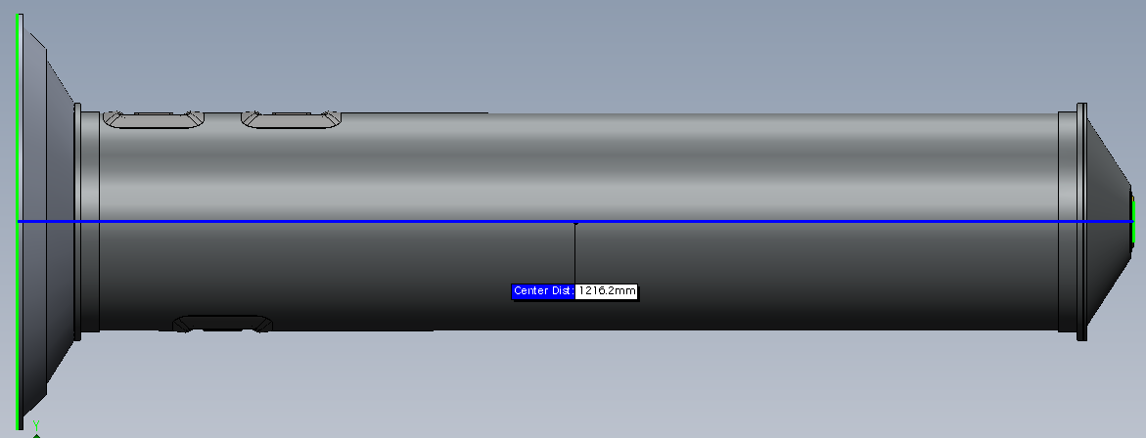
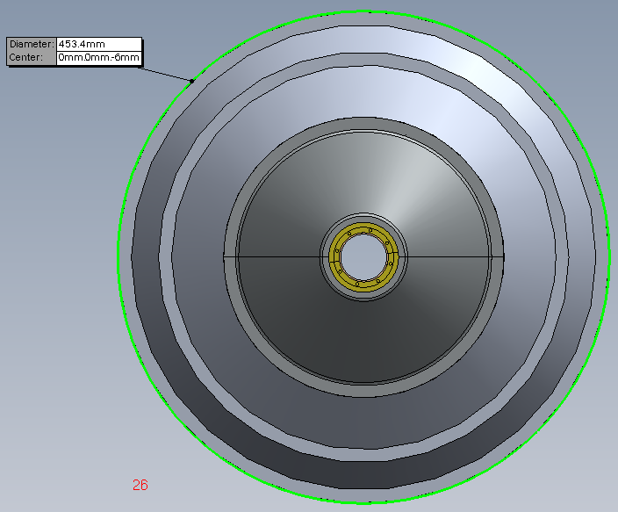
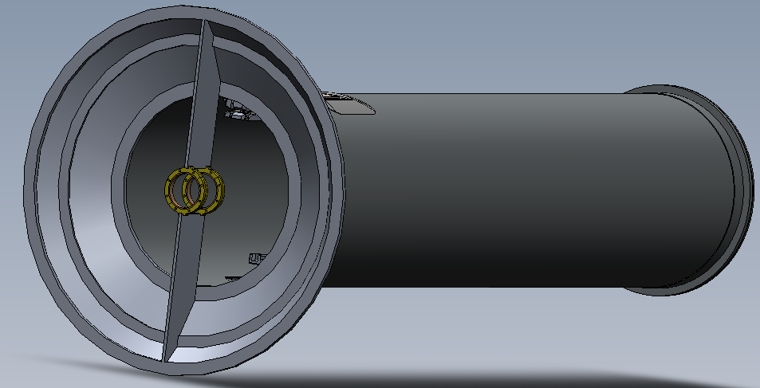
3.1 SW model of the PST

Slide 26
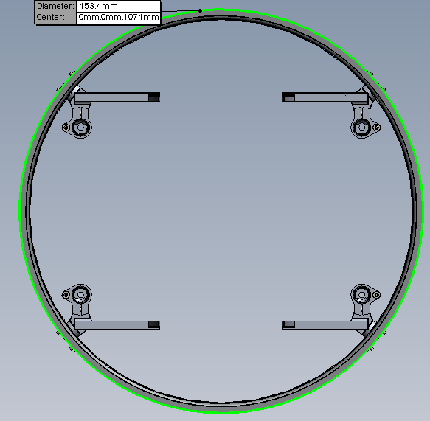
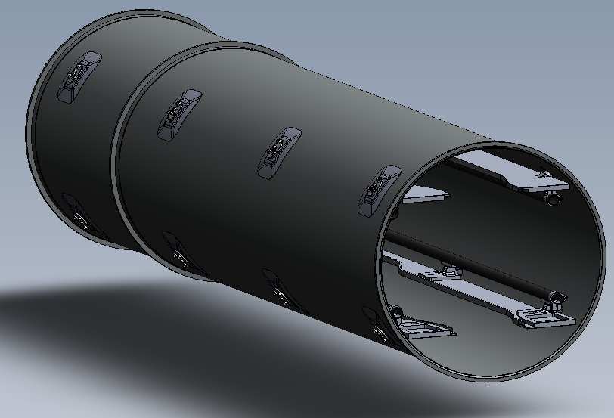
3.2 SW model of the PIT

Slide 27
Example of implementation
LFBA : Left Flange Base part A
LFBB : Left Flange Base part B
LFBK : Left Flange BacKer
APTS : A Pipe Tube Shell
Length(Z) = 25mm
Outer1 = 239 mm
Inner1 = 237 mm
Length(Z) = 1mm
Outer2 = 259mm
Inner2 = 239mm
Length(Z) = 6mm
Outer = 259mm
Inner = 239 mm

Slide 28
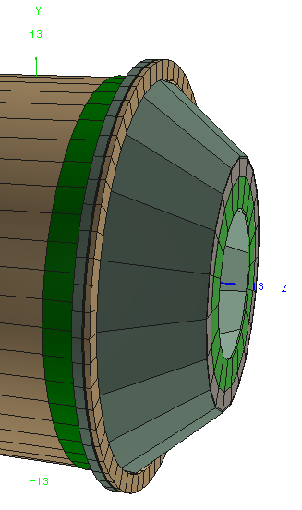
Example of Naming convention : beam pipe support cone
RFBA : Right Flange Base part A
RFBB : Right Flange Base part B
RFBK : Right Flange BacKer
ABPR : A Beam Pipe Ring
BPPC : Beam Pipe PolyCon
EBPP : End Beam Pipe Polycon
RBPP : Ring Beam Pipe Polycon

Slide 29
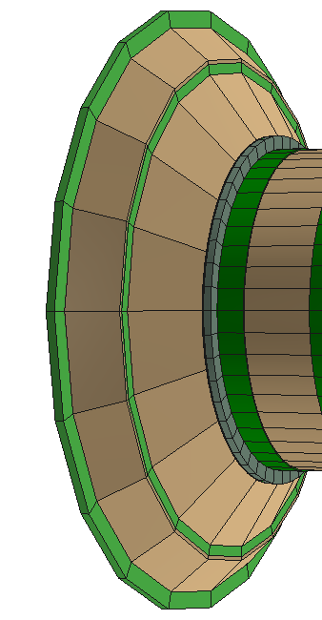
Example of Naming convention : MSC transition plate
MTPA : Msc Transition Plate part A
MTPB : Msc Transition Plate part B
MTPC : Msc Transition Plate part C
MTPD : Msc Transition Plate part D
MTPE : Msc Transition Plate part E
29

Slide 30
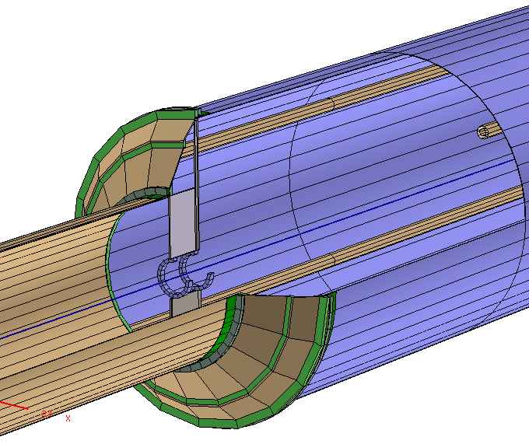
Overview of the MSC
rails
Rings surroundings
the beam pipe
GEANT NAME | piece | Composition / mixture | Radiation length | density
ALL(*) | Carbon Fiber | C | 23.9 | 1.3(*)
: temporary until
implementation of
real material (slide 39)

Slide 31
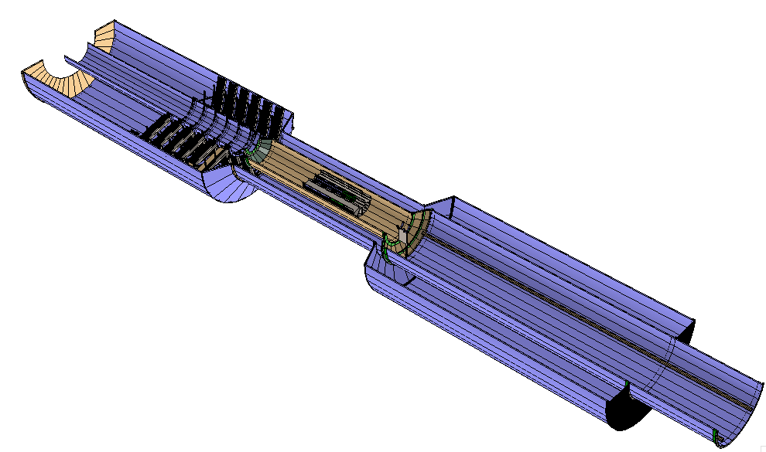
AgML model
FGT
PIXEL
PST
⬆
PIT
SW model
Note : in this version, the inner radii of the IDSM (⬆)
has been changed from the coded value in order to avoid
overlap with the PIT.

Slide 32
GEANT Volumes : Hierarchy
Volumes have to be organized by level in order for GEANT to find energy loss, impact point in each volumes/layers.
The current status is :
The IDSM includes the PIXEL and MSC.
➔Issue : the MSC has a larger Z extension than the IDSM.
The beam pipe is at the same level of the IDSM.
The IDSM does not include the beam pipe.
➔Issue 1 : the beam pipe has a larger extension in Z than the IDSM.
➔Issue 2 : the beam pipe is inside the PIXEL, therefore it should be placed INSIDE the PIXEL/IDSM.
The MSC is placed with respect the center of the IDSM.
It is then placed at the center of STAR.
The pixel detector is not placed at the center of the IDSM because the active silicon are not symmetric along a ladder.
there’s a offset of the whole sector in order to have the center of the active silicon placed at (0,0,0).

Slide 33
CAVE
PIPE
IDSM
All the other detectors
Pixel :
main volume
Pixel : MSC
FGT
FGTM
PXMO
PSTM
PXLA_1
PXLA_3
Sector : main volume
PXLA_10
…
…
LADR_1
LADR_2
LADR_3
LADR_4
PLAC_1
SIFR
SIFL
Ladder : main volume

Slide 34
Radiation length breakdown
Left : using StarBASE ; it does not include the beam pipe material.
Right : using STARSIM ; it does include all material (beam pipe + PXL + FGT + IDSM) in |eta|<3
There is more material (red histogram) for the PXL in eta<0 (Z<0) because the silicon ladder is asymmetric with respect the ladder support.

Slide 35
summary
PIXEL detector geometry has been implemented in AgML.
It has the fine details inherent to the PIXEL/CMOS sensor and then necessary for tracking evaluation.
The support material of the PIXEL, as well as the new beam pipe (requirement) have also been implemented.
Material, radiation length and dimensions look agree with the input source (SW, Brushwellman drawing).

Slide 36
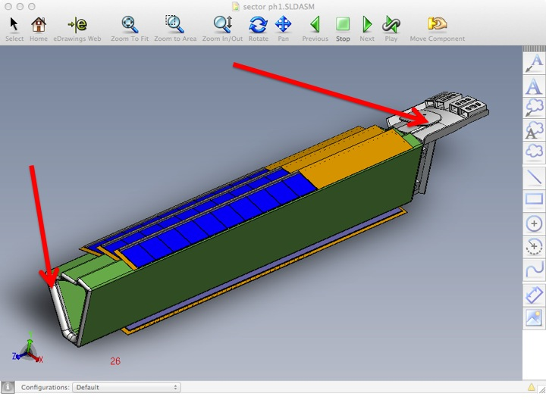
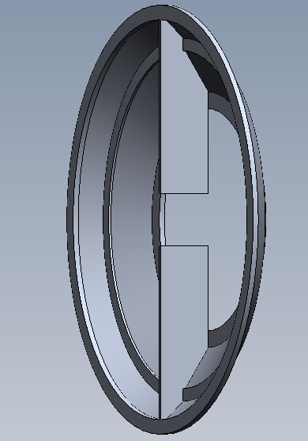
Next steps
Refine material budget for the MSC (slide 39)
Remaining “big” parts of the MSC and some corrections :
Representation of ladder’s cables (slide 38)
Look at the GEANT tree for optimization.
shrouds

Slide 37
end

Slide 38
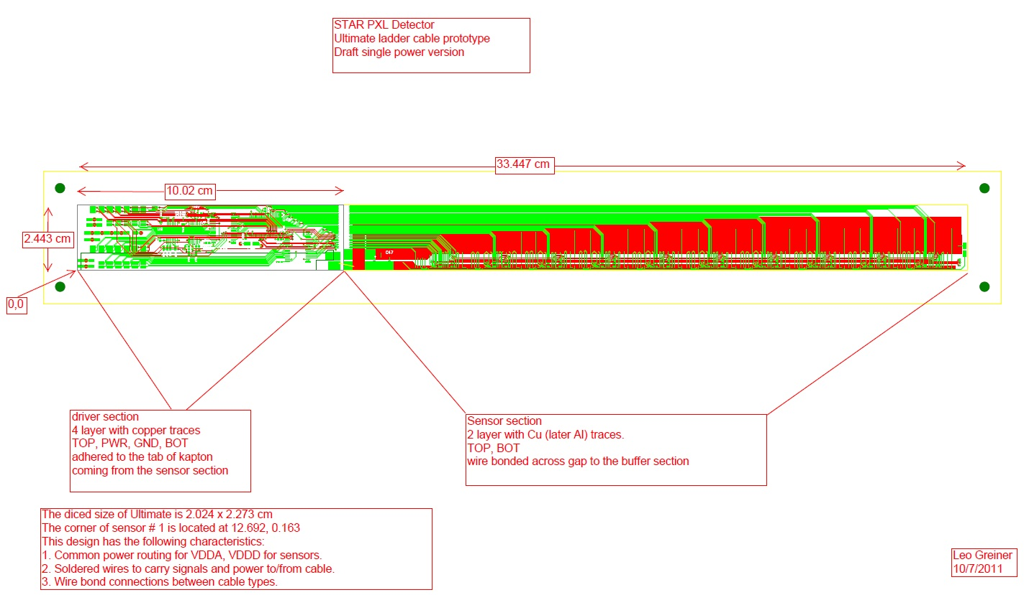
Cables on a ladder

Slide 39
Material for some parts of the MSC
From Joe Silber

Slide 40
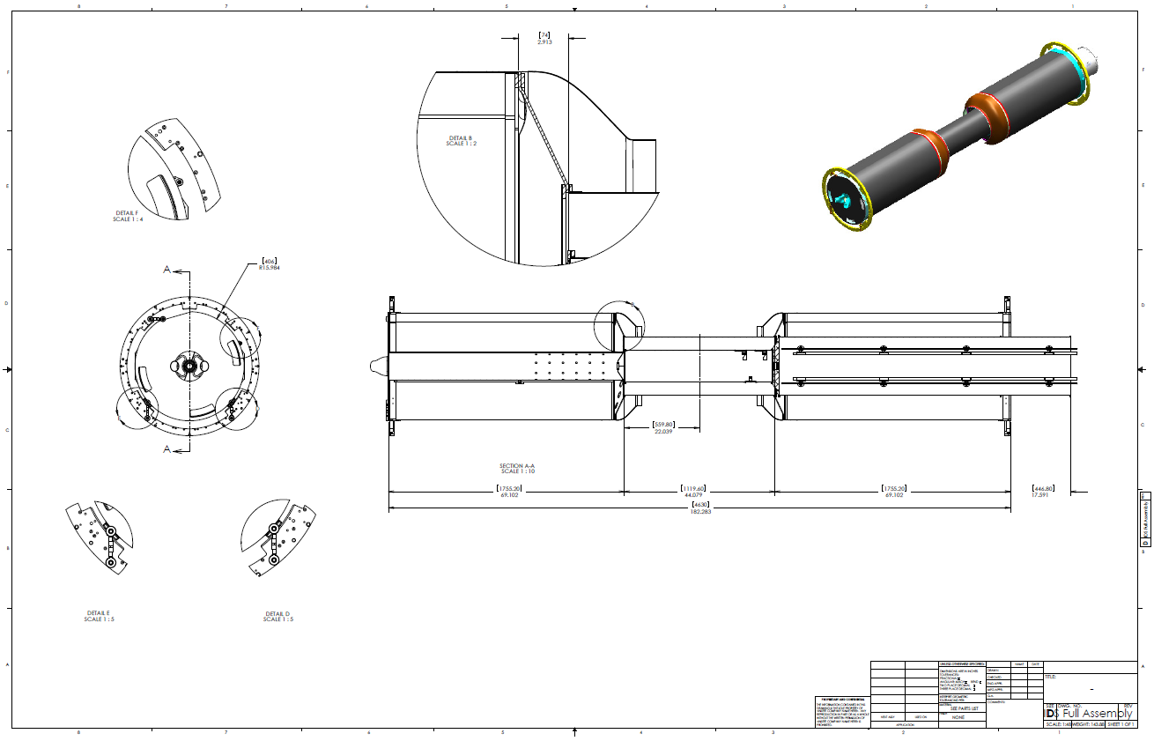
IDS envelope/Interface drawing
PST
PIT

Slide 41
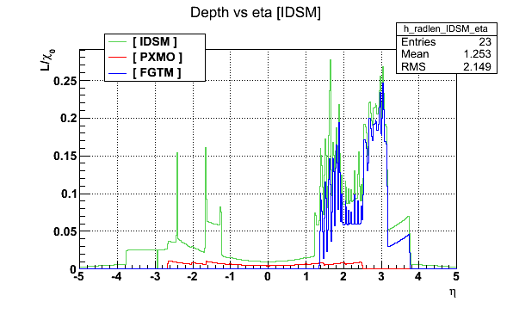
Radiation length vs η for IDSM, PIXEL, FGT
Default parameters are :
Ntrig = 4
dφ =.2
dη = .1
|η|<6
|φ|<1 deg.
Same with Ntrig =100
Increasing the # of triggers give a slightly better resolution

Slide 42
Explanation of the “radlen vs. Z/eta” profile
Real length of material crossed
by the particle
Z=0
Real length of material crossed
by the particle
Z≠0

Slide 43
Si 2 mil (0.0529%)
sensor
0.0677%
acrylic 2 mil (0.0148%)
Al 0.7 mil (0.0124%)
kapton 1mil (0.0073%)
Al 0.7 mil (0.0124%)
cable
acrylic 2 mil (0.0148%)
0.079%
0.223 mm
Al 0.7 mil (0.0124%)
kapton 1mil (0.0073%)
Al 0.7 mil (0.0124%)
acrylic 2 mil (0.0148%)
10 mil carbon composite
open weave (0.0587%)
backer
0.2221%
4 mil silicon adhesive
(0.0469%)
support
beam
9.6 mil carbon composite
sector beam (0.1017%)
TOTAL = 0.3688 % X₀
Notes:
Curtsey Leo

Slide 44
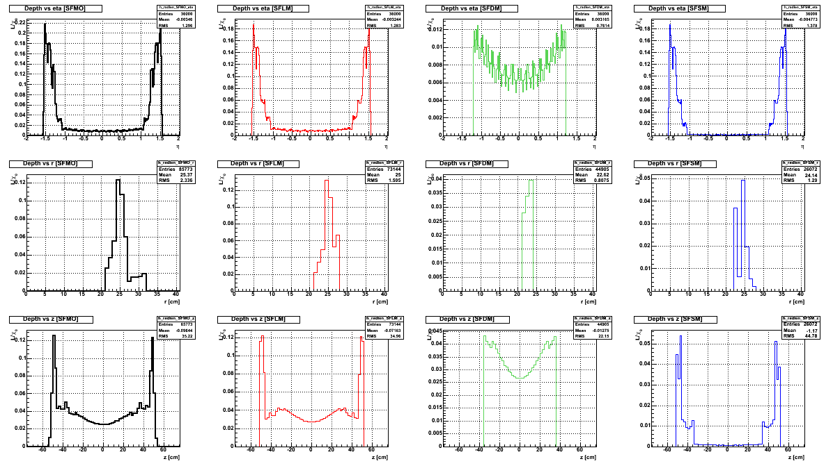
Check with the [SSD] volume
ALL “SSD”
SSD LADDERS
ACTIVE
SILICON
RDO

Slide 45
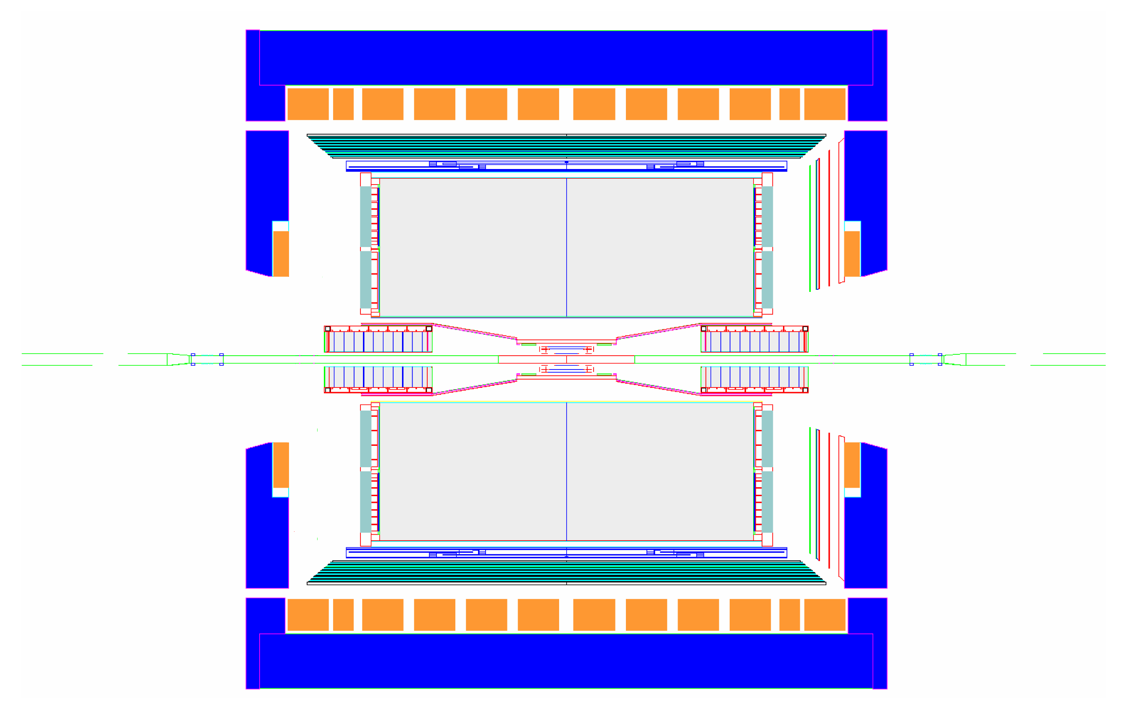
HFT
MRPC ToF barrel
100% ready for run 10 (now!)
MTD
EMC barrel
SSD
IST
PXL
EMC End Cap
BBC
FMS
FPD
TPC
FHC
PMD
DAQ1000
Completed
HLT
HFT
FGT
Ongoing
R&D
➔ This review is focused on the PXL and its support structure

Slide 46
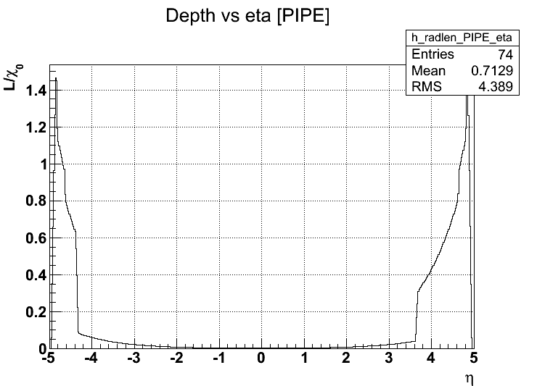
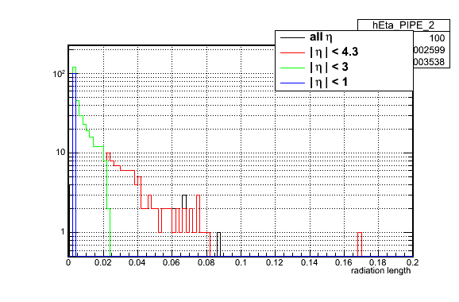
Radiation length of the beam pipe (starbase)
At mid rapidity (|η|<1), the radiation length is ~ 0.25%X0
Notes:
Radlen vs. phi is uniform at .1%X0 because it has an average in |eta|<6

Slide 47
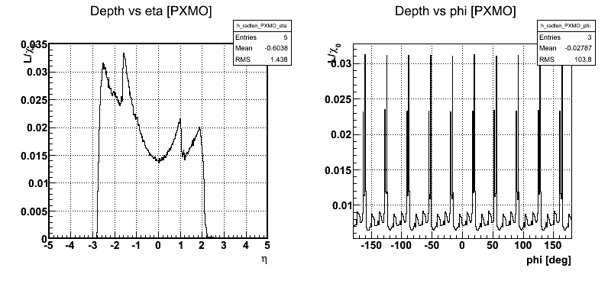
PIXEL DETECTOR [PXMO volume] radiation length
right : radiation length vs. azimuth.
We observe double peaks (high radiation length) for tracks crossing the entire sector support
Other small peaks are the overlaps between ladder.

