Slide 1
Threshold configuration discussion

Slide 2
Bias configurations
Thresholds:
DB+6*sigma
DB+6*sigma+2.5mV for noisy ladders
Clamping voltage
0
Collision data: 14152026
Noise data: 14152034

Slide 3
Comparison collision-noise data
Inner ladders:
+ 4-8 hits per sensor per event
Outer ladders
+ 1-2 hits per sensor per event

Slide 4
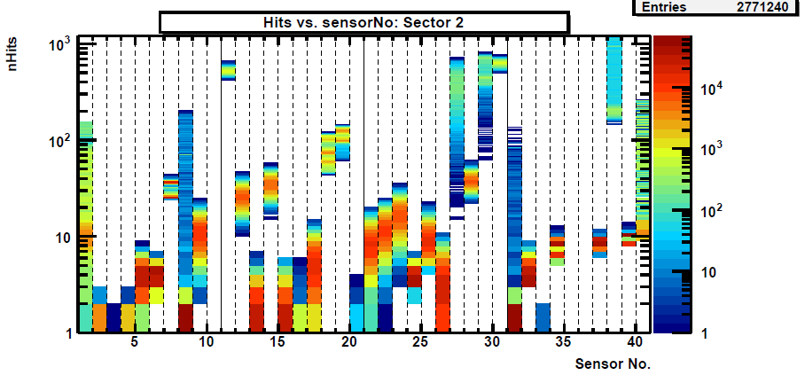
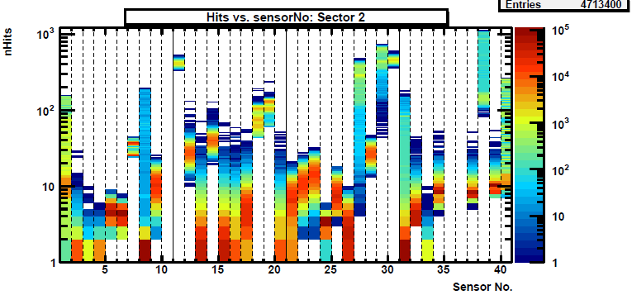
S2
Noise
Beam

Slide 5
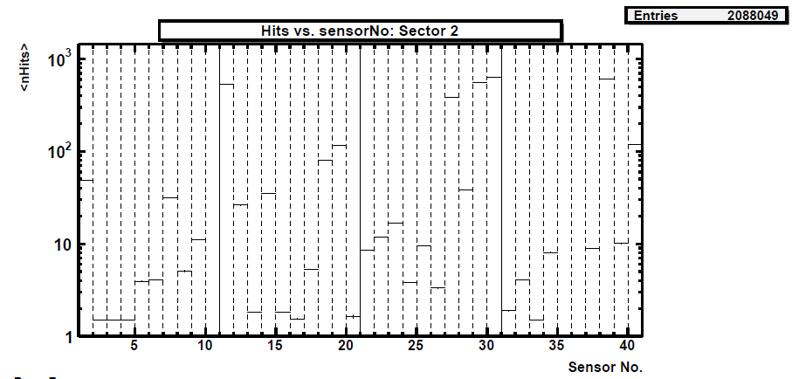
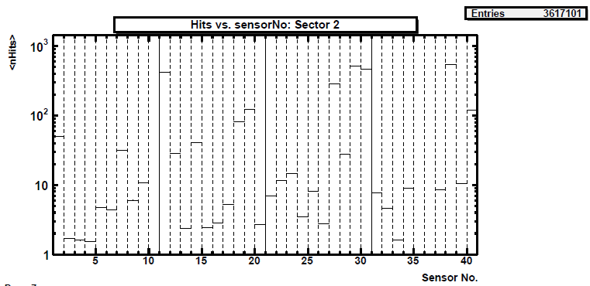
S2
Noise
Beam

Slide 6
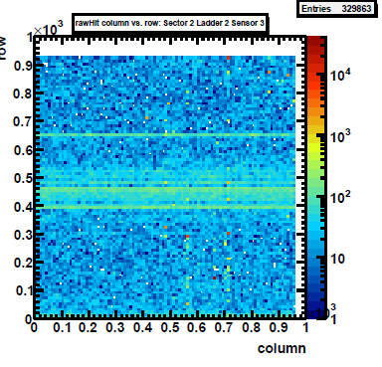
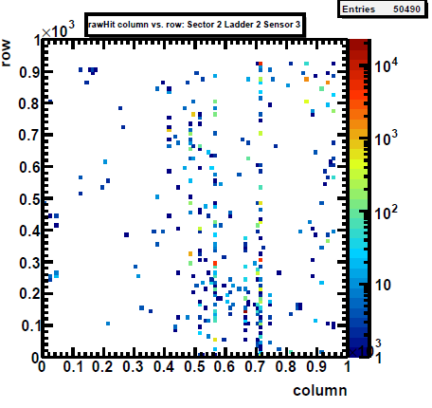
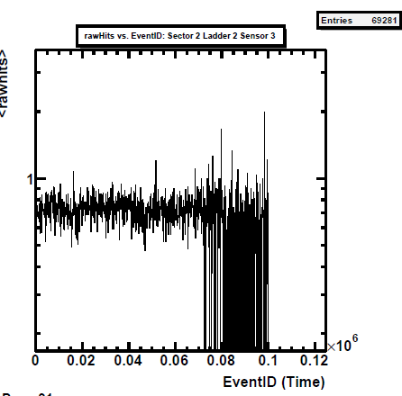
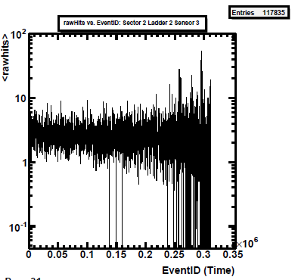
S2
L2
s3
Clp=0
Opt. th

Slide 7
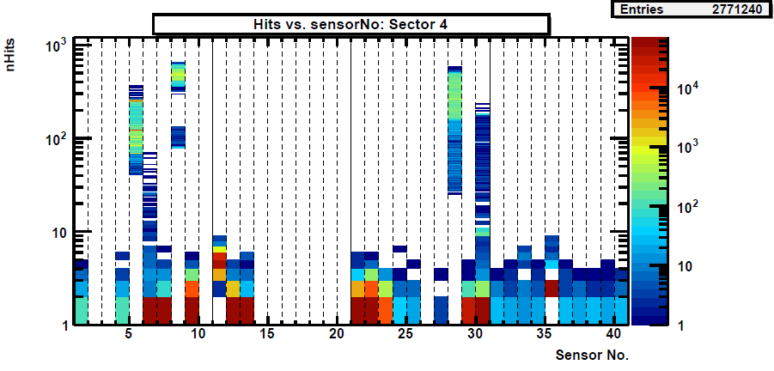
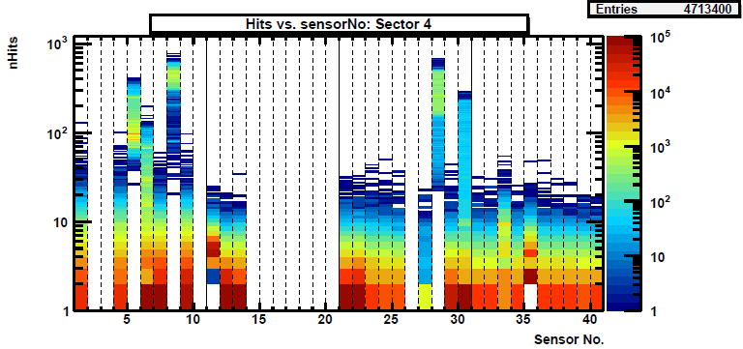
S4
Noise
Beam

Slide 8
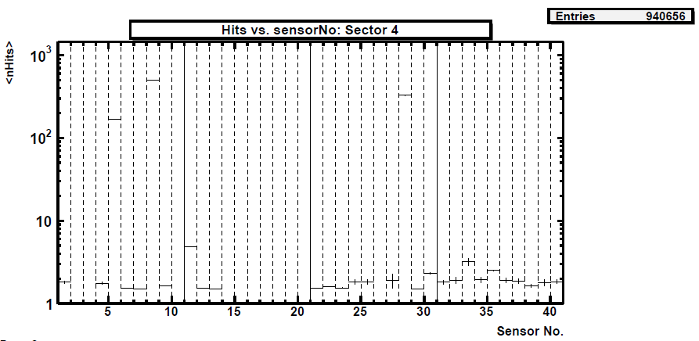
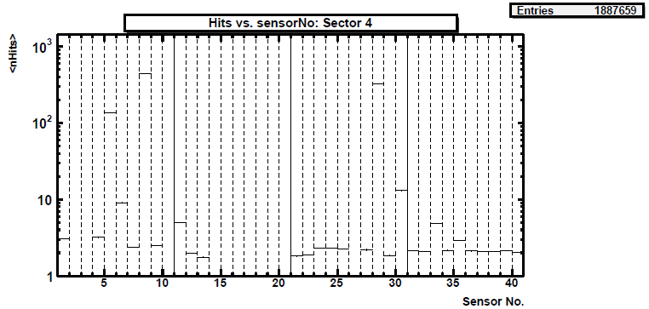
S4
Noise
Beam

Slide 9
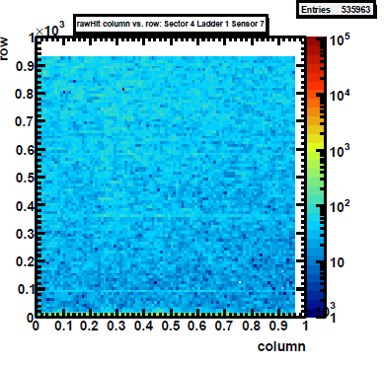
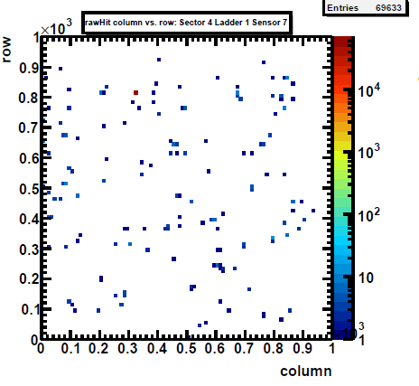
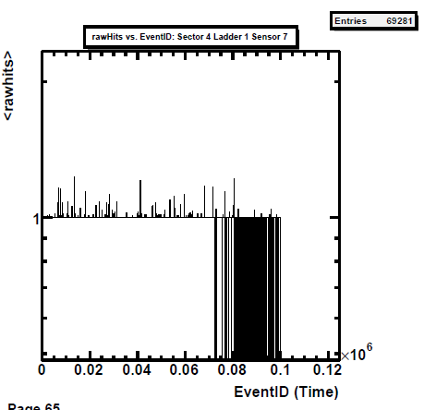
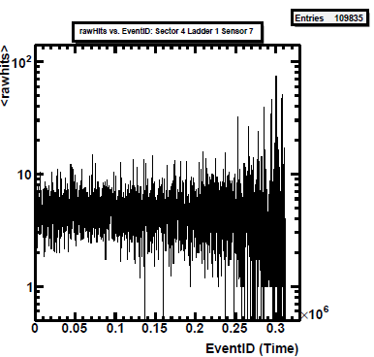
S4
L1
s7
Clp=0
Opt. th

Slide 10
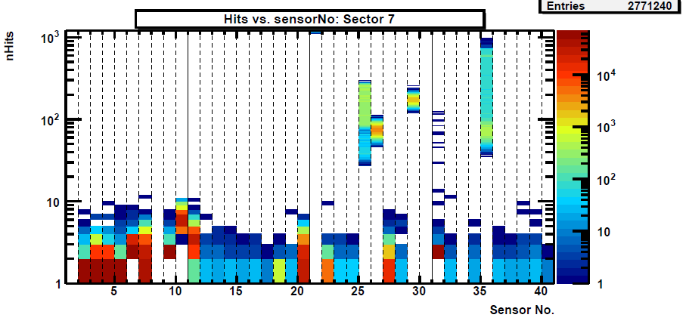
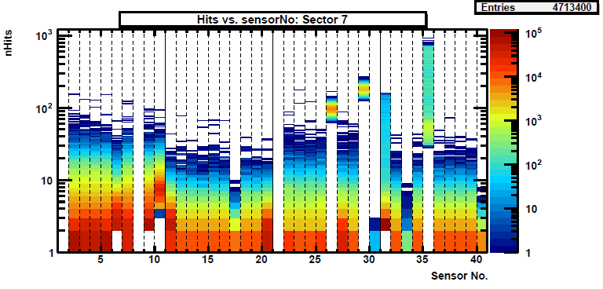
S7
Noise
Beam

Slide 11
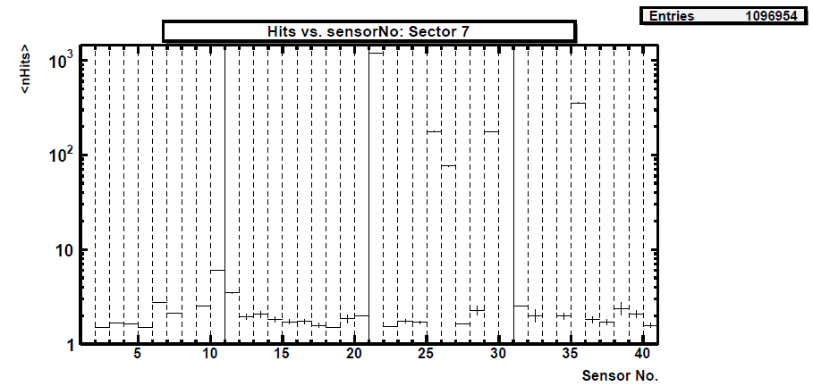
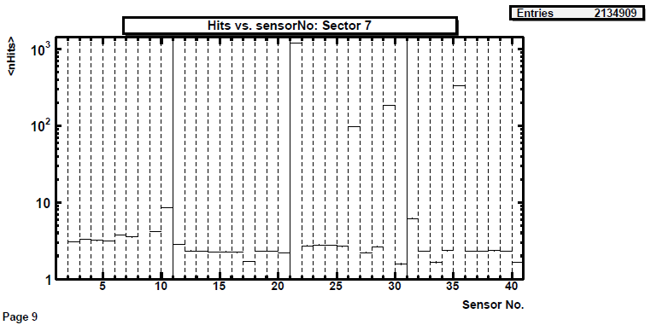
S7
Noise
Beam

Slide 12
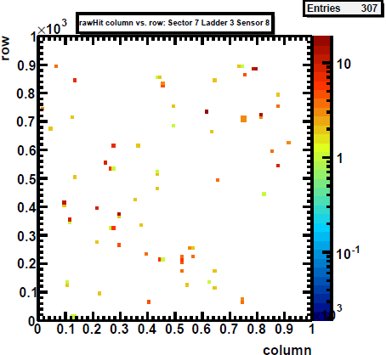
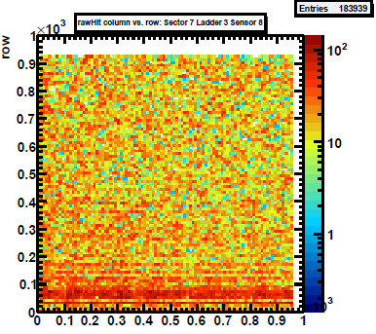
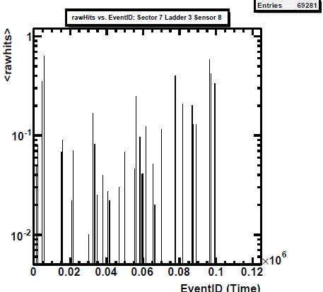
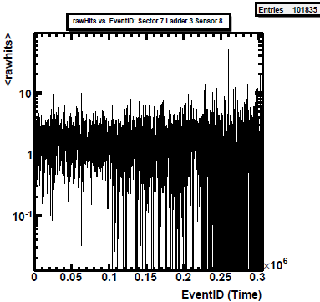
S7
L3
s8
Clp=0
Opt. th

Slide 13
Further improvements
Sector 2
Some sensors in L2, L3 are still too noisy
L1 is still getting less points compared to other inner ladders
Single sensors
Specific threshold/mask for a few (~6) sensors can be discussed
Hot pixel to be masked

