Slide 1
QA histos from run st_pxl_14152024_raw_1220001.pxlQa.root

Slide 2
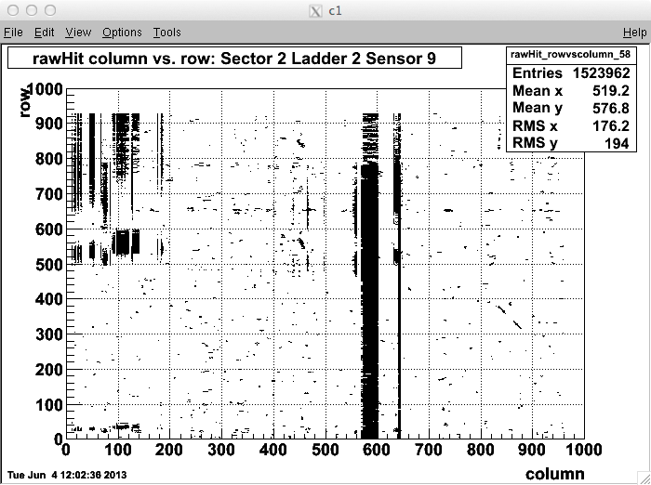

Slide 3
