Slide 1
Single electrons UPC pileup
Evaluation of the UPC electron contribution to the pileup.
Input is the Pt of electrons in 0<Pt<0.5 from Y. Gorbunov.
dump the number of bin ontent (= number of electrons ) per bin in a .dat file.
Use the .dat file as input for starsim (upgr15 geometry) where 1 electron / event is thrown (flat in |y|<1, σ_{Vz} = 20cm)

Slide 2
Pt input
Tracks with no pixel hits
remove
# of hits in layer1,2
Effective Pt
divide
Excess in hits

Slide 3
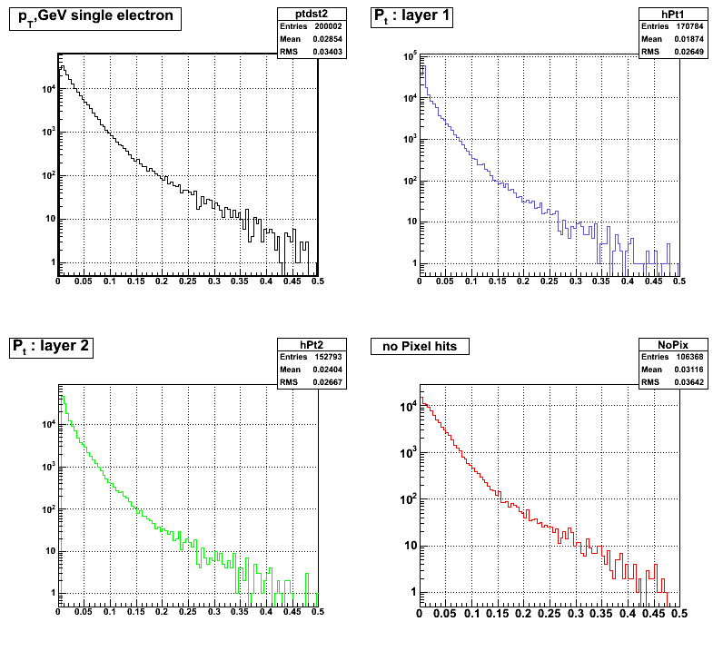
# of hits in inner layer vs. PT of associated tracks
input
# of hits in outer layer vs. PT of associated tracks
Pt of tracks with no pixel hits

Slide 4
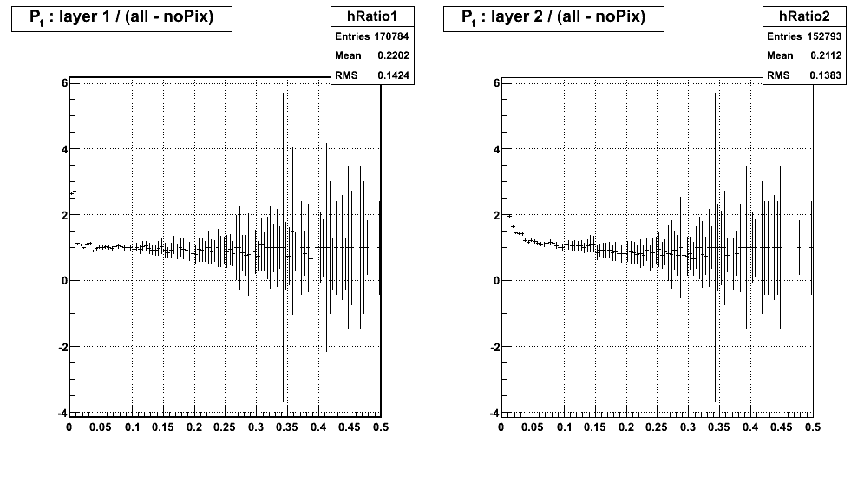

Slide 5
comments
Contribution at very low Pt (<.1) of extra hits due to UPC electrons is not negligible
For higher Pt, we found back a ratio ~1, meaning 1 track leaves 1 hit in each layer.
To do : simulations with rapidity |y|<5 because even for vertex ~30cm, UPC electrons can hit the PXL detector.

Slide 6
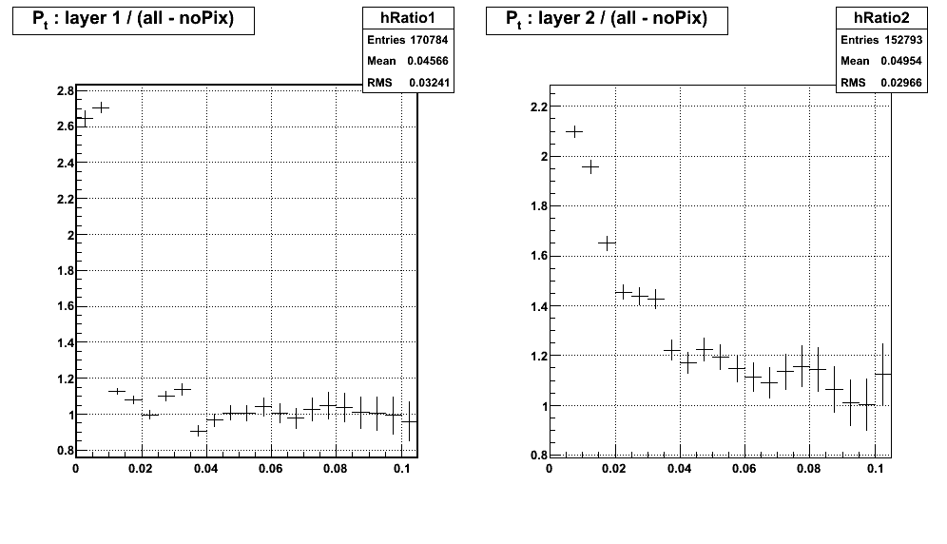
Zoomed in 0 < Pt < 0.1

Slide 7
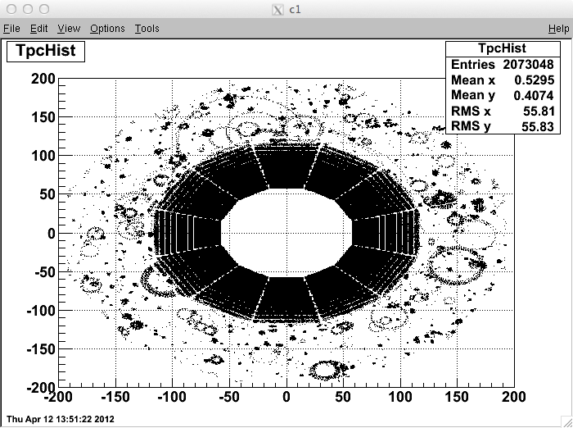
“Loopers” in TPC

