Slide 1
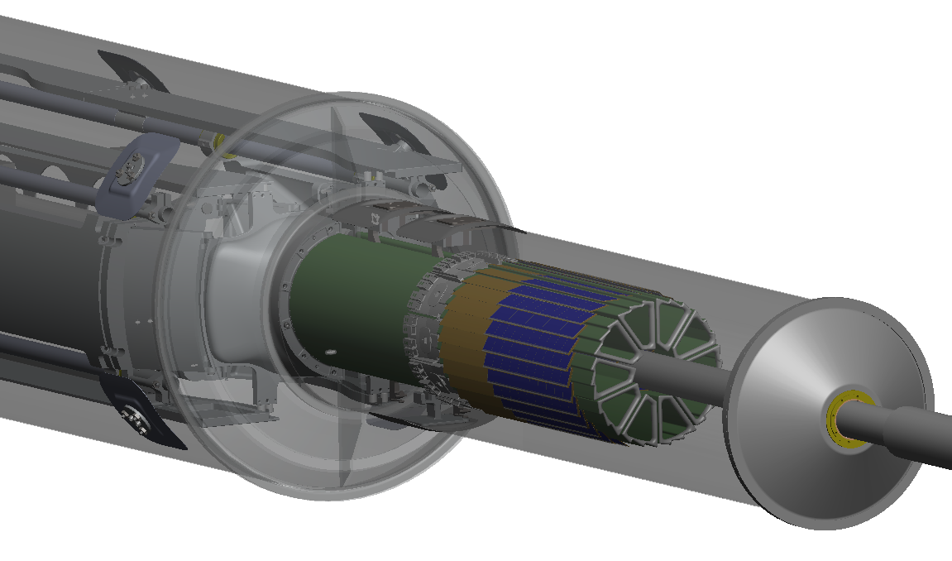
The STAR-PXL sensor and electronics
Progress report for F2F

Slide 2
Talk Outline
Technical progress (since last F2F on January 10, 2012)
Expected progress for the next 6 months
Directed points for subsystems

Slide 3
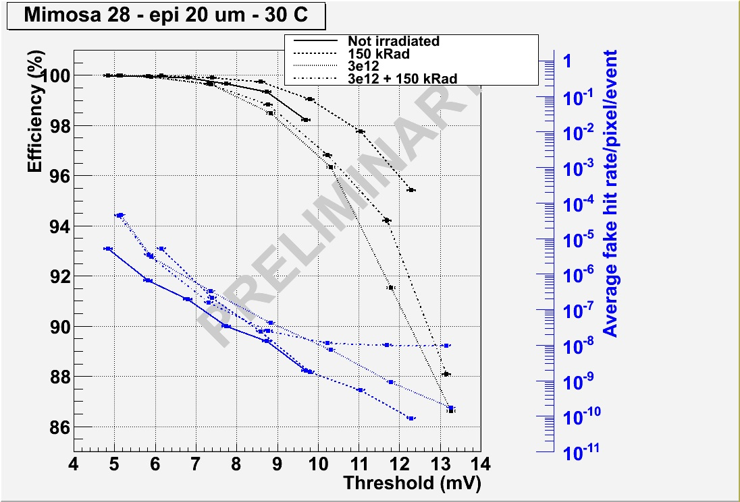
Technical Progress (Sensor)
Tests conducted by IPHC at DESY
Meets PXL sensor requirements

Slide 4
Technical Progress (Sensor)
Mimosa-28 (PXL Sensor) redesign is complete. The list of modifications was shown in the last F2F meeting. All hardware including probe testing is compatible with both versions of the PXL sensor. The submission will take place after initial ladder testing at IPHC. This is to allow for as much testing as possible before final silicon is ordered.
11 wafers of PXL sensors (version 1) are thinned and diced and awaiting probe testing. The yield for the mechanical processing was an acceptable 93%. A full report can be found at http://rnc.lbl.gov/hft/hardware/docs/yield_for_11_wafers_2011_12_13.docx

Slide 5
Ultimate probe testing card
Sensor wire bonded to the probe card to test the full functionality of the probe card and testing system before the probes are mounted to the card.
The probe cards have been tested for functionality and with the scripted testing.
Testing results allowed us to load and send out 2 probe cards to have the probe pins loaded. They will be at LBNL by Wednesday of this week. Testing by hand (not integrated into database) will begin soon thereafter.

Slide 6
PXL RDO Board Architecture
6 m (24 AWG TP)
2 m (42 AWG TP)
Mass Termination Board (signal buffering) + latch-up protected power
Clk, config, data
Clk, config, data, power
RDO motherboard
w/ Xilinx Virtex-5/6 FPGA
Daughter card
USB
SlowCont PC
100 m (fiber optic)
RDO PC with fiber link to RDO board
PXL built events
Slow control,
Configuration,
etc.
Highly parallel system
4 ladders per sector
1 Mass Termination Board (MTB) per sector
1 sector per RDO board
10 RDO boards in the PXL system
1 Trigger TCD interface board
TCD Board
Trigger

Slide 7
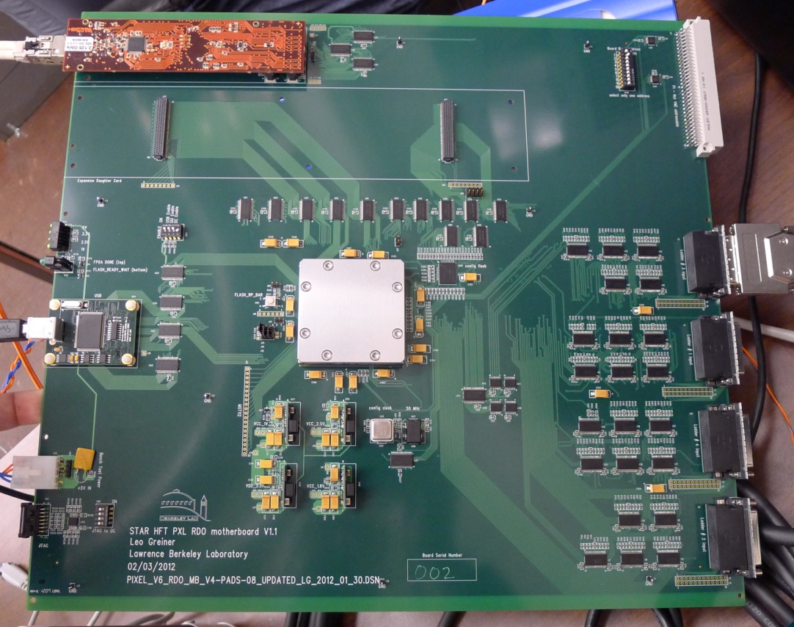
Production Prototype RDO System V1.1
5 PCBs at LBNL and 2 are loaded.
2 boards loaded with solderless socketed FPGAs
All fixes from V1.0 implementation. New BUSY handling design.
FPGA configuration, configuration from flashXL, SIU (fiber optic connection) and USB all tested and working. Data path testing will continue.

Slide 8
Other PXL RDO system components
MTB – schematic complete. Layout as per HW mechanical design envelopes is in progress at IPHC.
Daughter-card (for RDO motherboard) – Layout complete and boards have been fabricated. Boards shipped and will arrive today. Loading and testing will follow shortly.
TCD interface board – Boards are in hand and loaded. Testing will begin shortly.
Interface boards – Design and layout complete. The fabrication PO will be sent out this week.

Slide 9
Technical Progress (Cable)
FR-4 prototypes are at LBNL
Kapton version under design (if testing shows that the existing design is satisfactory)
Possible submission to CERN PCB shop after completion of ladder testing at IPHC

Slide 10
Recent Documentation
Report on VHDCI cable testing
Mechanical thinning yield report
Draft ladder assembly documentation
Draft slow controls plan
Schematics and layout files for production prototype V1.1 RDO system
Is anything else required for the July review?

Slide 11
Simplified schedule

Slide 12
directed points for sub-systems
Critical items/tasks for run-13 installation
Critical items/tasks for run-14 installation
Needs for CF shop
Revisit risk list in view of schedule updates, and task accomplished so far.
Major upcoming procurements.
Survey plans and software (Spiros)
Upcoming internal Reviews – None? Mechanical?
Cooling Plan – See HW’s talk

Slide 13
Critical items/tasks for run-13 installation
Full ladder development chain
Probe testing
Ladder testing
Ladder assembly production
Full mechanical production chain (see HWs talk)
Sectors
Cooling system
Metrology
Software
Metrology to tracking points
Tracking
Firmware and software for cosmic ray / beam tests
Slow control
Notes:
everything

Slide 14
Critical items/tasks for run-14 installation
If the previous list of critical tasks for run-13 is completed successfully, the production of sensors, RDO electronics, sectors and mechanical components for run-14 should be a simple production of already vetted components.
Problem(s) uncovered in the engineering run will form the core of the critical task list for run-14. We will need to see what develops.

Slide 15
Needs for CF shop
All mechanical parts for the PXL detector. This will be detailed in HW’s presentation.
Technician labor for ladder and sector assembly. This will be augmented by ETs including RW, JW, JB.

Slide 16
Revisit Risklist
We will expire the 1.2.2.2 “PXL sensor meet requirements” risk after testing the Ultimate 2 first run sensors (late summer 2012).
The “skilled non-costed staff unavailable” risk has been exercised.
Other risks still appropriate.

Slide 17
Major upcoming procurements.
Moderate procurements expected
Production prototype sensors engineering run (~$171k)
RDO production Motherboards (~ $40k)
Flex Cables (~ $20k)
RDO MTBs (~ $15k)
SIU and RORC RDO modules (~$30k)

