Slide 1
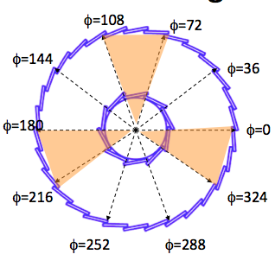
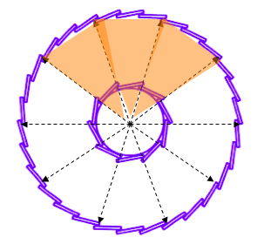
HFT-prototype BUR considerations for Run-13
The main goal of the HFT engineering run will be system verification and correction; this includes the study of the collision environment, detector response, backgrounds, operational experience, first attempts on Alignment and basic detector performance (e.g. DCA resolution).
At the same time we performed simulation studies to determine what physics could be done in Run-13 assuming that a certain number of sectors have sensors?
Relates to how long would be the AuAu run, if any.
How many sectors will have sensors-> can we change/afford changes in configuration?
Is there a possibility for a high pt trigger in prototype acceptance? What are the peripheral-event rates (error defining) for a given threshold? This makes sense only for the Joined-configuration
Need realistic data-taking rates, duty factors, detector ‘up’ estimates
Full simulations are underway and partially done
Assuming 3-sectors equipped
Mercedes config. – low pt D0
Joined config. – higher pt D0

Slide 2
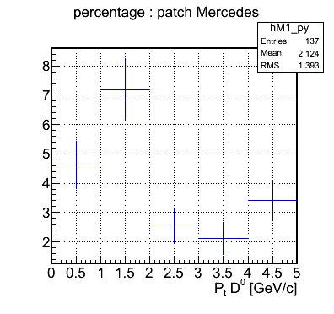
Single track efficiency (STE) changes about ~10% for all pt (from ~80%->70%), so impact on D0 signal is ~15% (or multiplication factor .85) for ideal TPC. In reality TPC->PXL tracking needs rethinking.
Both configurations have geometrical acceptance (ACC) penalty for D0s
Acceptance doesn’t affect S/(S+B) but lowers signal significance
S/sqrt(S+B)
Figures below are Full simulations for Mercedes (left) and Joined (right)
Joined - ACC+STE
|y|<1
|η|<0.5

Slide 3
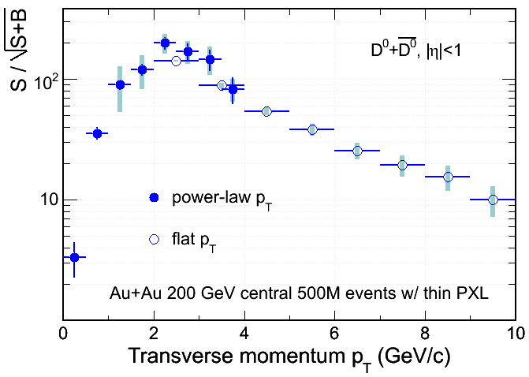
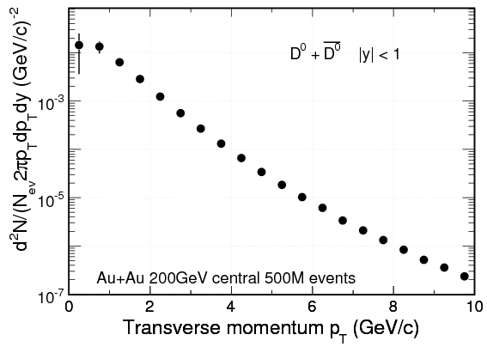
Rough estimates:
For 500 Million AuAu 200 GeV events (CDR plot input).
This can be a couple of weeks running time in Run-13 provided things are not going to be terribly wrong.
Needs a VPD event vertex trigger to constraint it within +- 5cm
The pt spectra plot errors should be increased @ 1 GeV only pt by a factor of 3-4 for the Mercedes prototype, and the same factor @ >= 5 GeV for the Joined prototype. This number results from evaluating the signal significance with the new penalties in track efficiency and acceptance combined for these two sweet spots.
We should be able to do something !
Full Simulation
Fig-5 CDR
Joined
Mercedes
Joined Configuration
Significance
Fig-4 CDR Signal significance

Slide 4
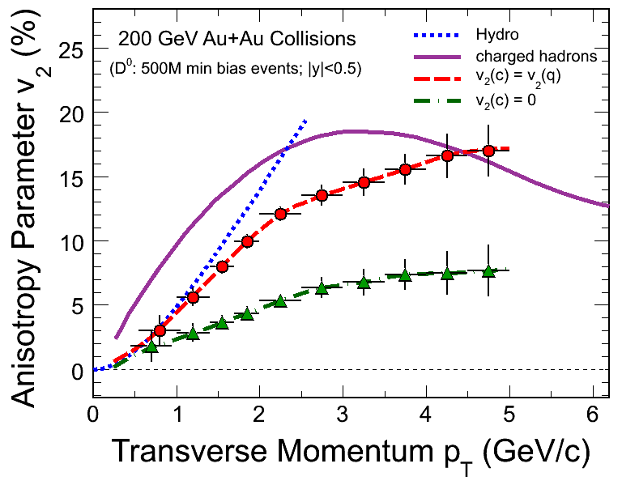
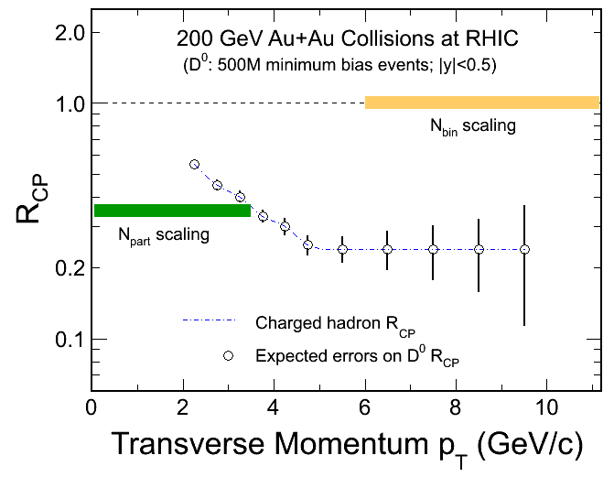
Full simulation results pending
Fig-8 CDR
With larger errors lower pt is not useful and higher pt needs statistics
With larger errors higher pt needs statistics since TOF is doing lower pt thoroughly

Slide 5
Summary
Depending on many factors like events on tape AND # of instrumented sectors available AND %-detector alive AND … we should be able to get a x-section and a R_{CP} estimate
Need to be confirmed by ongoing simulation studies
If only ONE configuration is allowed then Joined seems to be the one to run, since it explores the higher pt area which is also easier to reconstruct (high pt tracks).
But keep in mind that HFT’s advantage is at lower pt over Phenix

