Slide 1
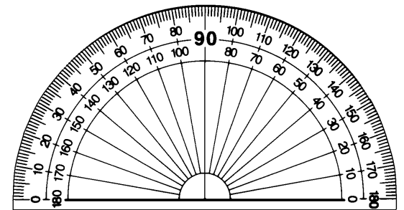
BLUE- TPC sectors
RED – PXL sectors

