Slide 1
PXL Mechanical 14-March-2012
HFT face to face

Slide 2
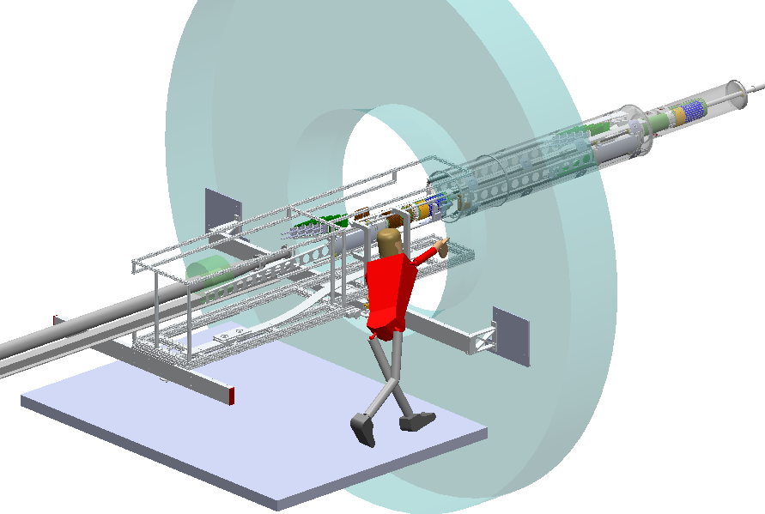

Slide 3
Critical items/tasks for run-13 installation
3 or more working sectors
spatial map of PXLs in working sectors
7 dummy sectors for air flow
complete insertion carriage
build second insertion carriage
complete detector/transfer box
build second detector/transfer box
design and build cart for detector/transfer box
design and build cabling plant for two PXL halves
design and build bulk heads with attachments and seals
cooling plant

Slide 4
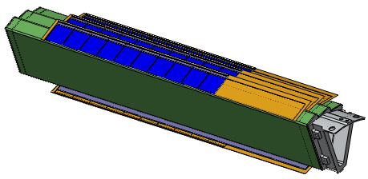
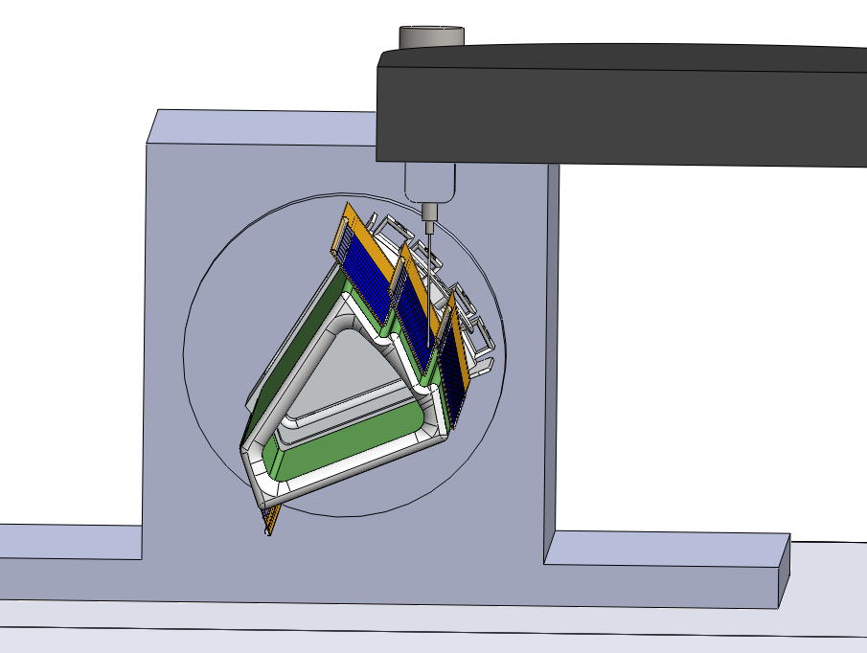
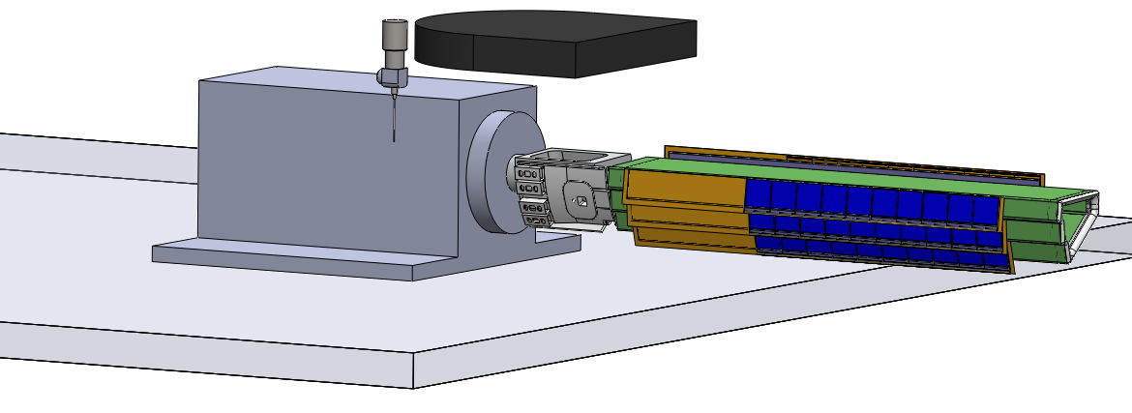
Critical items/tasks for run-13 installation
3 or more working sectors
Design cable connection
Design tooling ball location and fixation
CF tech fabrication time
spatial map of PXLs in working sectors
OGP rotary head delivery delayed, March 30
Need dummy sector with thinned silicon to develop procedures
requires ladder assembly fixture modifications – waiting for main LBL shop – but should have parts end of this week then CF techs can finish sector fab by March 30
sector support – waiting for main LBL shop
7 dummy sectors for air flow
can strip cooling test sectors?

Slide 5
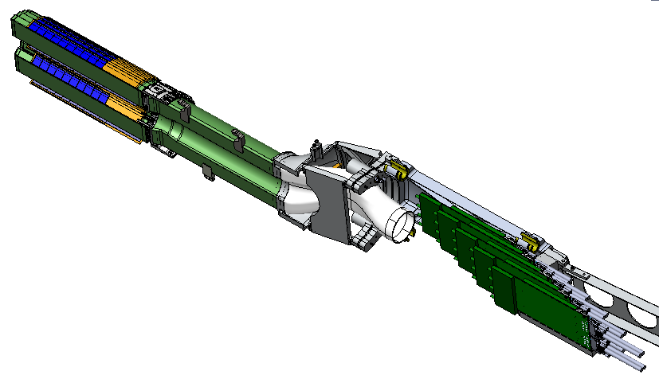
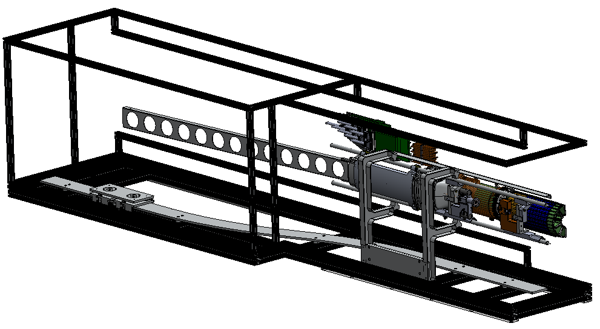
Critical items/tasks for run-13 installation
complete insertion carriage
modify release mechanism
build second insertion carriage
order second copies of machined parts – 10s k$ - long lead time?
some CF tech fabrication time
complete detector/transfer box
strengthen cover
order/fab cover plates
CF tech time
build second detector/transfer box
CF tech time

Slide 6
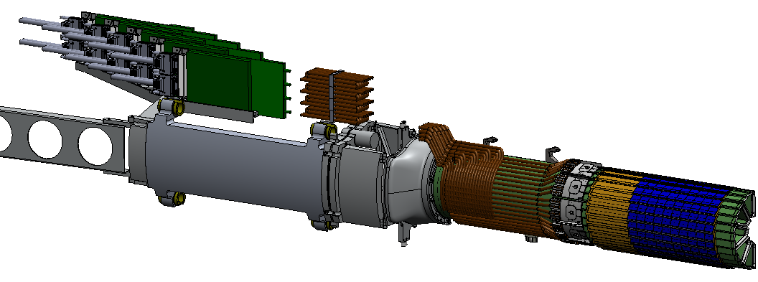
Critical items/tasks for run-13 installation
design and build cart for detector/transfer box
BNL design and fabricate?
design and build cabling plant for two PXL halves
design ladder flex cables with connectors
design low mass cables with support structures and take up structures
design high mass cables with support structures – coupling arm
status - design in process, but awaiting models
build – CF tech time
(place holders)

Slide 7
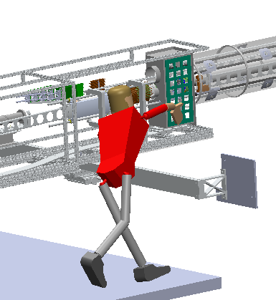
Critical items/tasks for run-13 installation
design and build bulk heads with attachments and seals
design feed through cards and connector structures
design fastening system to PIT/MSC
design sealing system to PIT/MSC
(place holder)

Slide 8
Critical items/tasks for run-13 installation
cooling plant
design
size chiller
design heater and feed back control
size and order pump
size and order filter
design and fab housing
design and fab ducting
order ducting internal to MSC
determine plant location
latest news (yesterday) Dana has found a vendor that may be able to do the job, but meeting time constraint of summer installation is very tight.

Slide 9
Critical items/tasks for run-14 installation
10 or more working sectors
spatial map of PXLs in working sectors

Slide 10
Misc. Mechanical run-13 Critical items/tasks
MSC hardware
BBC support
External adjustable beam pipe support

