Slide 1
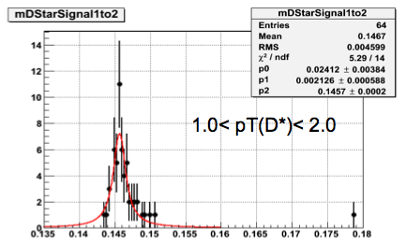
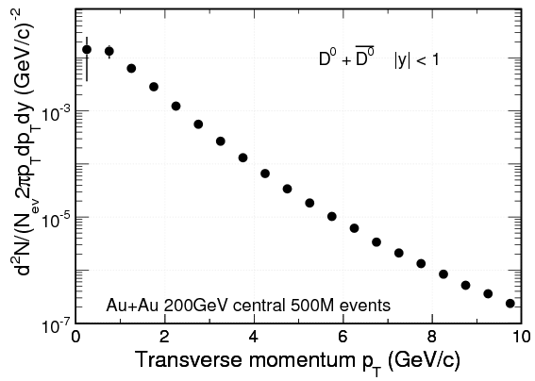
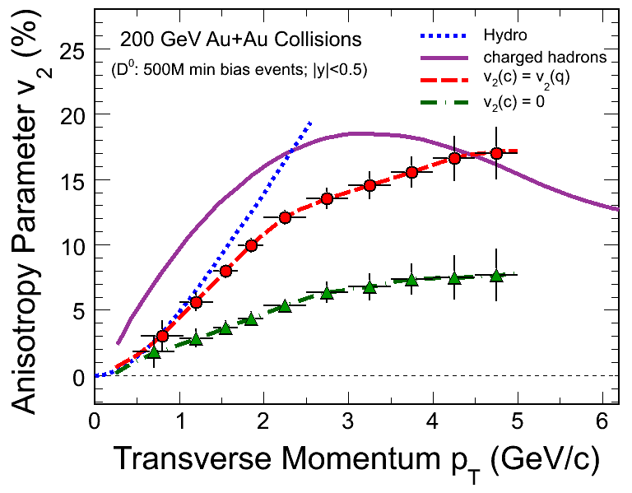
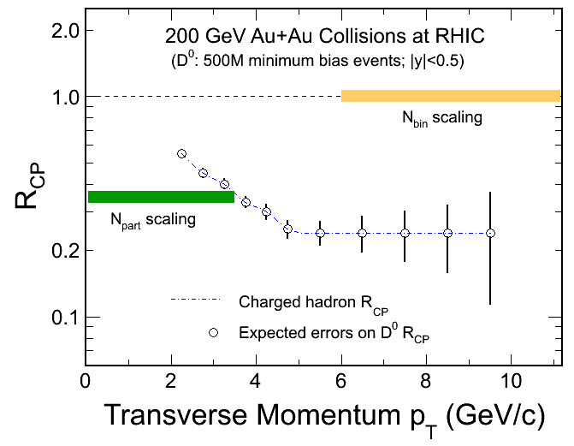
HFT
Charm Capabilities
HFT
Hermetic/Full topological reconstruction of Charm
HFT
HFT
HFT
HFT

Slide 2
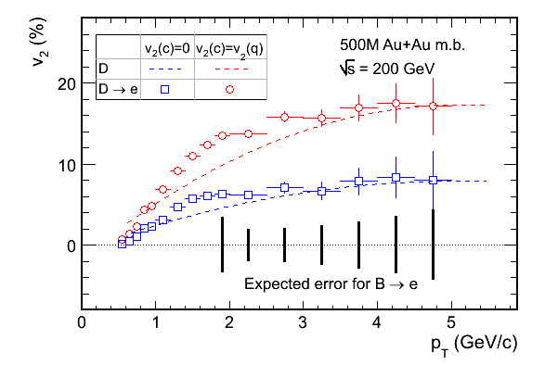
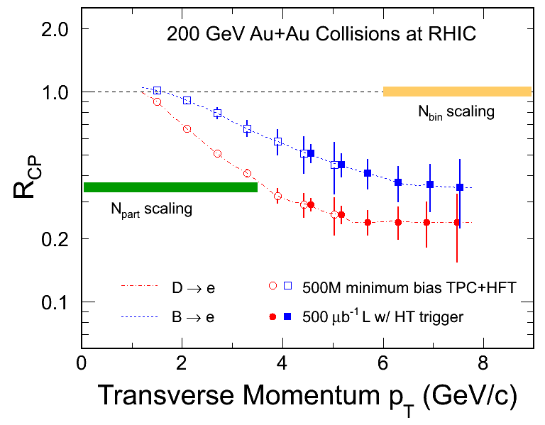
Bottom electrons via subtraction method
Bottom trigger capabilities of MTD in progress
Exclusive bottom reconstruction

