Slide 1
Details of the new beam pipe for DEV13 geometry
dimensions
Radiation length

Slide 2
Input : Dimensions from Brushwellman drawing

Slide 3
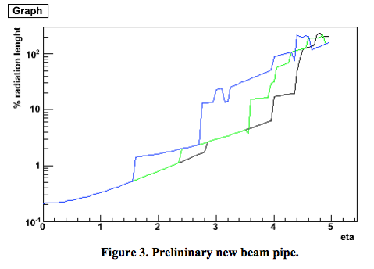
Input : radiation length vs. pseudo-rapidity η(*)
Vertices :
30cm (blue)
0.cm (green)
-30.cm (black)
for |η| <1, the estimated radiation length is ~ 0.2 - 0.3 % X₀
*: plot taken from Effective Thickness of the HFT Beam Pipe, D. Beavis, August 26, 2009

Slide 4
Implementation in GEANT
The new beam pipe has been implemented by Amilkar
Done within the new framework AgML
Available for DEV13 geometry (year > 2012 including the PXL detector)

Slide 5
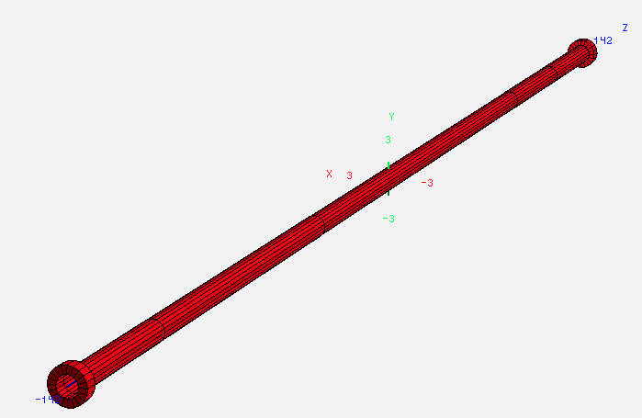
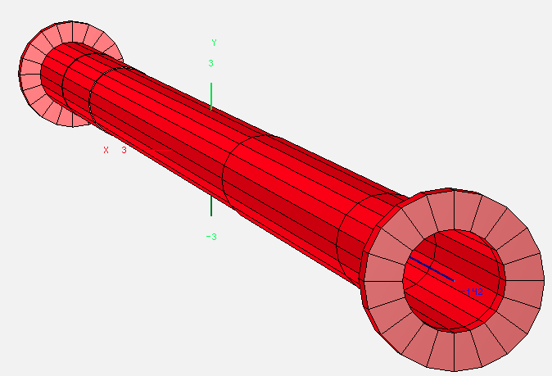
Details from GEANT
Dimensions (*) | -Z | +Z | Radius (min) | Radius (max)
inch | 55.71 | 55.71 | 0.7875 | 0.7875+0.03 (Beryllium layer**)
cm | 141.50 | 141.50 | 2.00025 | 2.07645
* : taken from PipeGeo1.xml
** : the beryllium section is at |z|<60 cm , the rest of the beam pipe is surrounded by an Aluminum layer

Slide 6
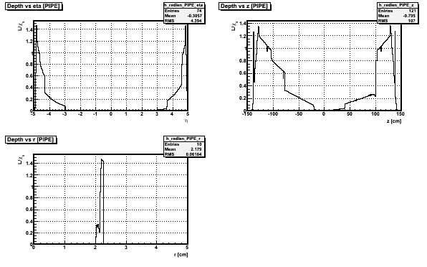
Checks : radiation length & dimension
Simulation : used Geantinos thrown at z=0
top left : radiation length vs eta
Top right : radiation length vs Z
Bottom left : radiation length vs radius
Radius looks OK
→next slide for log scale

Slide 7
Checks : radiation length & dimension (log)

Slide 8
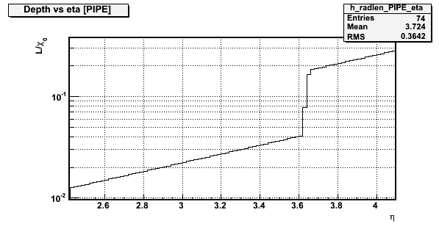
~0.15
~15%
~4%
~0.04
green line is for vertices at z = 0
We see the same jump at eta~ 3.6 in both plots with same values in radiation length
✔Nice agreement between design and GEANT

Slide 9
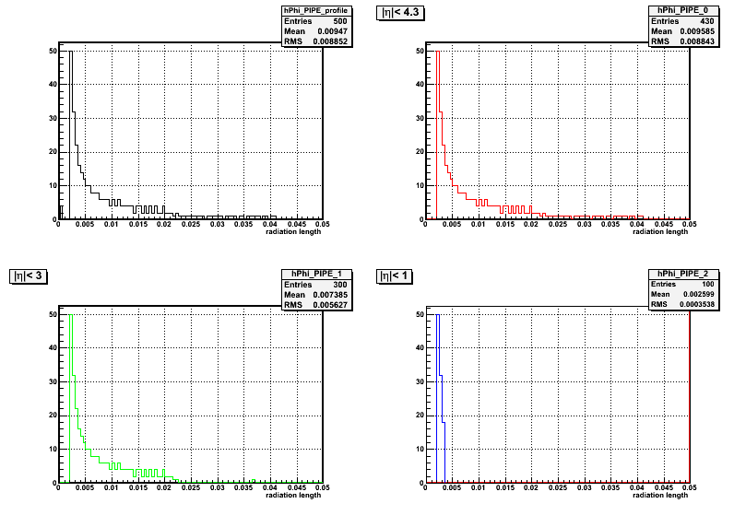
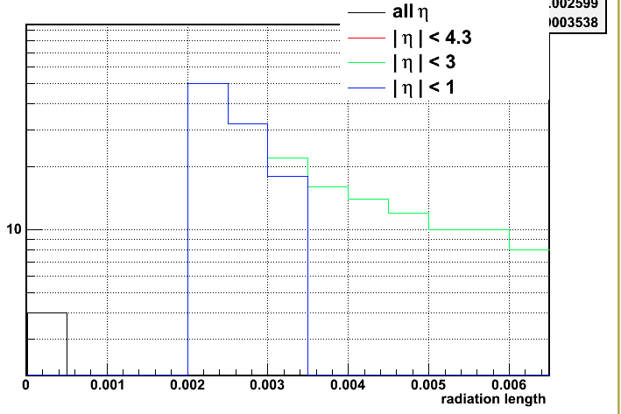
Radiation length vs pseudo-rapidity η
We see that for |η|<1, the radiation length is peaked at ~ 0.0026 ( = 0.26% of X0)
✔Agree with slide 3

Slide 10
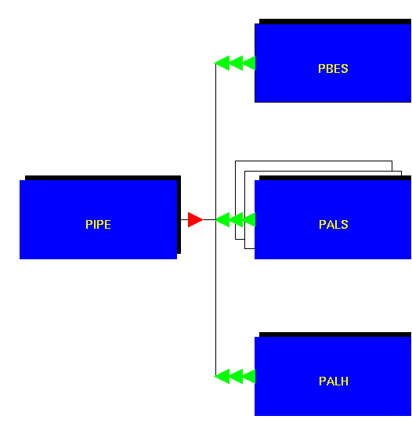
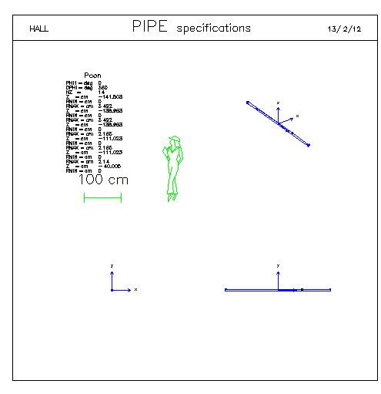
BeamPipe in GEANT
The beam Pipe is made of 3 volumes :
PBES
PALS
PALH

Slide 11
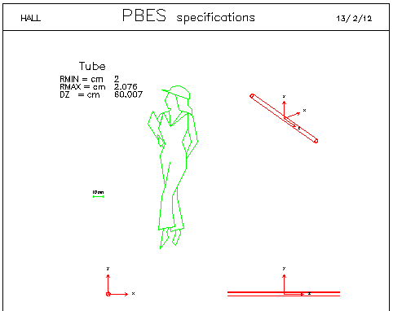
Beryllium part : PBES
Z range | -100 ; 20
Rmin ; Rmax | 2 ; 2.076
Note : the Be part is centred at z = -15.75inch ( = - 40 cm)

Slide 12
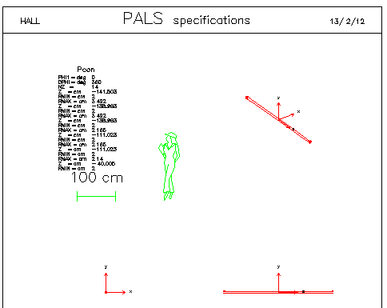
Aluminium part : PALS
Z range | -141.50 ; -138.9 | -138.9 ; -111.04 | -111.04 ; -40 | -40; 80 | 80; 111.04 | 111.04; 138.9 | 138.09; 141.50
Rmin ; Rmax | 2 ; 3.492 | 2 ; 2.185 | 2 ; 2.14

Slide 13
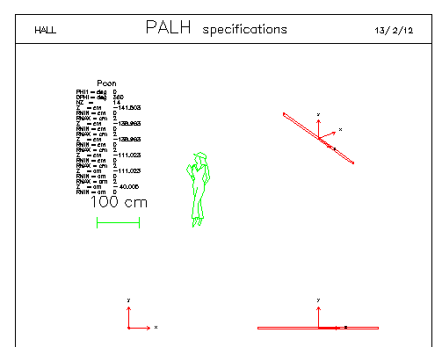
PALH (AIR)
Volume = air ; not supposed to have radiation length

Slide 14
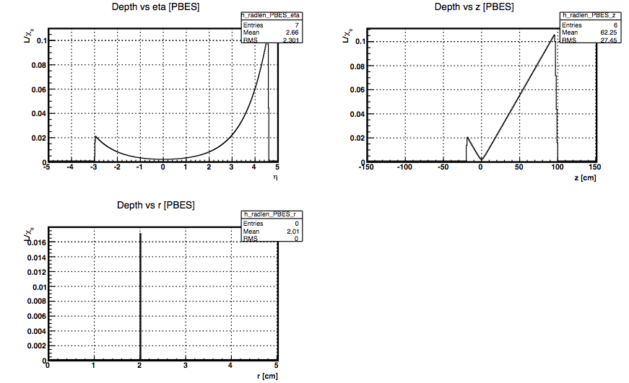
Check : Beryllium part
The agreement is very good :
radius is agree with the AgML model
Z range too

Slide 15
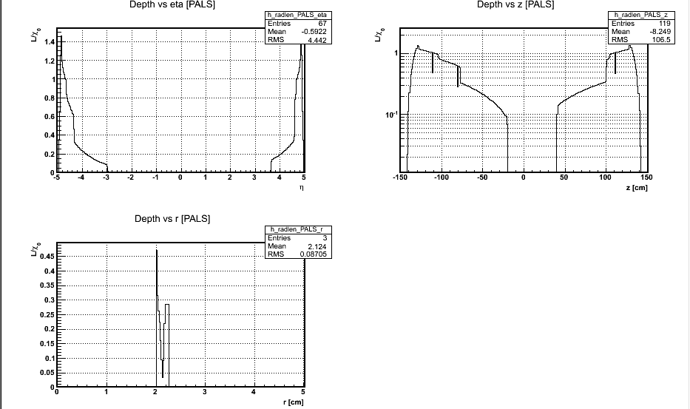
Check : Aluminium part
The radius looks OK : we see the larger values for the extremites
But there is something wrong with the central part : it is supposed to
have a volume (slide 12) but it looks empty
➔ Overlap between volumes ? Option kOnly vs. kMany ?

