Slide 1
Alignment Update
HFT Alignment studies
Review – done
We now have a fully functioning alignment environment, including the PXL, IST and SSD detectors based on older SVT/SSD work
a TPC t0-like bug still persists. Geometries used for MC generation and track reconstruction are not consistent
Yuri suggested the direct use of root geometry matrices. Eliminate going back/forth to tables step
We plan to use the chain for Run-13 alignment
Need to establish a VMC application for detailed studies/debugging
Need to change the starting point from ideal to surveyed geometry
one of the goals of the engineering run

Slide 2
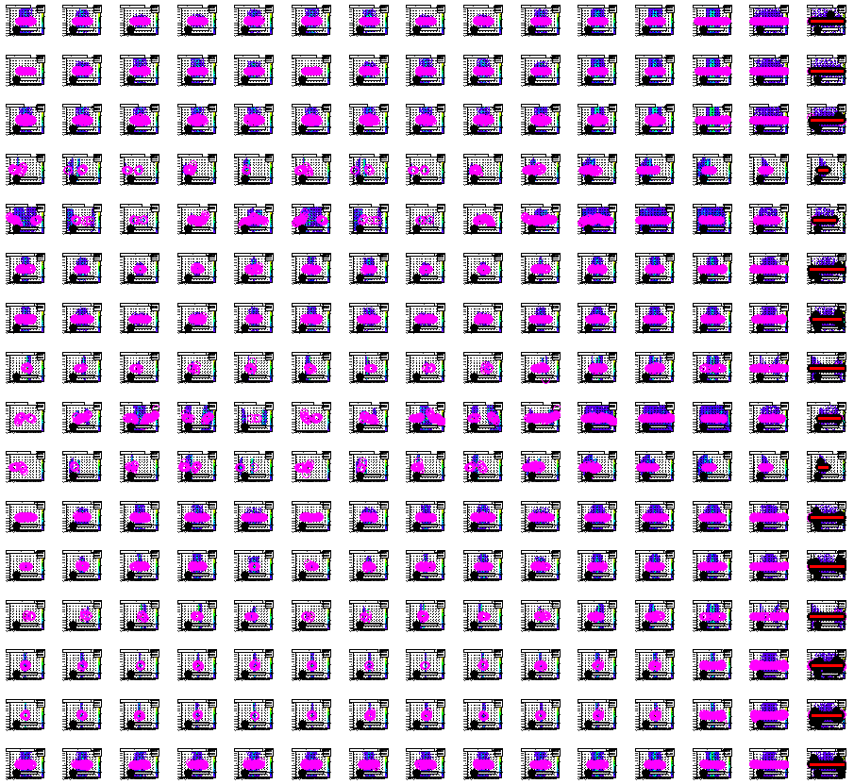
PXL sectors
PXL Halve 1/2 ALL
IST SSD

Slide 3
Test Results
FIXED ALL+Vertex– MEDIUM STATS
dX mkm dY mkm dZ mkm alpha mrad beta mrad gamma mrad Comment
Statistics matter (up to a point)
Averages come from several histo fits

Slide 4
Test Results
SHIFTED SSD (some ladders) – MEDIUM STATS
dX mkm dY mkm dZ mkm alpha mrad beta mrad gamma mrad Comment
Statistics matter (up to a point)
Averages come from several histo fits
Missing points are artifact (see next slides)

Slide 5
Test Results
FIXED – MED STATS
dX mkm dY mkm dZ mkm alpha mrad beta mrad gamma mrad Comment
Averages result from several fits

Slide 6
Test Results
FIXED – MED STATS
dX mkm dY mkm dZ mkm alpha mrad beta mrad gamma mrad Comment
Averages result from several fits

Slide 7
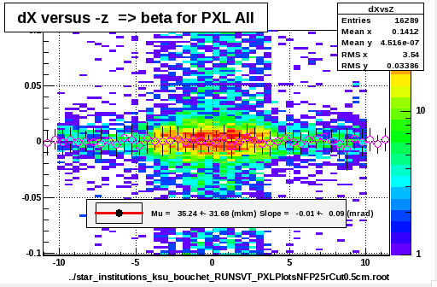
7

