Slide 1
The Physics of HFT
the Heavy Flavor Tracker at STAR
Spiros Margetis
Kent State University, USA
Excited QCD 2010

Slide 2
The Bottom Line
Hot and dense matter with strong collectivity has been formed in Au+Au collisions at RHIC. Study the properties of the new form of matter requires more penetrating probes like heavy quark. New micro-vertex detector is needed for STAR experiment.
PHENIX has a similar approach, but with a different philosophy.
DM12: “Measure production rates, high pT spectra, and correlations in heavy-ion collisions at √s_{NN} = 200 GeV for identified hadrons with heavy flavor valence quarks to constrain the mechanism for parton energy loss in the quark-gluon plasma.”

Slide 3
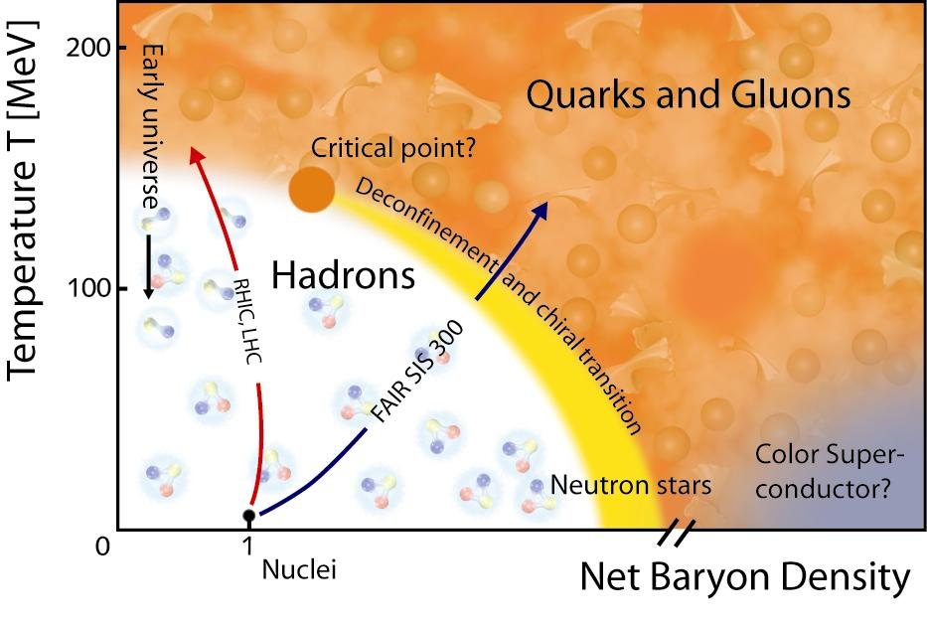
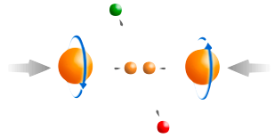
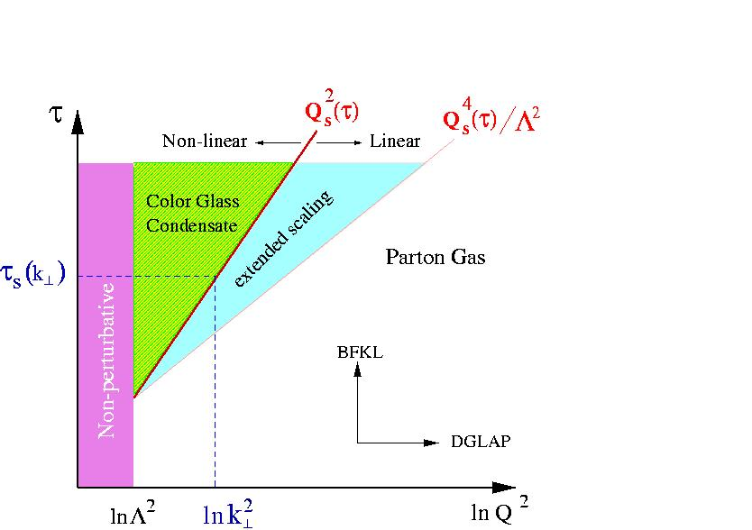
STAR Physics Focus
1) At 200 GeV top energy
- Study medium properties, EoS
- pQCD in hot and dense medium
2) RHIC beam energy scan
- Search for the QCD critical point
- Chiral symmetry restoration
Spin program
- Study proton intrinsic properties
Forward program
- Study low-x properties, search for CGC
- Study elastic (inelastic) processes (pp2pp)
- Investigate gluonic exchanges

Slide 4
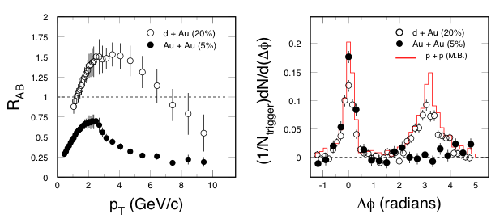
Partonic Energy Loss at RHIC
STAR: Nucl. Phys. A757, 102(2005).
Central Au+Au collisions: light quark hadrons and the away-side jet in back-to-back ‘jets’ are suppressed. Different for p+p and d+Au collisions.
Energy density at RHIC: ε > 5 GeV/fm³ ~ 30ε₀
Explore pQCD in hot/dense medium
R_{AA}(c,b) measurements are needed!

Slide 5
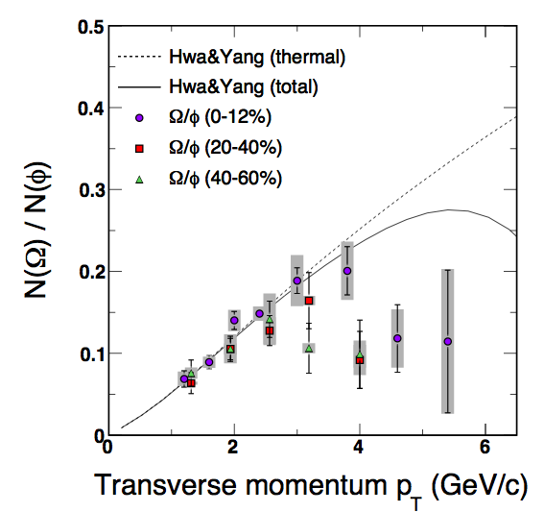
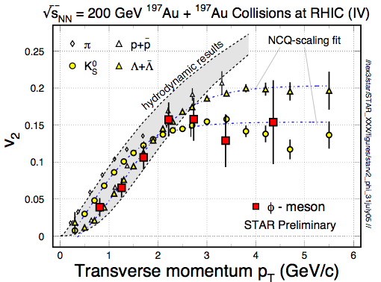
φ -meson Flow: Partonic Flow
STAR: Phys. Rev. Lett. 99, 112301(2007).
“φ-mesons (and other hadrons) are produced via coalescence of seemingly thermalized quarks in central Au+Au collisions. This observation implies hot and dense matter with partonic collectivity has been formed at RHIC”
In order to test early thermalization: v₂(p_{T}) of
c- and b-hadrons data are needed!

Slide 6
Partonic Collectivity at RHIC
STAR: preliminary
STAR: QM2009
Low p_{T} (≤ 2 GeV/c): hydrodynamic mass ordering
High p_{T} (> 2 GeV/c): number of quarks ordering
s-quark hadron: smaller interaction strength in hadronic medium
light- and s-quark hadrons: similar v₂ pattern
=> Collectivity developed at partonic stage!

Slide 7
The QCD Phase Diagram and High-Energy Nuclear Collisions
The nature of thermalization at the top energy:
Heavy quarks
Di-lepton
1
T_{ini}, T_{C}
LHC, RHIC
2
T_{E}
RHIC, FAIR
3
Phase boundary
RHIC, FAIR, NICA
Early Universe
quark-gluon plasma
1
2
3
T_{E}
Critical Point?
Temperature
hadron gas
CSC
nuclei
Baryon Chemical Potential

Slide 8
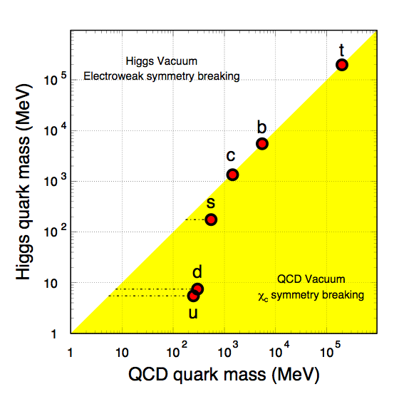
Quark Masses
- Higgs mass: electro-weak symmetry breaking (current quark mass).
- QCD mass: Chiral symmetry breaking (constituent quark mass).
Strong interactions do not affect heavy-quark mass.
New scale compare to the excitation of the system.
Study properties of the hot and dense medium at the foremost early stage of heavy-ion collisions.
Explore pQCD at RHIC.
Total quark mass (MeV)
X. Zhu, et al, Phys. Lett. B647, 366(2007).

Slide 9
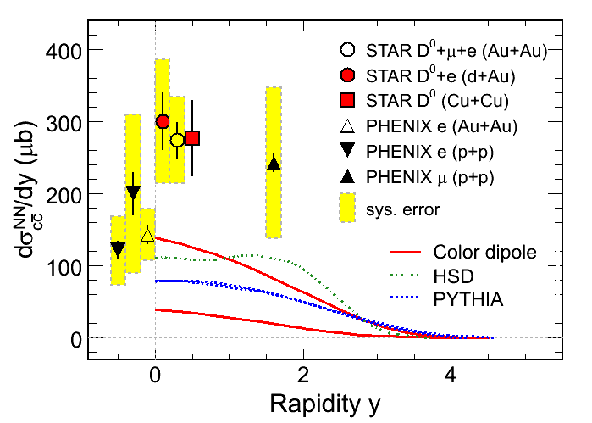
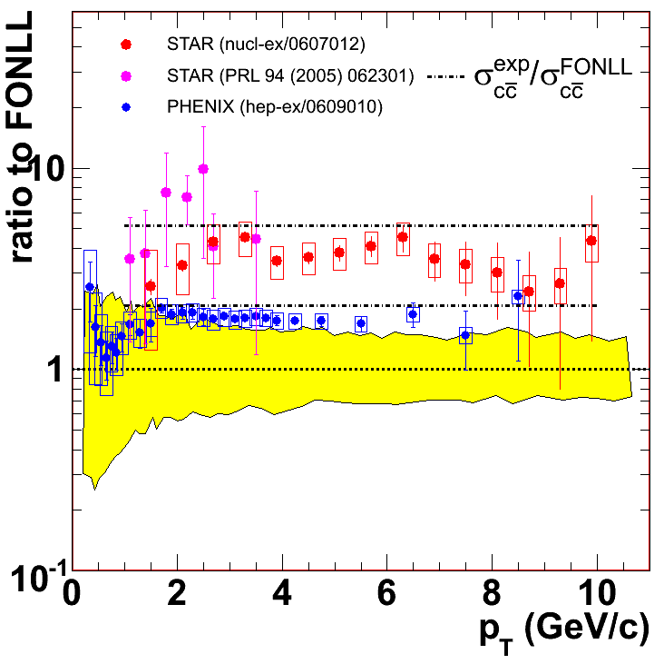
Charm Cross Sections at RHIC
Large systematic uncertainties in the measurements
New displaced, topologically reconstructed measurements for c- and b-hadrons are needed ⇦ Upgrade

Slide 10
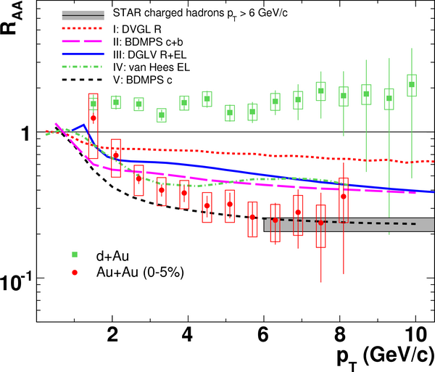
Heavy Quark Energy Loss
STAR: Phys. Rew. Lett, 98, 192301(2007).
1) Non-photonic
electrons decayed
from - charm and
beauty hadrons
2) At p_{T} ≥ 6 GeV/c,
R_{AA}(n.p.e.) ~ R_{AA}(h±)!
contradicts to naïve
pQCD predictions
Surprising results -
- challenge our understanding of the energy loss mechanism
- force us to RE-think about the collisional energy loss
- Requires direct measurements of c- and b-hadrons.

Slide 11
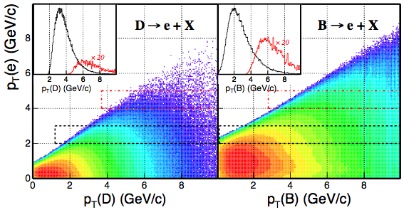
Decay e p_{T} vs. B- and C-hadron p_{T}
Key: Directly reconstructed heavy quark hadrons!
Pythia calculation Xin Dong, USTC October 2005

Slide 12
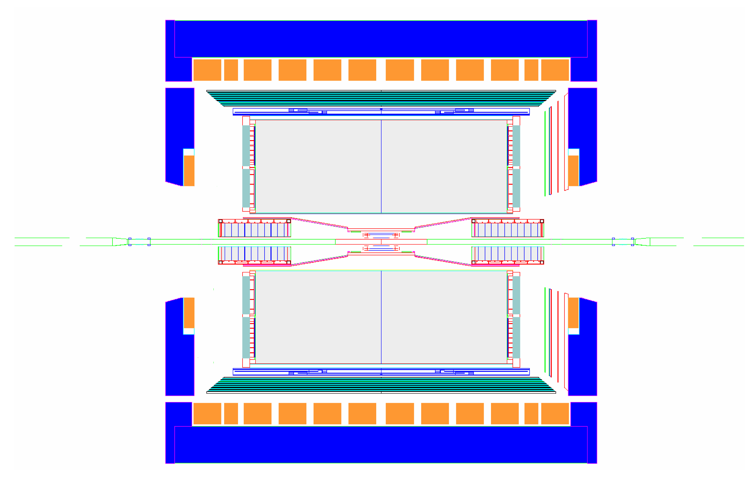
STAR Detector
MRPC ToF barrel
100% ready for run 10
MTD
EMC barrel
EMC End Cap
FMS
BBC
FPD
TPC
FHC
PMD
DAQ1000
Completed
HLT
HFT
FGT
Ongoing
R&D

Slide 13
Requirement for the HFT
 | Measurements | Requirements
Heavy Ion | heavy-quark hadron v₂ - the heavy-quark collectivity | - Low material budget for high reconstruction efficiency p_{T} coverage ≥ 0.5 GeV/c mid-rapidity High counting rate
 | heavy-quark hadron R_{AA} - the heavy-quark energy loss | High p_{T} coverage ~ 10 GeV/c
p+p | energy and spin dependence of the heavy-quark production | - p_{T} coverage ≥ 0.5 GeV/c
 | gluon distribution with heavy quarks | - wide rapidity and p_{T} coverage

Slide 14
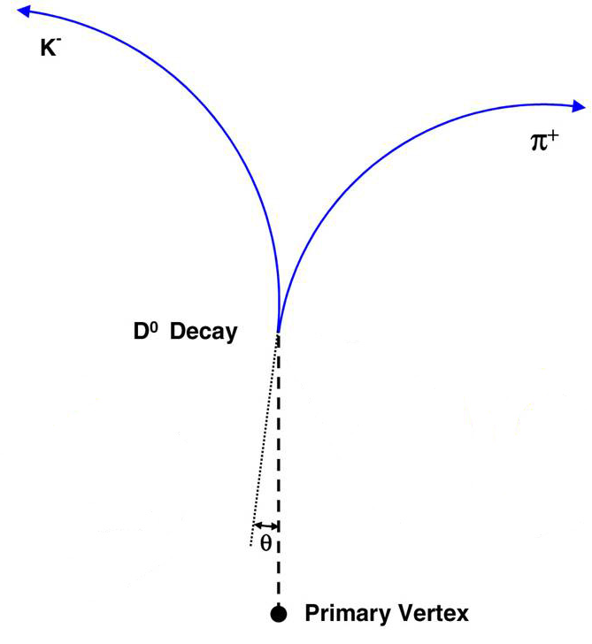
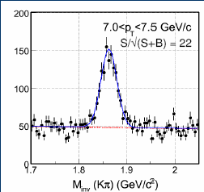
D⁰ Reconstruction Efficiency
- Central Au+Au collisions: top 10% events.
- The thin detector allows measurements down to p_{T} ~ 0.5 GeV/c.
- Essential and unique!

Slide 15
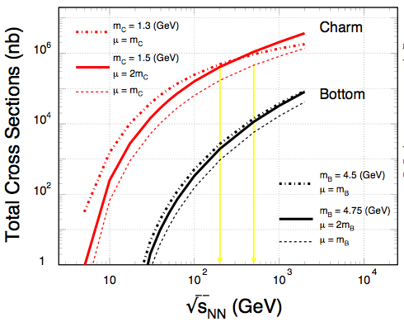
Heavy Quark Production
NLO pQCD predictions of charm and bottom for the total p+p hadro-production cross sections.
Renormalization scale and factorization scale were chosen to be equal.
RHIC: 200, 500 GeV
LHC: 900, 14000 GeV
Ideal energy range for studying pQCD predictions for heavy quark production.
Necessary reference for both, heavy ion and spin programs at RHIC.
RHIC LHC

Slide 16
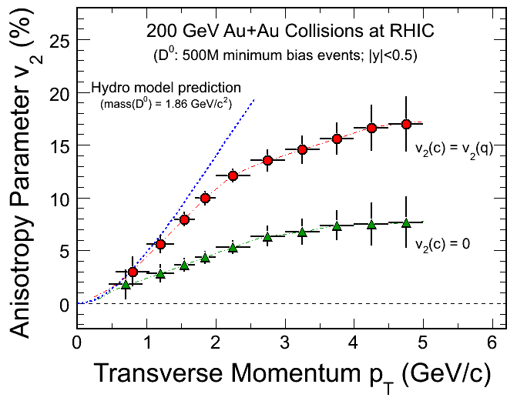
Charm Hadron v₂
Charm-quark flow
→ Thermalization
of light-quarks!
Charm-quark does
not flow
→ Drag coefficients
- 200 GeV Au+Au minimum bias collisions (500M events).
- Charm collectivity  drag/diffusion constants  medium properties!
Notes:
Hydro model: Pasi Huovinen, private communication, January 2008.
Just to remind you: these calculations were done using my "standard" set of parameters: initial time 0.6 fm/c, first order phase transition at T_c=165 MeV, chemical equilibrium all the way until until kinetic freeze-out, freeze-out at T_f=130 MeV reproduces pion spectra and (anti)proton p_T-slope, initial profiles as a combination of participant and binary collision scaling.

Slide 17
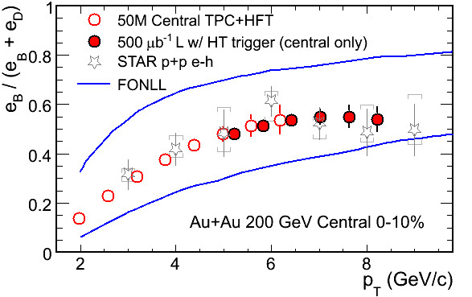
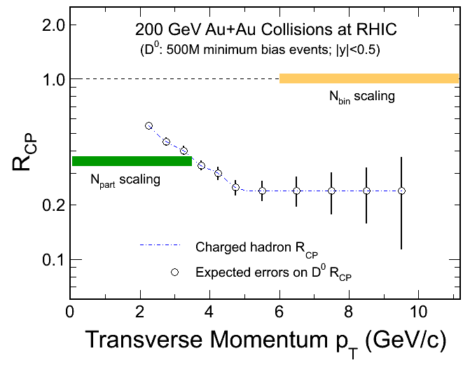
Charm Hadron R_{CP}
NEW
R_{CP}=a*N^{10%}/N^{(60-80)%}
Significant Bottom contributions in HQ decay electrons.
200 GeV Au+Au minimum bias collisions (|y|<0.5 500M events).
Charm R_{AA}  energy loss mechanism!
Notes:
10%

Slide 18
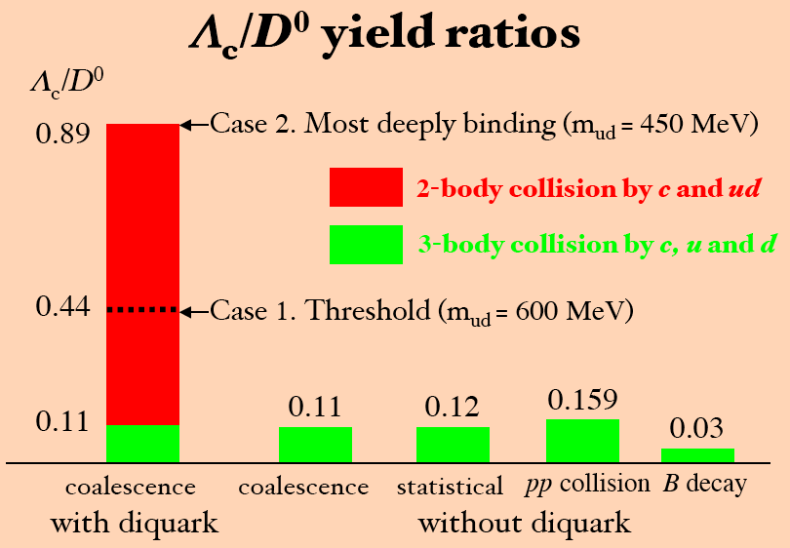
Charm Baryon/Meson Ratios
Λ_{C} → pK⁻π⁺
D⁰ → K⁻π⁻⁺
2-body collisions by c and ud
3-body collisions by c, u and d
QGP
medium
Y. Oh, C.M. Ko, S.H. Lee, S. Yasui, Phys. Rev. C79, 044905(2009).
S.H. Lee, K.Ohnishi, S. Yasui, I-K.Yoo, C.M. Ko, Phys. Rev. Lett. 100, 222301(2008).

Slide 19
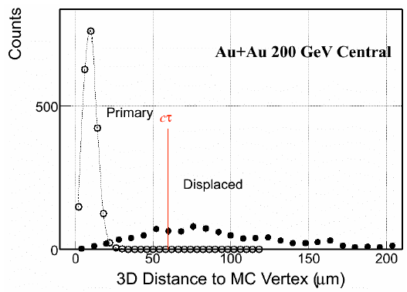
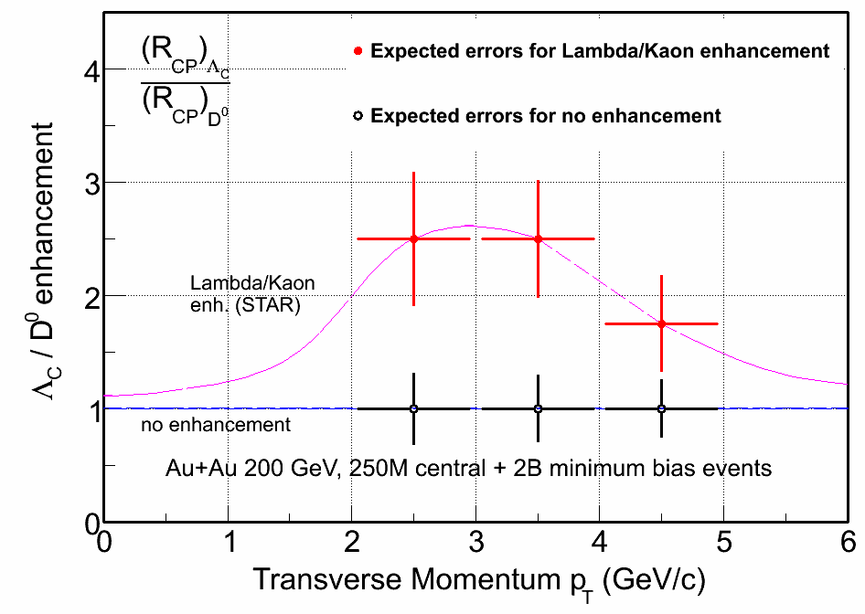
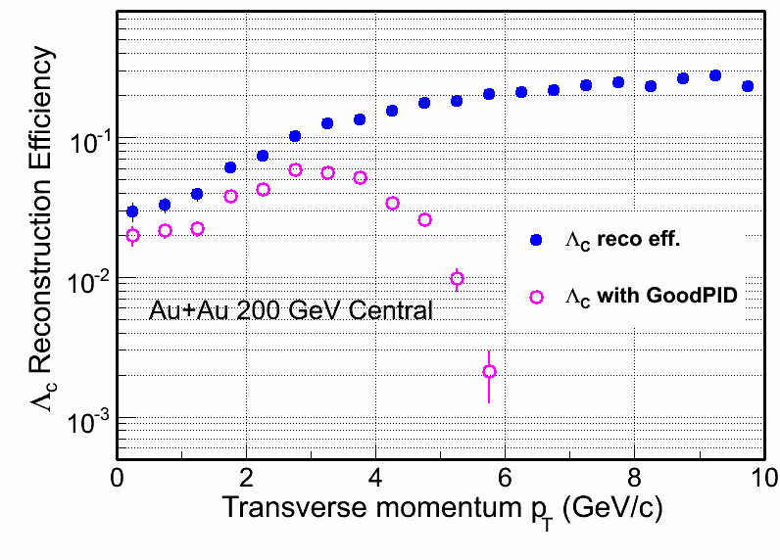
Λ_{C} Measurements
NEW
Λ_{C} ( ➔ p + K + π):
Lowest mass charm baryon
Total yield and Λ_{C}/D⁰ ratios can be measured.

Slide 20
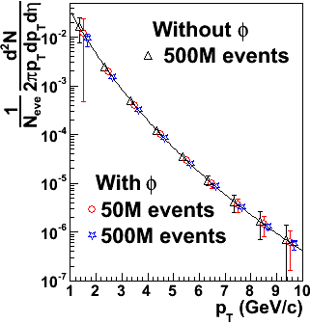
D_{s} Reconstruction
NEW
200 GeV Central Au+Au Collisions at RHIC
D_{s}→ K⁺K⁻π (BR 5.5%)
D_{s}→φπ→ K⁺K⁻π (BR 2.2%)
mass = 1968.49 ± 0.34 MeV
decay length ~ 150 μm
Work in progress …
200 GeV central Au+Au
Ideal PID
Power-law spectrum with:
n = 11, <p_{T}> = 1 GeV/c
0.5B events will work!

Slide 21
Strategies for Bottom Measurement
(1) All Charm states
( D^{0,±}, D_{s}, Λ_{C} )
(1.a) Displaced vertex
electrons (TOF+HFT)
⇦
⇦
(2) Charm decay electrons
(Charm)
⇦
(1.a) - (2)
⇦
Some Bottom states
(Statistics limited at RHIC)
Bottom decay electrons
Measure Charm and Bottom hadron:
Cross sections, Spectra and v₂

Slide 22
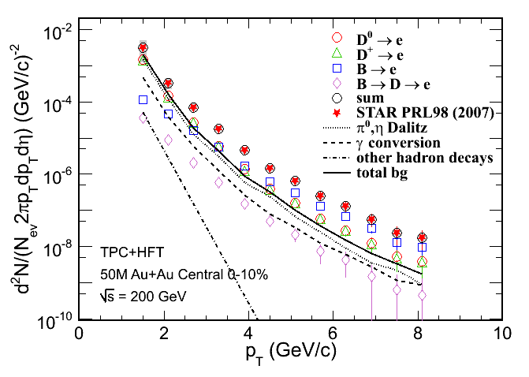
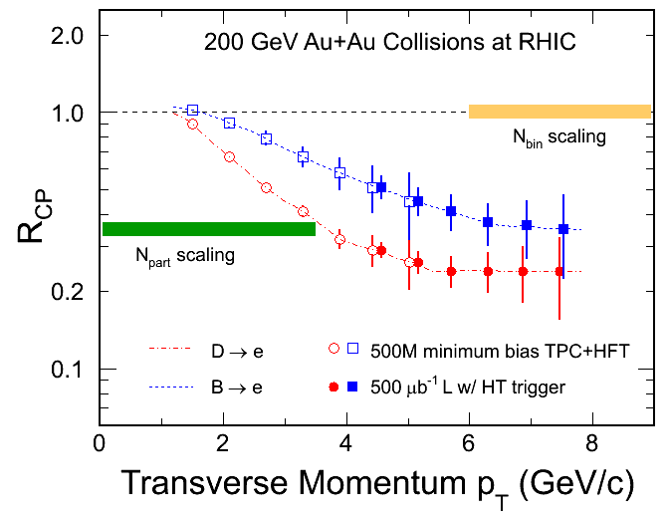
c- and b-decay Electrons
NEW
H. van Hees et al. Eur. Phys. J. C61, 799(2009). (arXiv: 0808.3710)
R_{CP}=a*N^{10%}/N^{(60-80)%}
DCA cuts  c- and b-decay electron distributions and R_{CP}
200 GeV Au+Au minimum biased collisions (|y|<0.5 500M events)
Notes:
10%

Slide 23
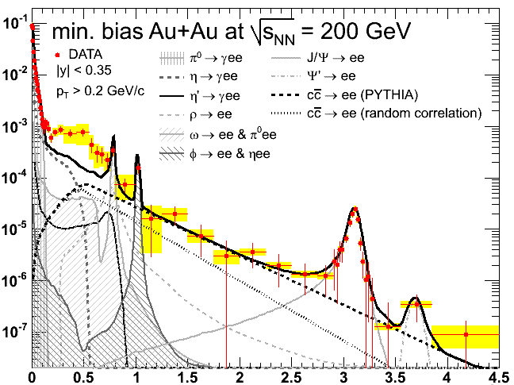
The di-Lepton Program at STAR TOF + TPC + HFT
ρ ϕ J/ψ
Direct
radiation from
the Hot/Dense
Medium
Chiral
symmetry
Restoration
⇧ A robust di-lepton physics program extending STAR scientific reach
(1) σ
(2) v₂
(3) R_{AA}
DY, charm Bk
PHENIX: 0706.3034
Mass (GeV/c²)
p_{T} (GeV/c)

Slide 24
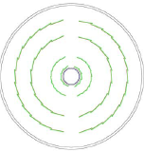
PHENIX and STAR Comparison
- 2-layer Si hybrid pixels: x/x₀ ~ 1.2%;
2.5cm inner radius; fast readout
- 2-layer Si strips, x/x₀ ~ 2%
p_{T} ≤ 2 GeV/c: e±
2 < p_{T} ≤ 6 GeV/c: D-mesons…
1 < p_{T} ≤ 6 GeV/c: B  J/ψ
PHENIX VTX
STAR HFT
2-layer CMOS: x/x₀ ~ 0.37% per layer;
2.5cm inner radius; 200μs integration
1-layer* Si strips
SSD: x/x₀ ~ 1%
e, D^{0,±,s,*}, Λ_{c} , B…
0.5 < p_{T} < 10 GeV/c: v₂, R_{AA}
D-D correlation functions
Notes:
Emphasize large acceptance, PID, good for D-D correlation analysis

Slide 25
Physics of the Heavy Flavor Tracker at STAR 1) The STAR HFT measurements (p+p and Au+Au) (1) Heavy-quark cross sections: D^{0,±,*}, D_{S}, Λ_{C} , B… (2) Both spectra (R_{AA,} R_{CP}) and v₂ in a wide p_{T} region: 0.5 - 8 GeV/c (3) Charm hadron correlation functions (4) Full spectrum of the heavy quark hadron decay electrons 2) Physics (1) Measure heavy-quark hadron v₂, heavy-quark collectivity, to study the medium properties e.g. light-quark thermalization (2) Measure heavy-quark energy loss to study pQCD in hot/dense medium e.g. energy loss mechanism (3) Measure di-leptions to study the direct radiation from the hot/dense medium (4) Analyze hadro-chemistry including heavy flavors

Slide 26
Projected Run Plan 1) First run with HFT: 200 GeV Au+Au  v₂ and R_{CP} with 500M M.B. collisions 2) Second run with HFT: 200 GeV p+p  R_{AA} 3) Third run with HFT: 200 GeV Au+Au  Centrality dependence of v₂ and R_{AA}  Charm background and first attempt for electron pair measurements  Λ_{C} baryon with sufficient statistics

Slide 27
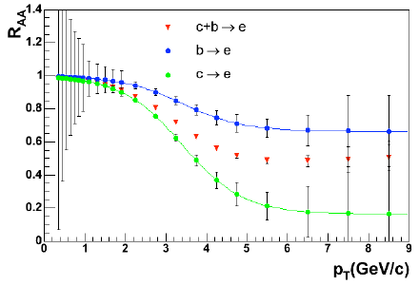
Auxiliary Slides (1)- R_{AA}
PHENIX VTX
STAR HFT
Blue: Assumed c decay e
Red: Assumed b decay e
Open Symbols: M.B. events, not trigger
Filled Symbols: triggered with HT
Cuts: DCA on decay electrons
Events: 200 GeV 500 M.B. Au + Au events
Y. Akiba, PHENIX, 2008.

Slide 28
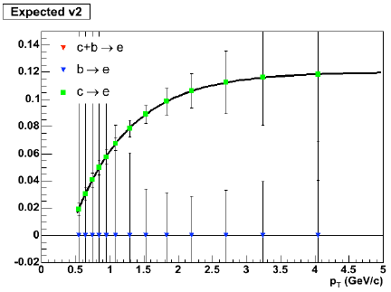
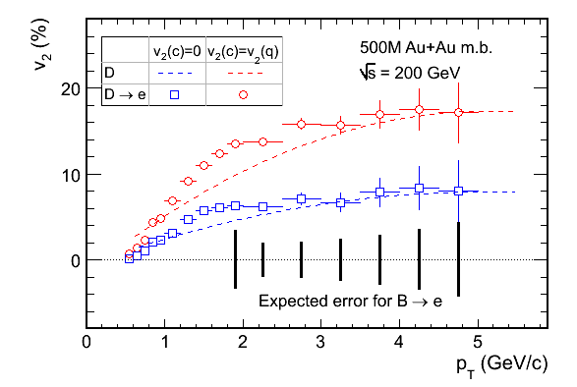
Auxiliary Slides (2)- v₂
PHENIX VTX
STAR HFT
Blue: c-quark flows // Red: c-quark does not
Dashed-curves: Assumed D⁰-mesom v₂(p_{T})
Symbols: D decay e v₂(p_{T})
Vertical bars: errors for b decay e v₂(p_{T}) from 200 GeV 500M minimum bias Au + Au events
Cuts: DCA on decay electrons
Y. Akiba, PHENIX, 2008.

