Slide 1
Alignment
S. Margetis, KSU
Old pages for SSD/SVT are here:
http://phys.kent.edu/~margetis/STAR/HFT/Survey/Alignment How-To.html
Working directory:
/star/institutions/ksu/margetis/hft/align
lrwxrwxrwx 1 margetis rhstar 26 Sep 4 10:55 data1 -> /star/data03/daq/2005/073//
lrwxrwxrwx 1 margetis rhstar 26 Sep 4 10:55 data2 -> /star/data03/daq/2005/076//
-rw-r--r-- 1 margetis rhstar 32801490 Sep 4 19:38 Event_6073006_raw_2020004.root
-rw-r--r-- 1 margetis rhstar 32148513 Sep 6 11:00 Event_6076003_raw_1030001.root
-rw-r--r-- 1 margetis rhstar 1237 Sep 6 08:27 history.txt
drwxr-xr-x 4 margetis rhstar 2048 Sep 5 10:22 plots/
drwxr-xr-x 3 margetis rhstar 2048 Aug 31 09:28 StarDb/
-rw-r--r-- 1 margetis rhstar 971656435 Sep 4 19:38 st_physics_6073006_raw_2020004.event.root
-rw-r--r-- 1 margetis rhstar 12047357 Sep 4 19:38 st_physics_6073006_raw_2020004.log
-rw-r--r-- 1 margetis rhstar 891354647 Sep 6 11:00 st_physics_6076003_raw_1030001.event.root
-rw-r--r-- 1 margetis rhstar 10721763 Sep 6 11:01 st_physics_6076003_raw_1030001.log
drwxr-xr-x 3 margetis rhstar 2048 Aug 31 09:28 StRoot/
-rwxr-xr-x 1 margetis rhstar 1512 Aug 31 09:50 subm.pl*

Slide 2
Procedure:
OLD SSD/SVT
TPC only tracks
Global alignment of SSD (+SVT) with respect to TPC
(Local) Alignment of SSD ladders:
TPC + SSD tracks
(Global) Alignment of SVT Clam Shells
(Local) Alignment of SVT ladders
TPC + SSD + SVT tracks
Check consistency and
re-evaluate SVT & SSD hit errors
Statistics needed:
1 mm → ~20 micron: reduction factor 50
~2,500 tracks per SVT sensor
data sample with ~250,000 tracks -> 250K CuCu events

Slide 3
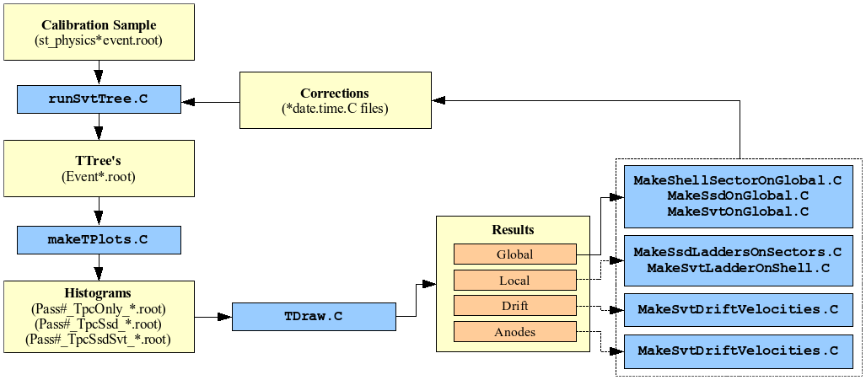
The sequence to be followed for each detector is:
1) SSD Alignment: (TPC tracks Only)
Global - SSD on Global and Sectors on Global;
Local - SSD Ladders on Sectors;
2) SVT Alignment: (TPC+SSD hits on tracks)
Global - SVT on Global and Shells on Global;
Local - SVT Ladders on Shells; (Drift Velocities);
3) Consistency Check: (TPC+SSD+SVT hits on tracks)
Global;Local (ladders);Drift Velocities;

Slide 4
Procedure:
HFT
Remember: PXL detector is a big asset (avoid TPC distortions):
Global Alignment of PXL sectors
Relative alignment of PXL halves using overlap region AND using Event vertex found by each half (hit level)
Global positioning in STAR (TPC) using primary TPC tracks
Primary tracks with TPC+PXL hits
Alignment of IST ladders with respect to PXL
Primary tracks with (All – SSD) hits
Alignment of SSD ladders
Check
We assume that ladders on sectors and sectors in halves are pre-surveyed to specs
Other methods (Millepede) should be developed in parallel

Slide 5
BackUp

Slide 6
Alignment methods (outline only)
There are ‘Global’ and ‘Self’ Alignment methods
use ‘external’ track info or ‘internal’
We lack a hardware monitoring system. Once detectors are installed we rely on survey and alignment software
We have successful ‘Global’ methods already in place
Software can be re-checked with simulations [->need (now have) geometry]. In SVT era precision was 10 microns and 0.1mrad
In PXL era should practically vanish
Specific alignment procedures might be different (next slide)
We now have significant sensor overlap to make use of ‘Self’ alignment methods. Industry standard is ‘Millepede’ code which was successfully used in Alice and elsewhere

Slide 7
Figure of merit for HFT alignment.
For alignment we use “good” (well defined) tracks fitted with the primary vertex.
Use of primary tracks significantly improves precision of track predictions in Silicon detectors and reduces influence of systematics.
In order to minimize TPC space-charge distortions (and PXL pileup) we will need to use low luminosity data
Pointing accuracy, aka Impact parameter resolution:
DCA resolution (in bending XY ≡ρφ plane: σ_{DCA}), and resolution in non-bending plane: σ_{z}, is figure of merit
σ²_{DCA}= σ²_{vertex}+ σ²_{track} + σ²_{MCS} (the same for non-bending plane),
primary vertex resolution: σ_{vertex} ~ 3μm+(120 μm / √N_{ch}); for central Au+Au collisions turns out to be ~5 μm
track pointing resolution: σ_{track} ~ 1.5 σ_{XY} in our case, where σ_{XY} is intrinsic detector precision (~10μm) ⊕ alignment errors,
Multiple Coulomb Scattering (MCS): σ_{MCS} ~ 20μm / βp (GeV/c) (for thin PXL)
Overall mis-alignments of < 10 μm are acceptable (no big impact)
Notes:
Heavy d

