Slide 1
Geometry update
J. Bouchet, F. Videbaek

Slide 2
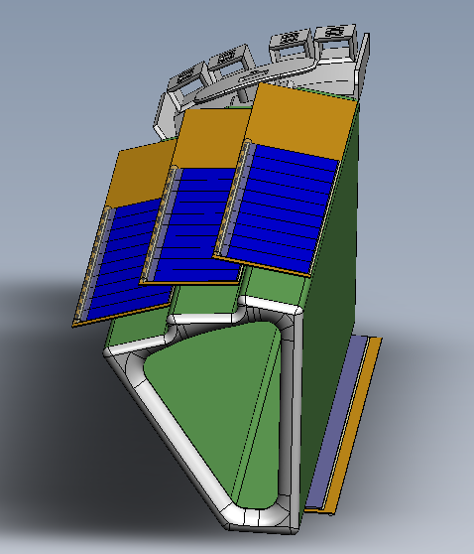
Using Flemming’s tool to
translate SolidWork Model
to a “root” geometry, the full pixel
geometry is implemented

Slide 3
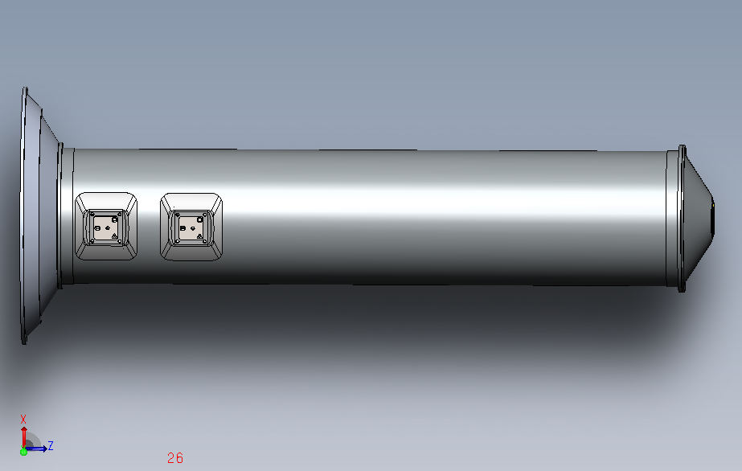
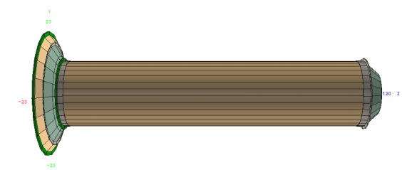
Pixel Support Tube
The same is being done for the PST
(see slides 5,6 for details)

Slide 4
summary
The pixel detector has been implemented in the new geometry software :
The pixel is part of the IDSM
After correct GEANT hits decoding, STAR software reconstruction chain with this new geometry is possible
To check : ladder numbering
The PST geometry is about to be finalized
Next steps :
Implement the PST within the IDSM
Put the correct material for the PST structure
Rerun simulations

Slide 5
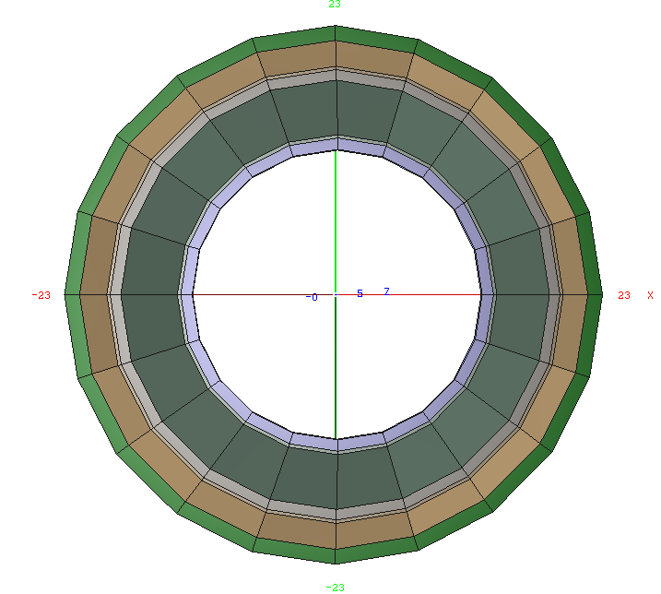
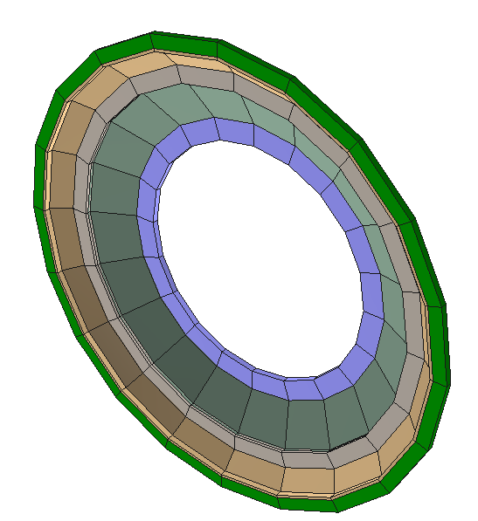
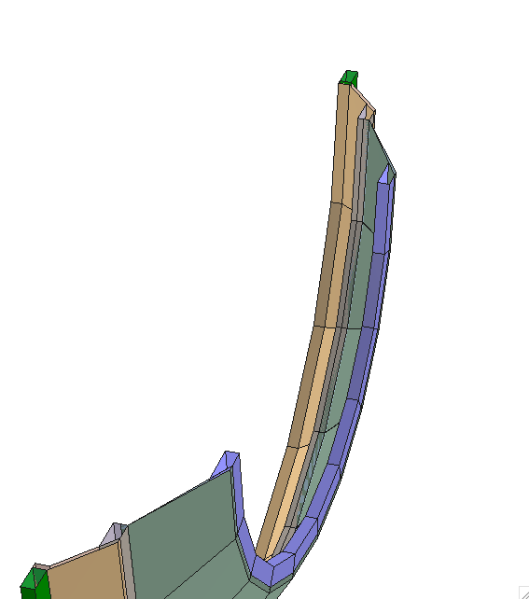
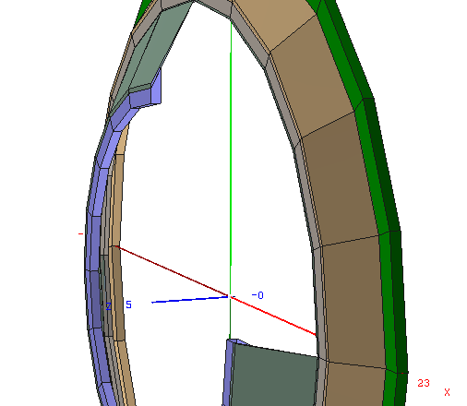
From inside
From front
Front : Cross section

Slide 6
