Slide 1
HFT-Beam Pipe
D. Beavis
BNL
March 14, 2012

Slide 2
Overview
Update on new Beam pipe
Assembly drawing
Material changes
Length changes
Outlook

Slide 3
Assembly

Slide 4
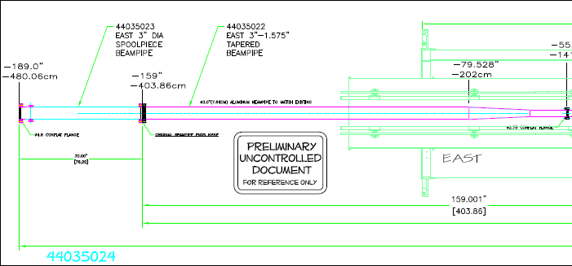
East end changes
Spool piece 30 inches 316 SS
Taper shorter and flanges are Al-TI bimetal

Slide 5
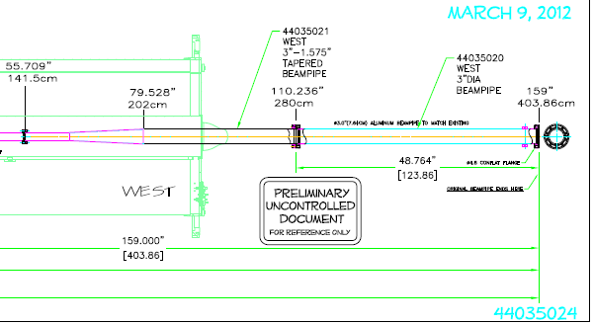
West changes
Tapered section shorter and has Al-Ti flanges
Section from 280cm to 403 cm may be desirable to be SS or Ti for cost purposes

Slide 6
Outlook
Awaiting for cost/schedule for NEG coating and heating jacket
Determining how to fabricate the Al2219 pipe
May try other alloys
May machine from solid piece
All fabrication awaiting the determination of the Al2219 pipe
Still appears that pipe can be complete in time for the next run. Will update as get schedule details
Update (3/14/12)
We heard from CERN and they can have the Be pipe NEG coated and wrapped by the end of June.
The Italian company will respond by tomorrow. They need to look up one more price on things.
Also CERN said they could provide the heating material to us so that BNL can wrap the pipes.

