Slide 1
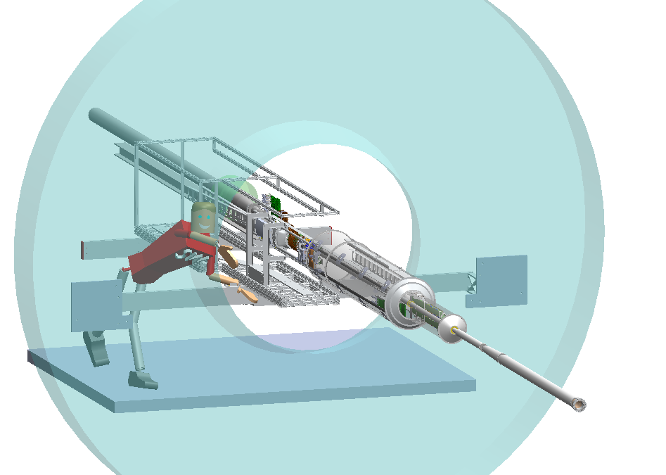
Examination of clearances with Ultimate chip ladders, old sector geometry
Ladders have new cable and chips
The sector geometry is the same as used for phase 1.
This model will come up with mating errors. These can be cleared by simply opening the sub assembly: DuctAndSupportHalf_FP.SLDASM This then allows one to slide the detector along the insertion path. At least that is true on my computer. There are two versions of the detector in this assembly, one with signal cables and one without. It is easiest to slide the detector halves that don’t have signal cables. That would be:
PXL_GIZMO.SLDASM (north and south)
The one with signal wires that is harder to move is:
PXL_GISMO_wire_bxed.SLDASM
The clearance checks to be shown on the following pages were obtained from a new BxPxFit.SLDASM using the ultimate ladders.
The model location:
http://www-rnc.lbl.gov/~wieman/BxPxFit%20u.zip
model does not contain latest kinematic mounts

Slide 2
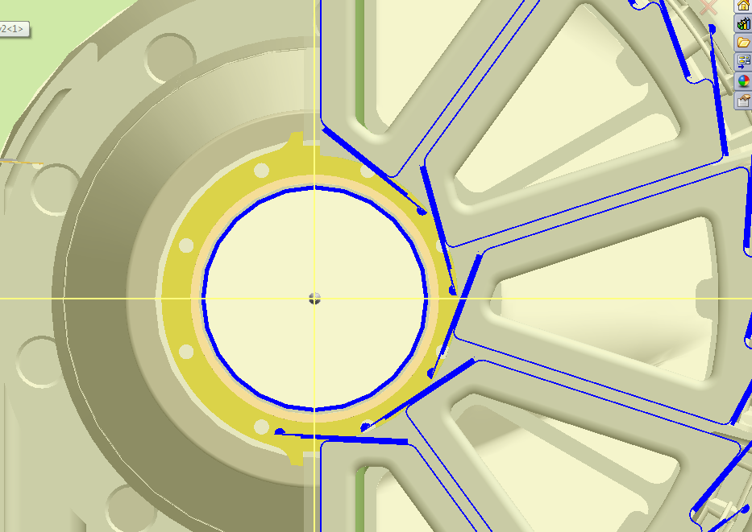
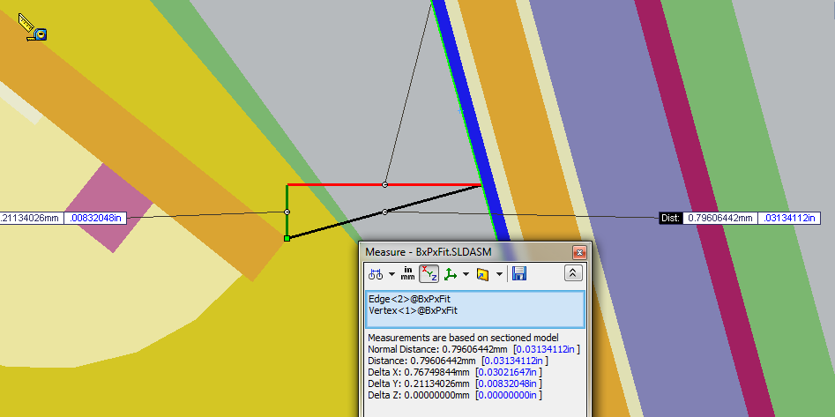
ladder to ladder minimum clearance: 0.80 mm

Slide 3
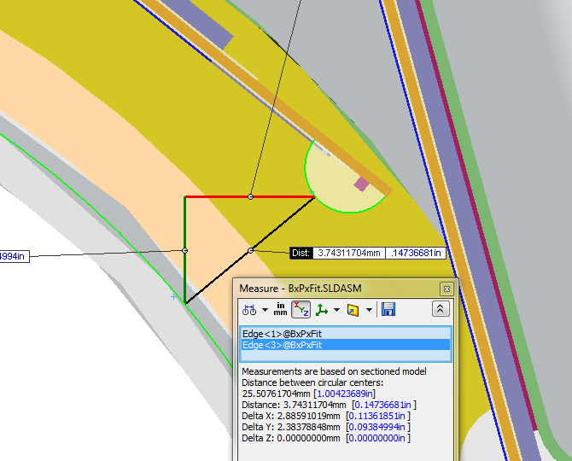
PXL in operating position
ladder to beam pipe minimum distance: 3.7 mm

Slide 4
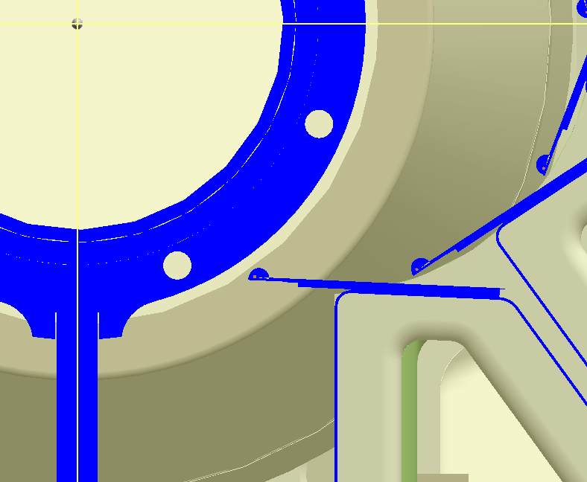
PXL partially withdrawn
minimum distance between ladder wire bond and inner beam pipe support collar: 1.35 mm
This is too close, but can modify design of the support collar

Slide 5
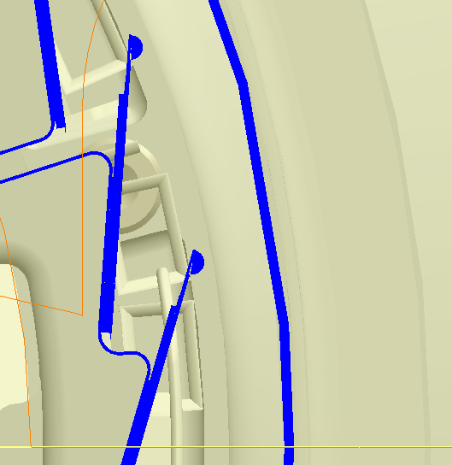
PXL partially withdrawn
minimum distance between ladder and MSC: 5.5 mm

Slide 6
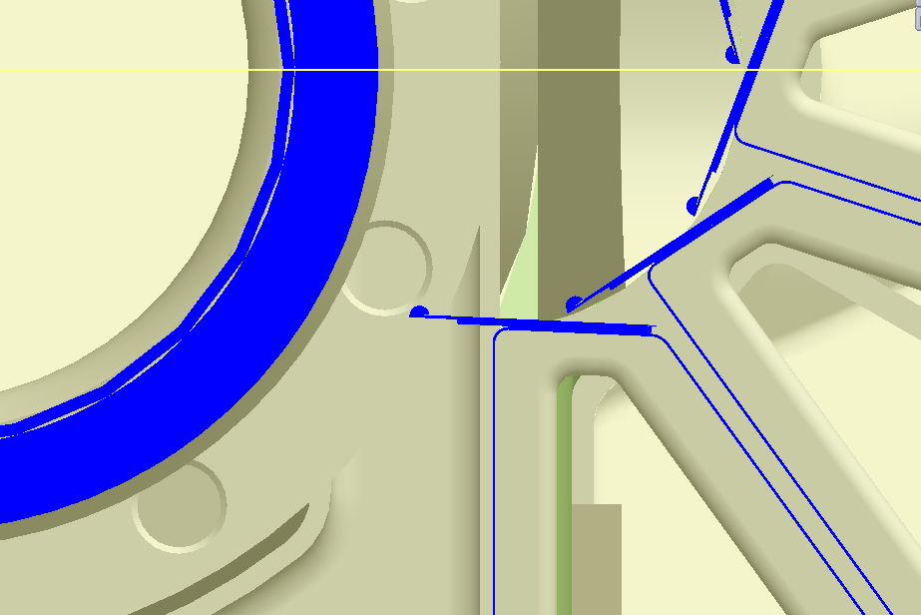
PXL passing over the larger beam pipe section and insulation
Minimum distance from ladder to beam pipe insulation: 7.2 mm

Slide 7
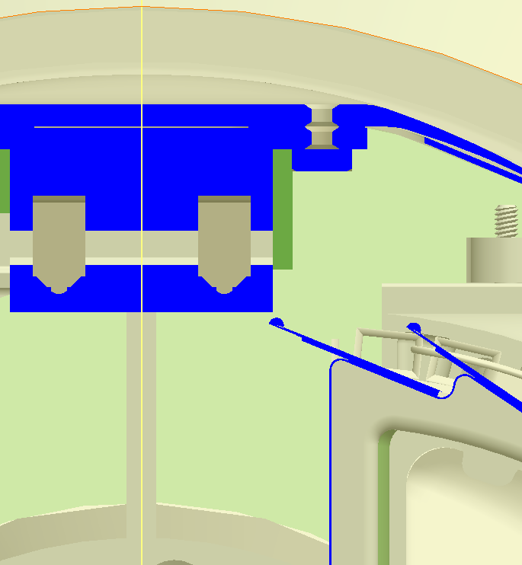
PXL passing by the kinematic mounts
ladder to mount minimum distance: 0.77 mm
Note this model does not have Joe’s latest kinematic mounts
This is too close, but it should be possible to design the mounts to clear. This has to be checked with the lower mount as well with the north PXL half. The south PXL half is shown here.

Slide 8
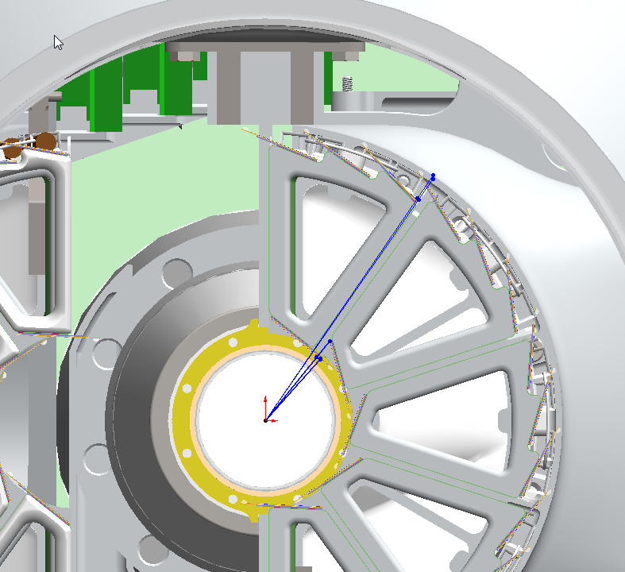
Active silicon overlap, outer and inner layers
overview diagram, details magnified on following two pages

Slide 9
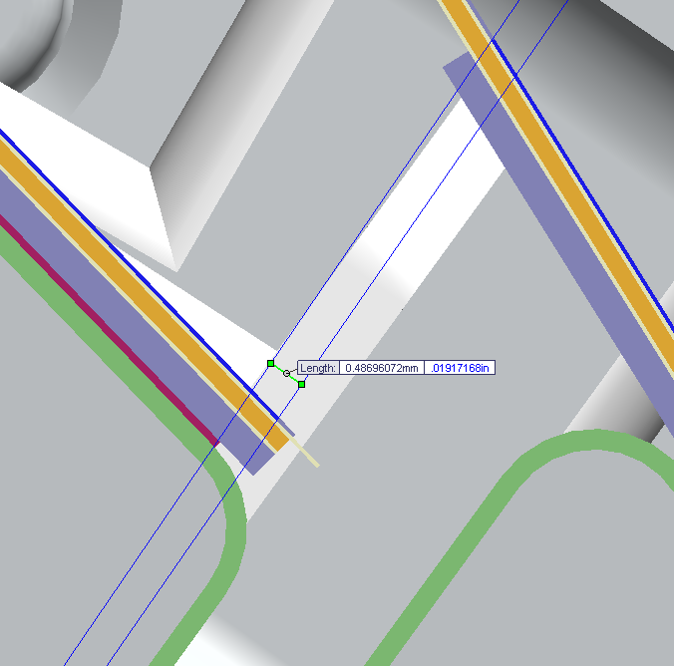
active silicon overlap outer ladders: 0.49 mm

Slide 10
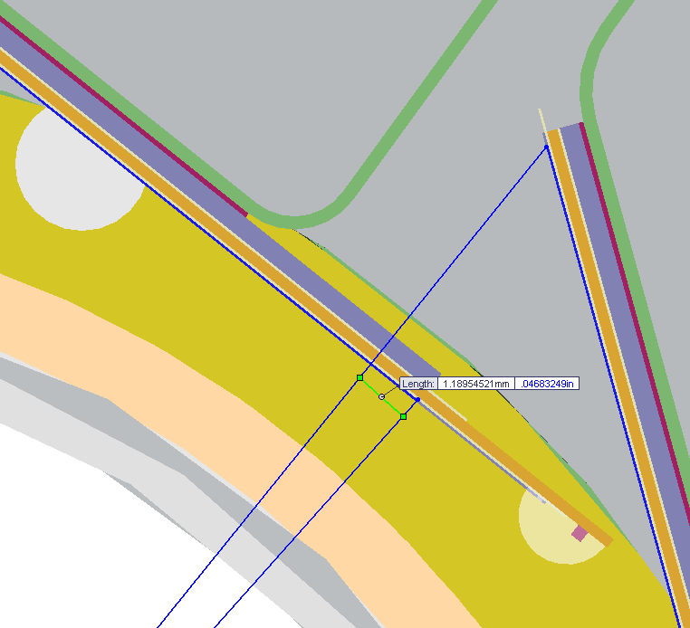
active silicon overlap inner ladders: 1.19 mm

