Slide 1
HFT project Overview and Status March 10, 2010
F.Videbaek
BNL

Slide 2
Welcome introduction
Organization
Today: talks by sub-system
Brief overview
Progress since pre CD-1 review
Plans towards finalizing design
Development plans
Tomorrow:
Management meeting
Grounding plans
Preparation for TDR, WBS , CD-2/3 review
Closeout- delegation of tasks

Slide 3
Content
Brief (very) overview
Review of homework
Completed
Yet to come
Preparations for CD-2/3

Slide 4
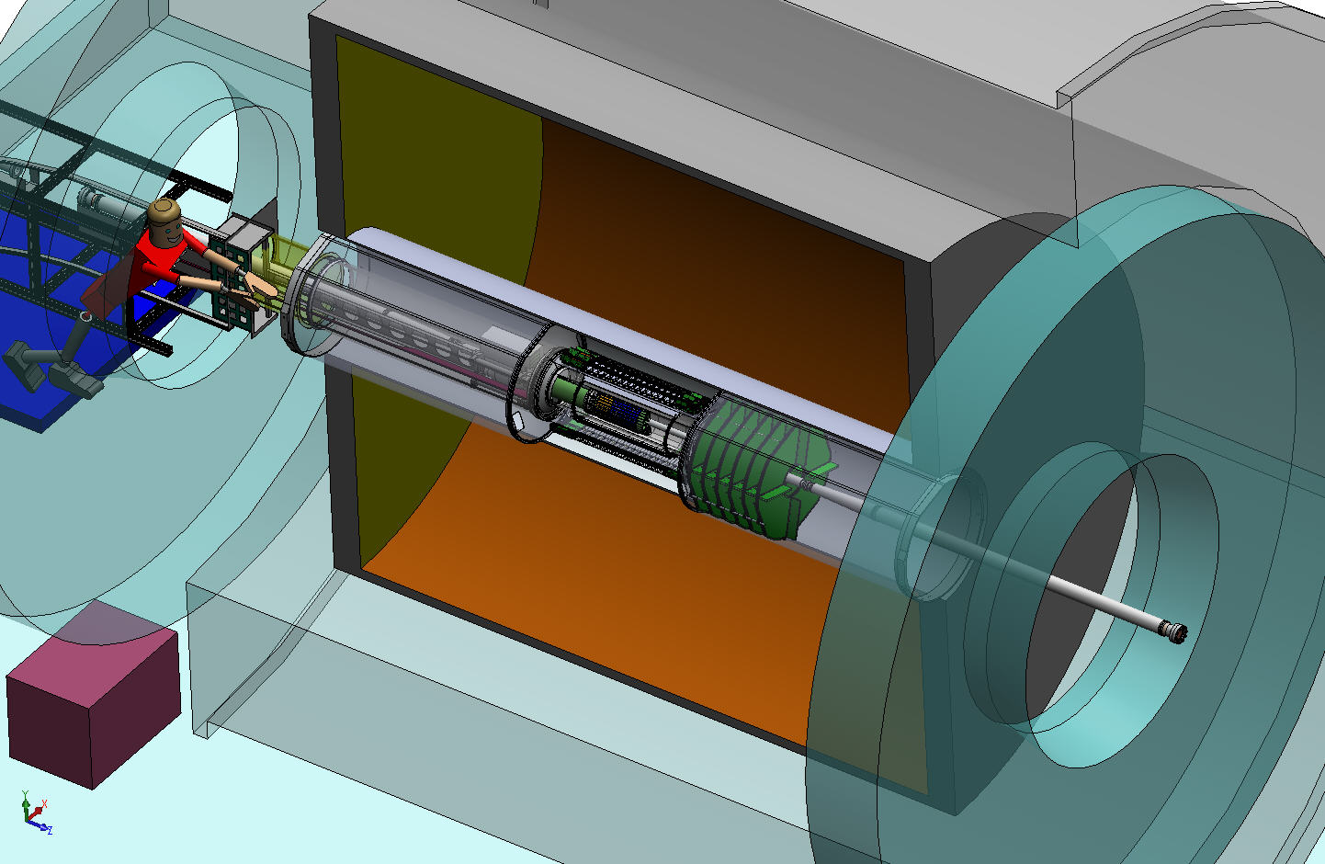
HFT Detector within STAR IFC
HFT
SSD
IST
PXL
IFC
Inner Field Cage
Magnet
Return Iron
OFC
Outer Field Cage
FGT
TPC Volume
Solenoid
EAST
WEST

Slide 5
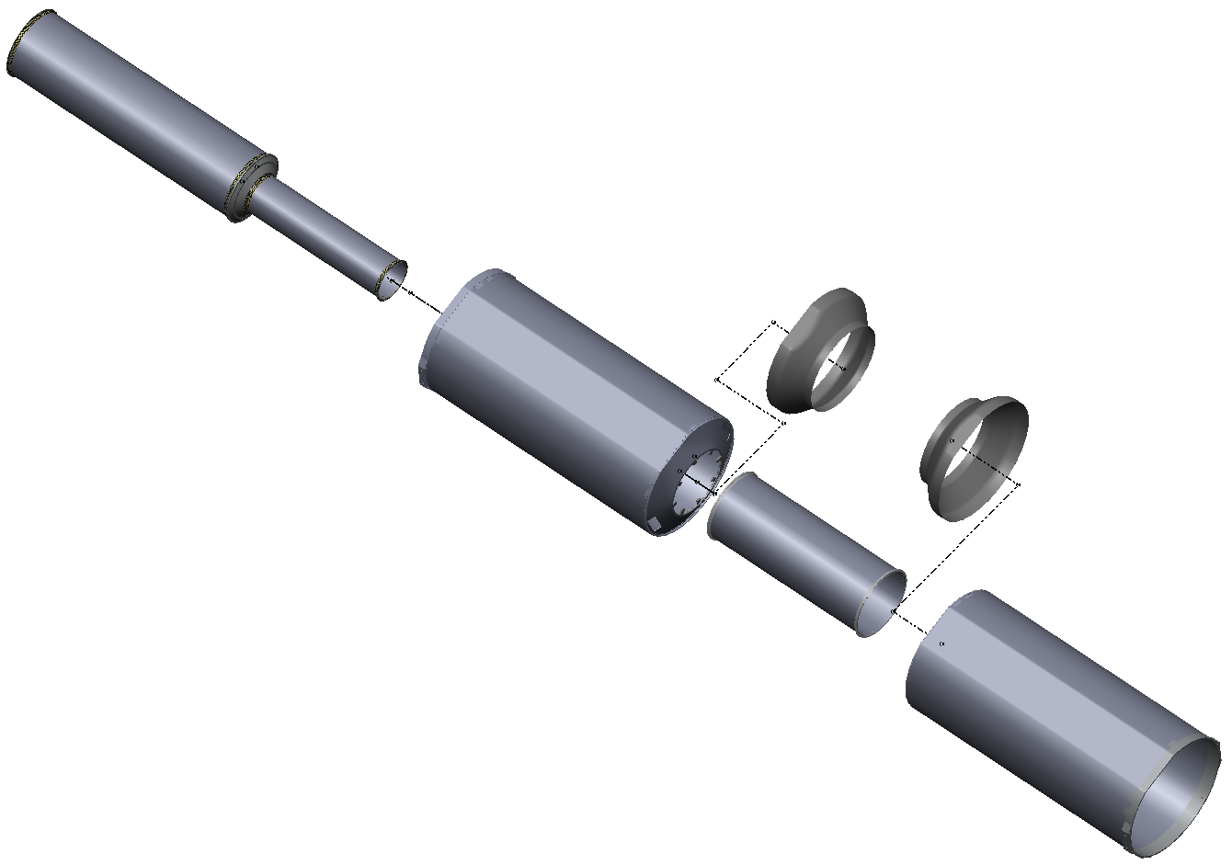
Naming Conventions
IDS
East Support Cylinder
Outer Support Cylinder
West Support Cylinder
PIT
Middle Support Cylinder
PST
Shrouds
MSC
Pixel Insertion Tube
Pixel Support Tube
ESC
OSC
Inner Detector Support
Assembly via bolted interfaces
MSC installed into IDS after IDS assembled (detectors not shown)
IDS w/MSC installed into STAR
WSC

Slide 6
Basic requirements

Slide 7
Review of CD-1 homework
Develop a plan for a ladder system test as soon as possible, using the available MIMOSA-26 chip, which has the architecture fully validated for the needs of STAR. Report draft system test plan to DOE by December 31, 2009.
Prepared by Leo++ and submitted on Dec 31.

Slide 8
Labor contributions
Provide, by institution, an annual breakdown of the project cost into capital, labor costed to the project, requested redirected labor cost, and all contributed labor. Submit to DOE by December 31, 2009.
This is quite a new twist on DOE management, normally contributed labor is non accounted for. We did gather the information and submitted a report.

Slide 9
We were requested to detail this further with names etc. Ready for submission.

Slide 10
reports
Evaluate the cost, schedule and workforce trade-offs between adding a second layer to the IST and a single-layer IST plus retaining the SSD. Report results to DOE by March 1, 2010.
Prepared by Gerrit
Submitted March 2 by Vigdor quoting
The bottom line is that choosing a second IST layer would add very substantial cost and time delay to the HFT project, while not improving the anticipated performance from even an SSD that suffers loss of some fraction of its sensors or readout electronics.

Slide 11
IST additional- comment
The APV chip used in the IST readout has a known issue with heavily ionizing particles which causes occasional dead time. There are mitigation strategies, but the collaboration should verify that this will not be an issue in the STAR environment.
A report on this was prepared by Gerrit, also in December,

Slide 12
Updated PEP and CD-4 parameters
Major Updates; cd-4 parameters & workforce/
In tc we agreed to relax parameters for pixel.We still strive for the thinner layers, There are clear implications if this cannot be achieved in terms of running time.

Slide 13
On-Project labor is defined as the effort associated with preliminary/final design, construction, and assembly. The scope is included in the work breakdown structure; the cost is included in the HFT TPC and is funded by the DOE.
Redirected labor is also associated with all design, construction, and assembly. The scope is included in the work breakdown structure; the cost is included in the HFT TPC and is planned as a redirection of base DOE funding at LBNL, BNL and MIT.
Contributed labor is scientific and IT labor supporting the overall development and operational capability of the HFT detector within the STAR experiment including software and physics analysis models. Contributed labor cost is not included in the HFT TPC but tasks and milestone dates related to this scope are embedded in the HFT Project schedule. Part of the funding comes from the DOE Base for Heavy Ion Physics Research Program.

Slide 14
Control via MOU’s
MOUs between BNL/HFT and the collaborating institutions will describe the expected efforts of both redirected and contributed labor; summarizing people (names/category) and their anticipated fraction (%) of activity related to specific tasks in the WBS. Draft MOUs which summarize the full scope and detail the first year’s expected effort and milestones will be prepared for CD-2 and signed thereafter. The MOUs will then be updated annually to assert the task efforts for each institution for the next 12 month period.

Slide 15
Reporting/control
Redirected labor will be tracked by each institution on a monthly basis and will be appropriately included in the Total Project Cost (TPC).
Contributed labor will be tracked from reports by institutions which will reflect the overall fractional time spent by individuals on the HFT project. This information will be reported at the DOE NP annual review.
Progress on all tasks will be monitored by sub-system managers by having sufficiently frequent milestones at level 4, such that task completions are noted, and changes to the schedule float (+/-) can be evaluated as soon as possible.
Non-DOE contributed labor will be tracked by monitoring milestones set forth in the MOUs.

Slide 16
Contingency
Scope funded as redirected labor will be assigned risk and contingency in the WBS. Contributed efforts will be assigned risk. Overruns in this category may result in overall schedule slip due to the special expertise of contributed scientific labor. Contingency funds will be set aside for use of short-term hires or support of scientist and students, and/or other measures that can be made available to alleviate a shortfall in effort on specific WBS tasks. In case an institutional commitment cannot be met, the HFT and STAR management will jointly seek solutions to identify and commit resources.

Slide 17
Pre-CD2 scheduling
Studies should be carried through to the final physics measurement, showing the degradation of the final physics significance if key requirements are not met:
Give an explicit evaluation of what the loss in low-pT efficiency does regarding the fundamental physics questions relating to flow and energy loss of heavy quarks in the hot-dense medium. Evaluate this loss in terms of current theoretical models and show whether these are well tested by the measurement above ~2 GeV/c or if the loss of statistics at lower pT is a critical loss.
Compare the significance of planned charm and beauty measurement to be done with the HFT to similar measurements expected from the upgraded PHENIX detector. Comment on how significant an advance in theoretical understanding of energy loss and flow for the hot-dense medium the HFT would provide compared to the earlier anticipated PHENIX measurements
Important subject for the Software talk by Spiros. Establish timeline for having a preliminary report we can discuss with Steve Vigdor
Notes:
The key requirements very much related to modificed c-4. Should make clear how this effect the STAR measurements and requirements for running time later.

Slide 18
Other pre CD-2 actions
Prior to CD-2, develop a grounding and shielding plan.
Prior to seeking CD-2 approval, include additional milestones (at least quarterly) on the project critical path so that performance can be effectively monitored and managed.
Prior to CD-2, develop a consistent, defensible methodology to calculate project contingency that takes in account documented project risks.
Evaluate the potential risk of design changes resulting from the engineering run and apply the appropriate cost contingency.
Evaluate areas of the project that could be identified as scope contingency.

Slide 19
Actions by approval
CD-2
Establish performance baseline
Continue Design
Request construction funding
CD-2
Approve expenditure for construction

Slide 20
Documents pre-CD 2&3 review
CD-2
Performance Baseline
Preliminary Design
Updated Risk Assessment
Update PEP
Updated Hazard Analysis
Updated SVAR
NEPA documentation
CD-3
Final design
Updated CD-2 documents
Updated QA program
An approved Construction Project safety and health plan

Slide 21
Pre next Review
Significant work to be done for CD2/3 as you can see from previous slide. Particular complete design and resource loaded cost and schedule.
We need before going to DOE to have internal design and cost review so this is in good shape.
The original timeline of June cannot hold.

Slide 22
Schedule
Need to setup realistic schedule for all these tasks.
Included answering remaining homework.
Revisit at tomorrows discussion.

Slide 23
Tomorrow
A word on tomorrow.
Meant to be in-depth discussion, material as needed
Management discussion
Organization, resources
Integration, specifications (Eric)
Grounding plans (Leo, Gerrit, Micheal)
Documentation (an open issue)
Future meeting, preparing for CD-2

