Slide 1
PXL surveying and mapping
Wieman 14-Nov-2011
Objective:
Provide location of each individual pixel for use in tracking software.
Precision requirement:
Pixel relative to Pixel location – within 20 μm
PXL detector relative to STAR coordinate system – within 200 μm
Outline of operation steps (more detail to follow):
Measure location of all pixels on a 4 ladder sector
Assemble 5 sectors into a detector half and measure the location of each sector
Precision of the kinematic mounts will establish relative position of the two PXL halves. Tracking through overlapping ladder regions to confirm or refine.
Mechanical precision of MSC/PST tube with kinematic mounts will establish location of PXL half cylinders relative to the STAR coordinate system
A data base will need be developed to carry all this information. Since sectors will be refurbished with new ladders as mortality requires there will have to be sector version records. Any rebuild will require new CMM measurements.

Slide 2
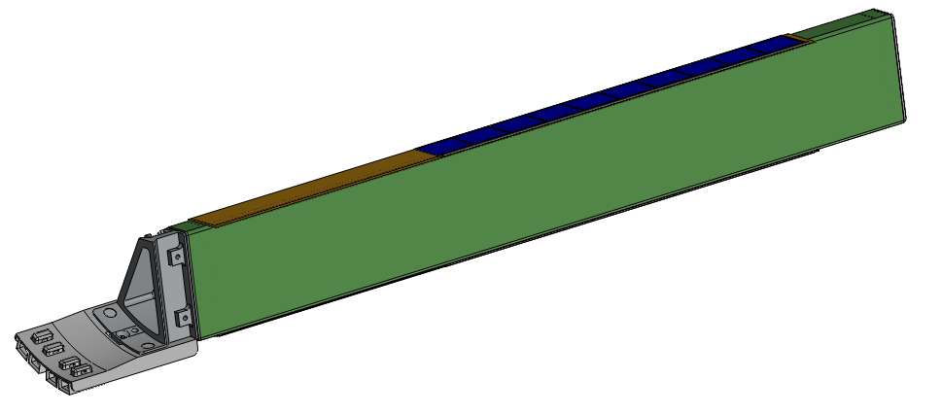
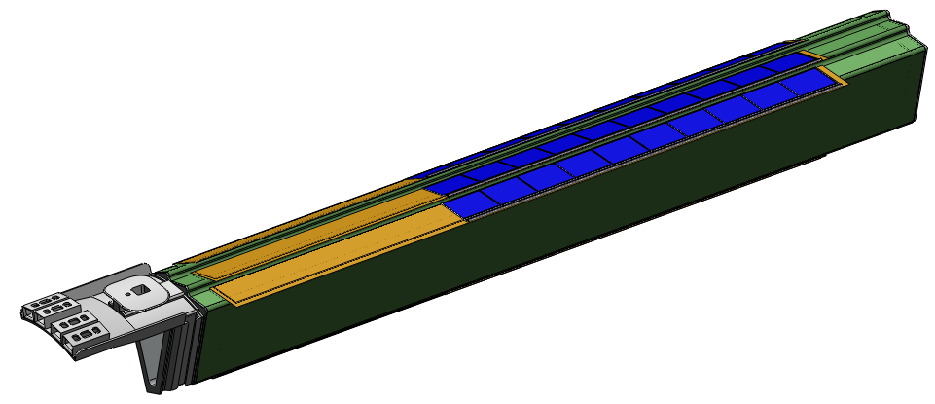
Mapping pixels on the sector with CMM
inner cylinder ladder
A holder tool in the CMM is required to perform measured rotation
Scan ladder surface with CMM touch probe.
Use CMM microscope to determine chip location on the surface.
outer cylinder ladders
3 reference marks required on outer sector surface for next step
Note overlapping ladders, this is why a touch probe is required.

Slide 3
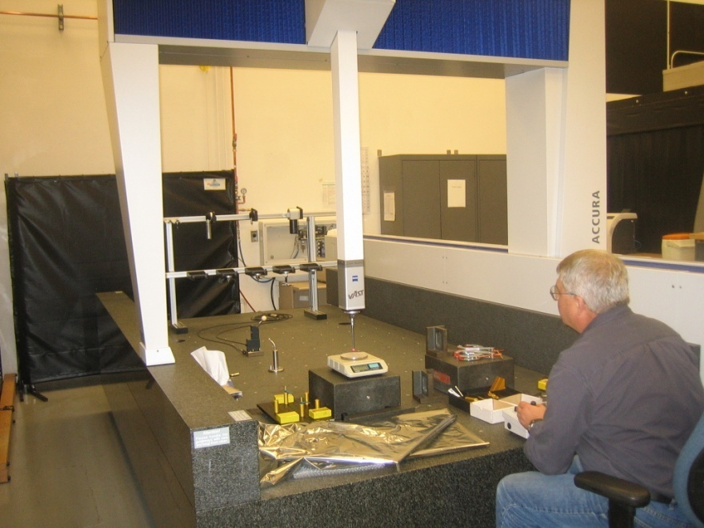
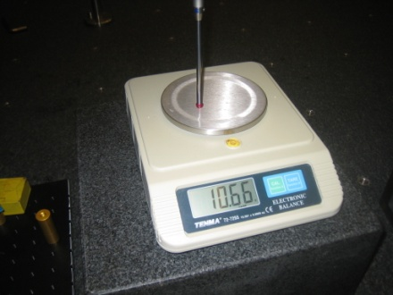
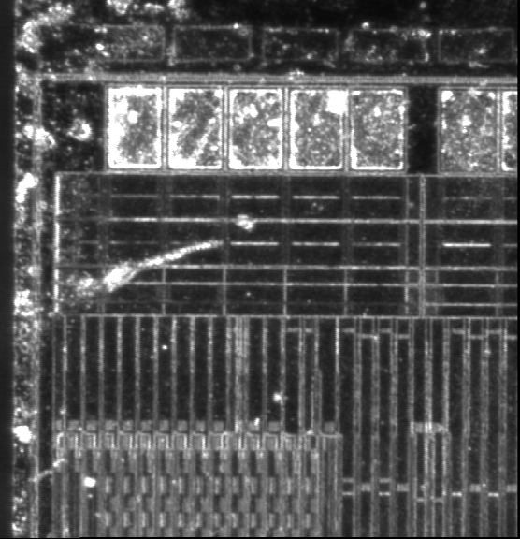
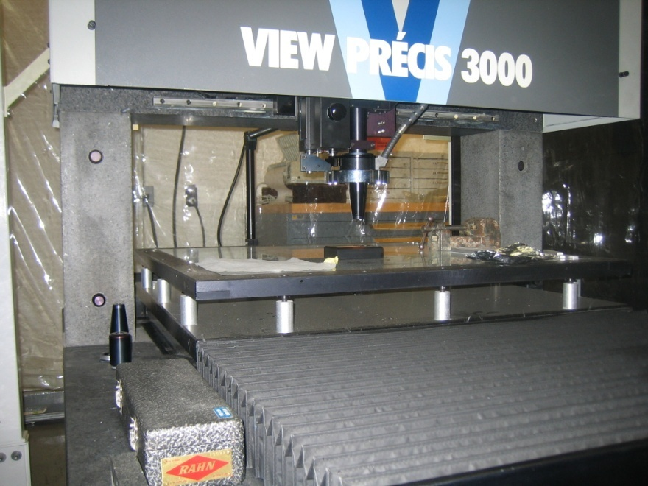
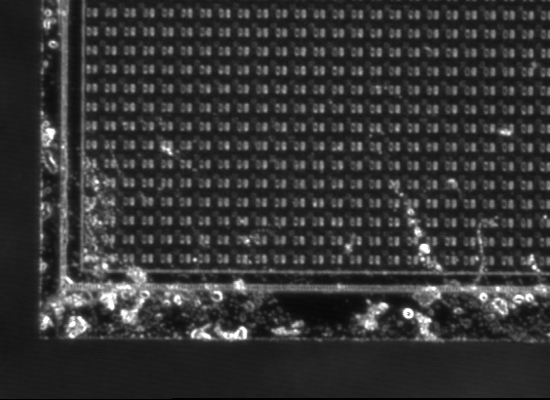
development of spatial map
Bob Connors
Spiros Margetis
Yifei Zhang
10 gm touch
probe force
touch probe 2-3 μm (xyz) and
visual 2-3 μm (xy) 50 μm (z)
active volume: huge
visual sub micron (xyz) repeatability
5 μm accuracy over active volume
a feather light touch probe has been purchased and it will arrive shortly
active volume:
30 in X 30 in X 12 in
MEMOSTAR3, 30 μm pitch

Slide 4
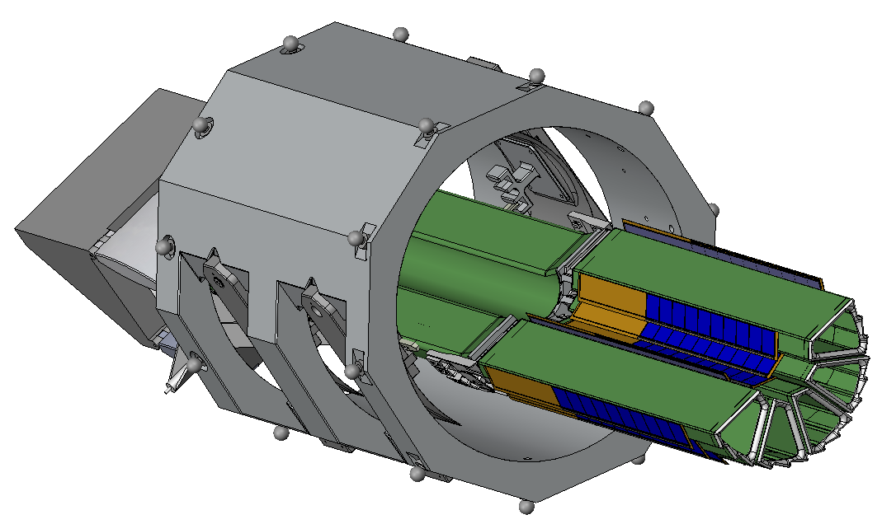
The next step: measuring the location of the 5 sectors in the PXL half
The grand master fixture is used to support the detector halves in the CMM for doing the spatial measurement of the sectors. The fixture is supported in the CMM with 3 point support on the tooling balls for all the required angular positions. The relative mapping of all the tooling balls provides the required cross referencing of all the angular positions.
Copies of the kinematic supports used here are used in the MSC/PST
The CMM picks up the 3 marks on each sector

Slide 5
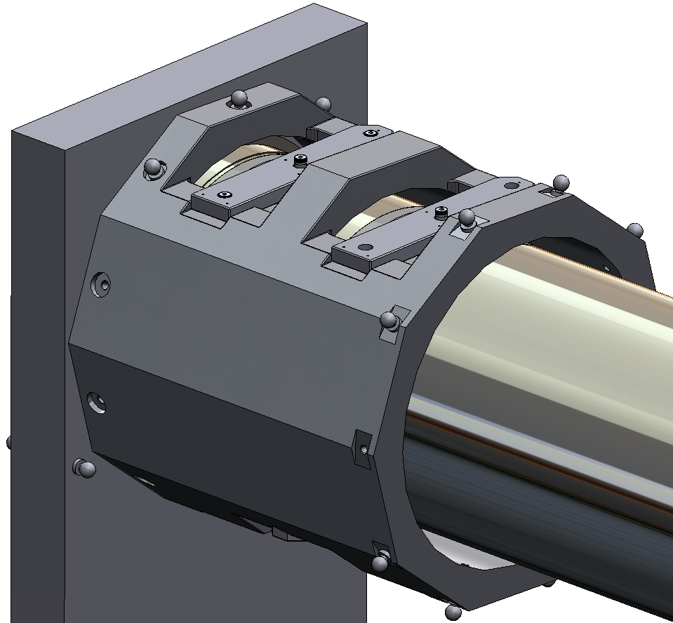
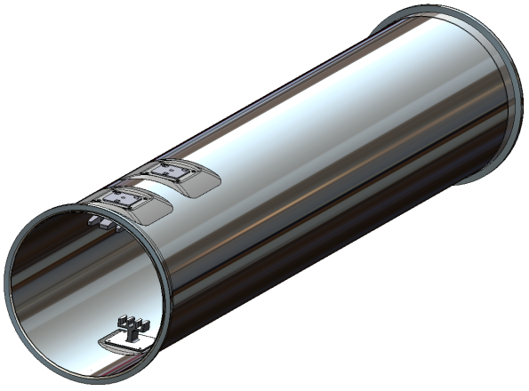
PST fabrication tooling for positioning the kinematic mounts
Kinematic mounts attach to grand master to position for gluing to the PST.
This ties the positions measured in the CMM to the building of the PST

