Slide 1
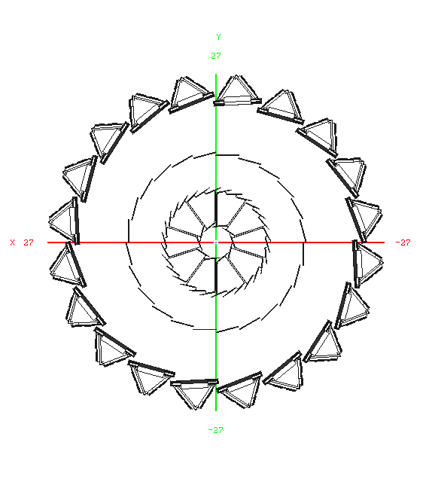

Slide 2
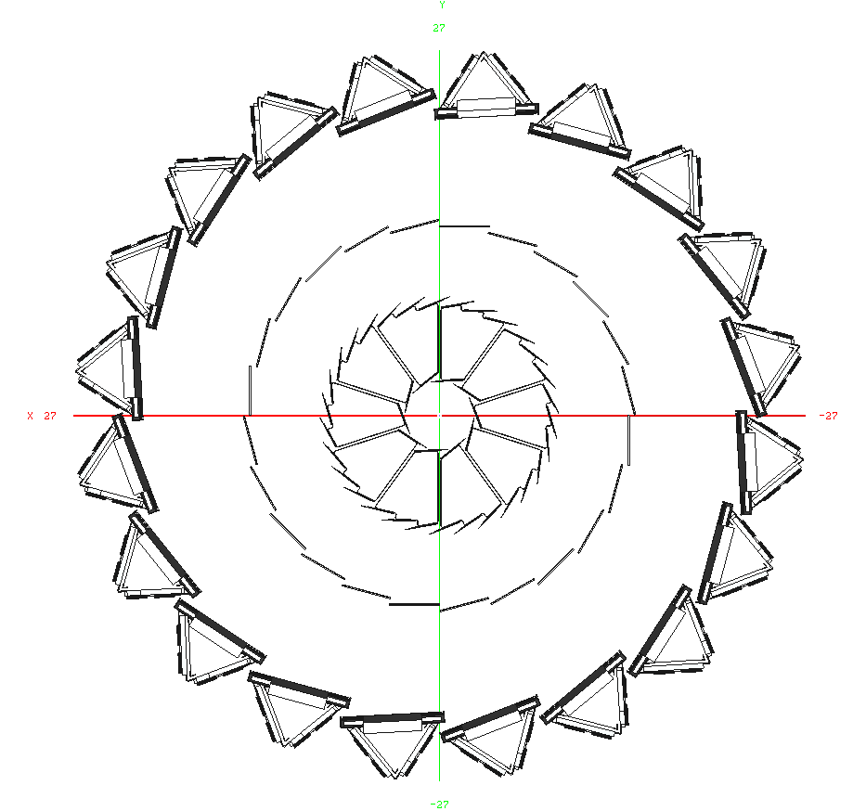
Layers 3 - 4
Layers 1 - 2

